Slide 1
Response of Organic Scintillators to $e^{−}$ Recoils
Z. McGuire
HEPCAT Annual Meeting, LBNL
01 November 2024

Slide 2
Organic Scintillators
γ
n

Slide 3
What Is My Research Focus?
Observed non-linear relationship between light and energy
Measure and tabulate the light yield as a function of deposited energy from electron recoils
Light
Energy
(Demonstrative, not representative)

Slide 4
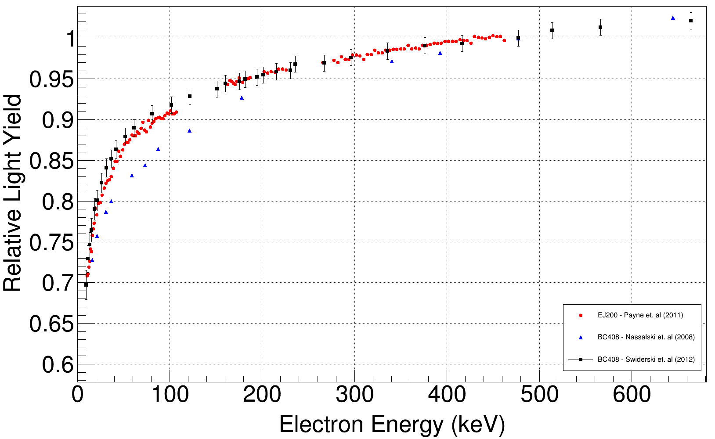
Why Perform This Measurement?
Existing data and conclusions do not agree between authors
Data scarcity for organic materials
Intrinsic energy resolution
$$\frac{L_{i}}{E_{i}}$$
$$RLY=$$
$$\frac{L_{ref}}{E_{ref}}$$
Notes:
Explain what is plotted
Explain the fraction
This data is for EJ-200, BC408 – one of the most common plastics, listed as “general use” plastic
Linear would form a line at 1 for all energy
This is not what is observed
Point out disagreements at
High energy
Low energy
This is a material property, conclusions for one do not carry to others
Contribution to intrinsic energy resolution is not well understood

Slide 5
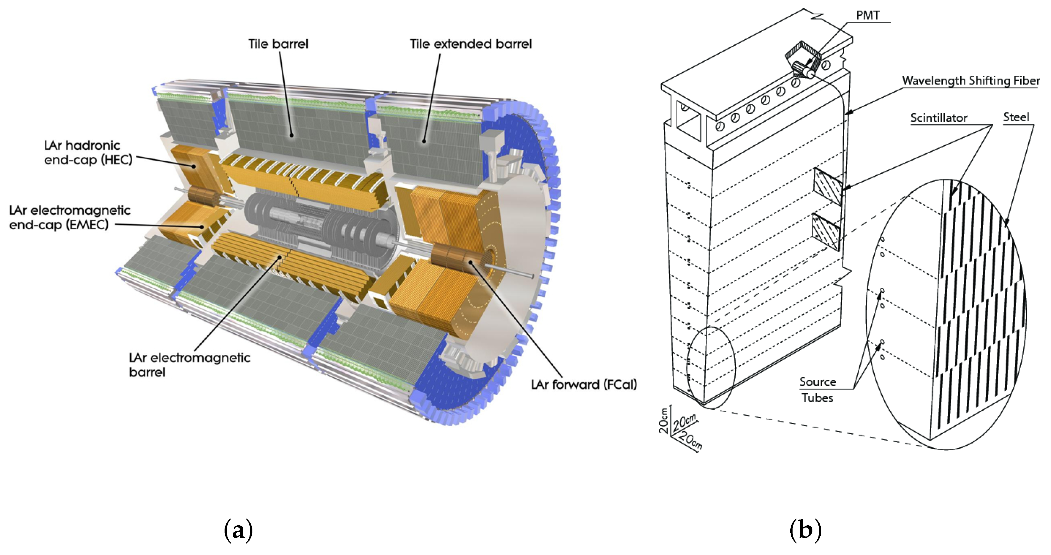
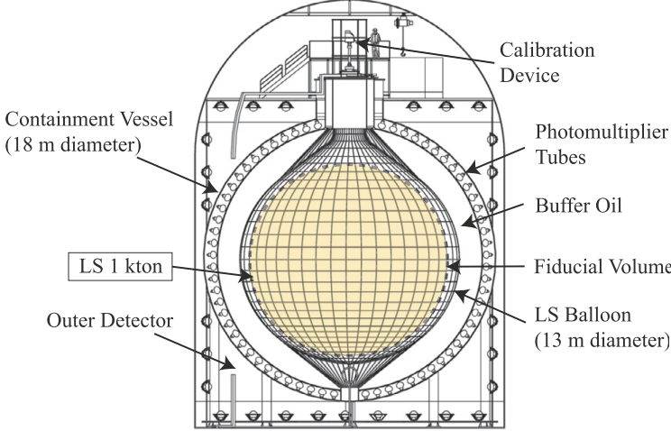
High Energy Physics Applications
Kamioka Liquid Scintillator Anti-Neutrino Detector (KamLAND)
Decowski, M.P., for the KamLAND Collaboration. "KamLAND’s Precision Neutrino Oscillation Measurements."
ATLAS Tile Calorimeter
420k Plastic Scintillating Tiles
40 tonnes of scintillating weight
Starovoitov, Pavel. "Upgrade of ATLAS Hadronic Tile Calorimeter for the High-Luminosity LHC.“ 2022

Slide 6
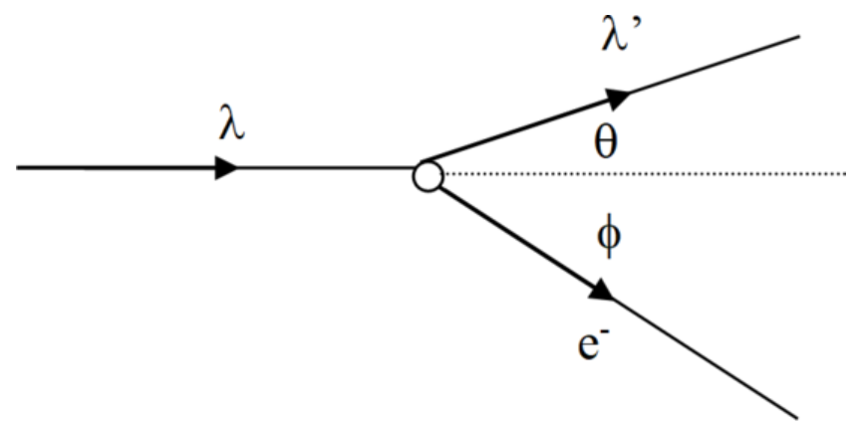
Compton Scattering
$$E_{γ}′$$
$$E_{γ}$$

Slide 7
The Compton Spectrometer
Light from Target
$$E_{γ}$$
$$θ$$
$$E_{γ}′$$
$$E_{γ}′=\frac{E_{γ}}{1+\frac{E_{γ}}{m_{e}c^{2}}(1 −\cos{θ})}$$
$$E_{e}=E_{γ}−E_{γ}′$$
Notes:
Monoenergetic gamma ray source impinges on an organic target
Compton scattered gamma rays detected in an HPGe detector
Light emitted from target scintillator and energy of detected scattered gamma ray are recorded
The energy of the electron that causes the scintillation can be calculated from Compton kinematics and conservation of energy
However, only one HPGe limits the measurement to some range based on the geometry of the arrangement
This experiment utilizes 7 HPGe detectors that were simulated and optimally placed for near 180 degree scatter coverage
Lets walk through how we get from light yield and energy to the Relative Light Yield plot from before

Slide 8
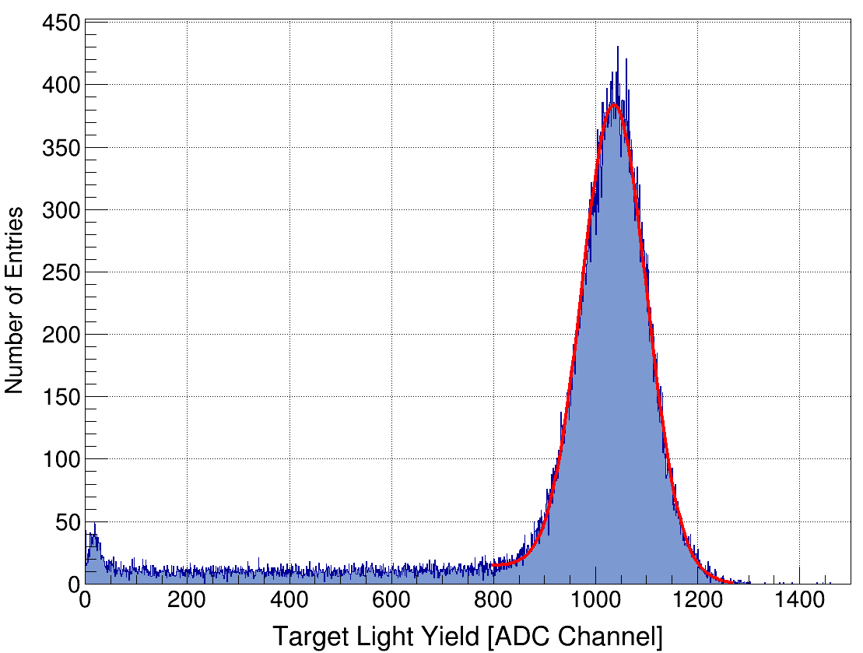
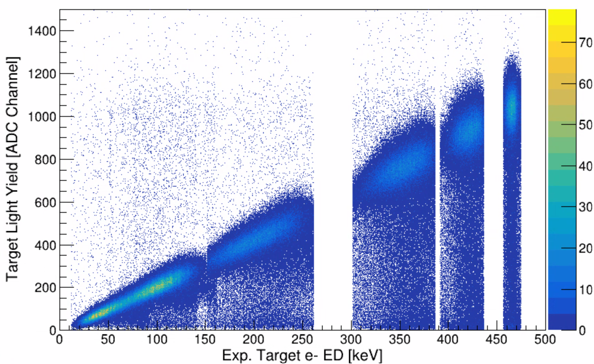
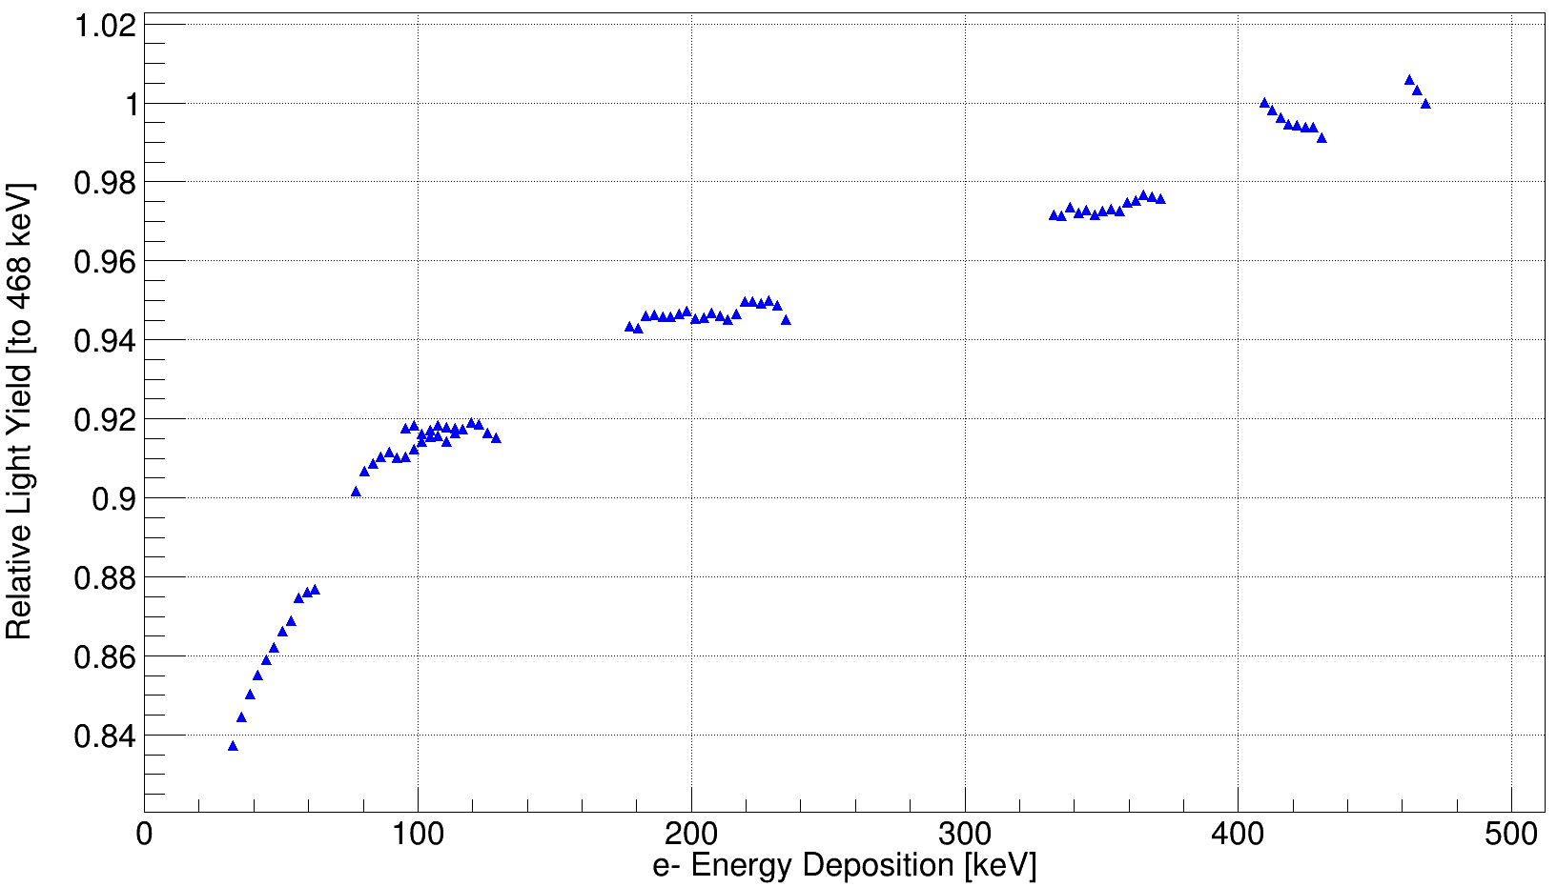
Preliminary EJ-204 Measurement
Preliminary
1” diameter x 1” long EJ-204
2D histogram of Light vs Deposited Energy
Slice each node and fit the projection
Construct ratios and fill Relative Light Yield plot
$$\frac{L_{i}}{E_{i}}$$
$$RLY=$$
$$\frac{L_{ref}}{E_{ref}}$$
Notes:
Here is a 2D histogram of the light yield from a 1” diameter x 1” long EJ-204 organic plastic scintillator
The y axis is light yield
The x axis is the derived electron energy
There are obvious and not so obvious “nodes” belonging to each HPGe detector involved
Obvious ones are here, here, here (point to each)
Not so obvious is the three bunched near the origin
Each node is sliced vertically with a width equal to the resolution of the detector in that energy range
That slice represents the distribution of light yield for that slice of energy
The slice is fit, and the centroid and associated error are recorded
The relative light yield plot is constructed with this set of points and is shown here
Errors are not yet shown, statistical error is smaller than the data points but proper uncertainty quantification remains to be completed at this moment
We can see that the resulting plot for this material is similar in shape to the curves from the other authors
Expected since they are similar materials made from the same polymer base

Slide 9
Future Work
Uncertainty quantification
Measure more materials including organic glasses, liquids, and lithium-doped plastics
Update Geant4 models of HPGe detectors
Extension of existing response models
To-Do List
Notes:
There is still much to do
Uncertainty quantification remains one of the largest components left to complete
One of the goals of this project is to report this data for a suite of scintillating materials
Measurements of several plastics, some organic glasses, a liquid, and lithium doped plastics are planned for the near future
The current Geant4 models of the HPGe detectors are not representative of the detectors actually being used in the experiment
Updated construction files are needed to properly compare simulations to real experimental data
Once the models are updated, we can begin evaluating how to extend existing response models with the data obtained from the experiment

Slide 10
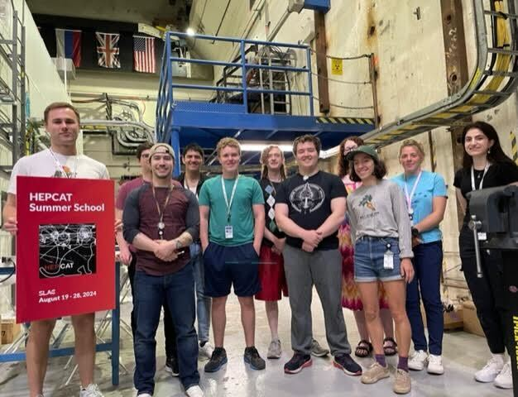
Thank You!

