Slide 1




Xenon-Doping of Liquid Argon with the CHILLAX Detector
James Kingston
2024 HEPCAT Annual Meeting
November 2nd, 2024
LLNL-PRES-XXXXX

Slide 2
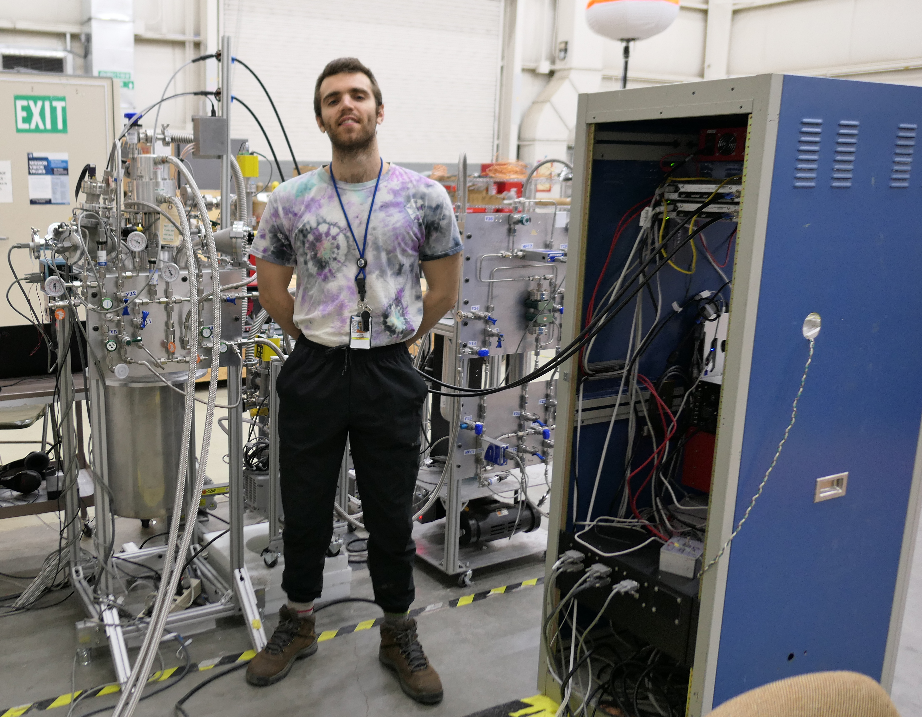
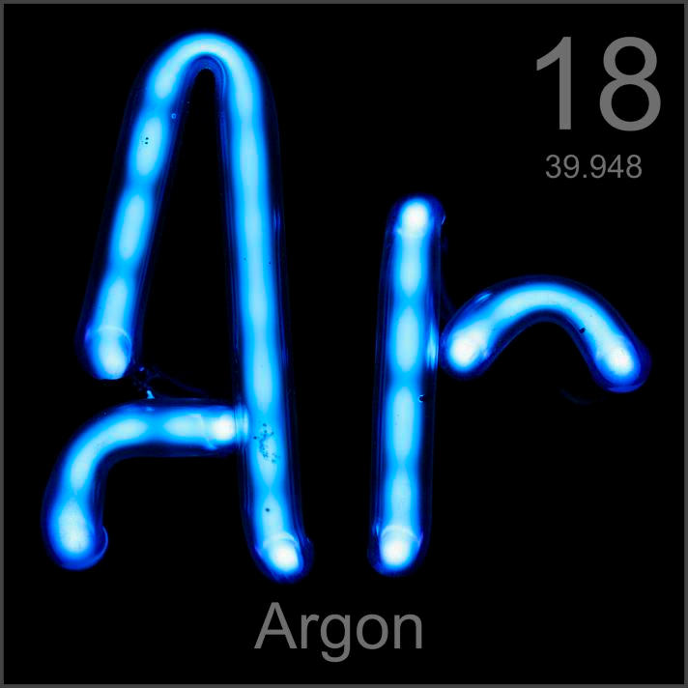
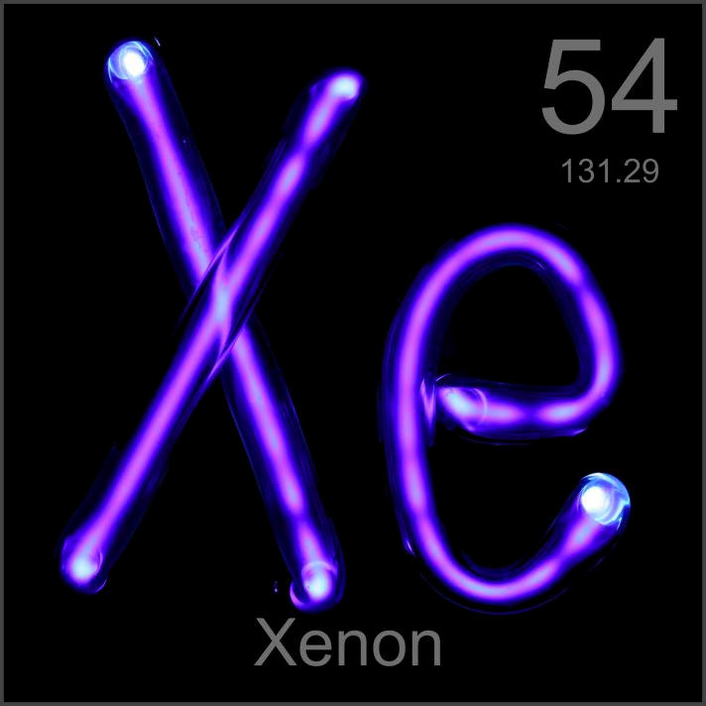
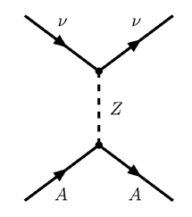
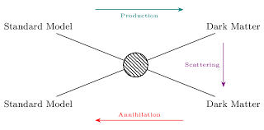
About Me
Noble Liquid R&D at LLNL for rare event searches (dark matter, neutrinos)
Name: James Kingston, 5th year PhD Student
HEPCAT: Winter 2023 Fellow
Institution: University of California, Davis
Academic Advisor: Mani Tripathi
Lab Mentor & Partner Laboratory: Jingke Xu, LLNL

Slide 3
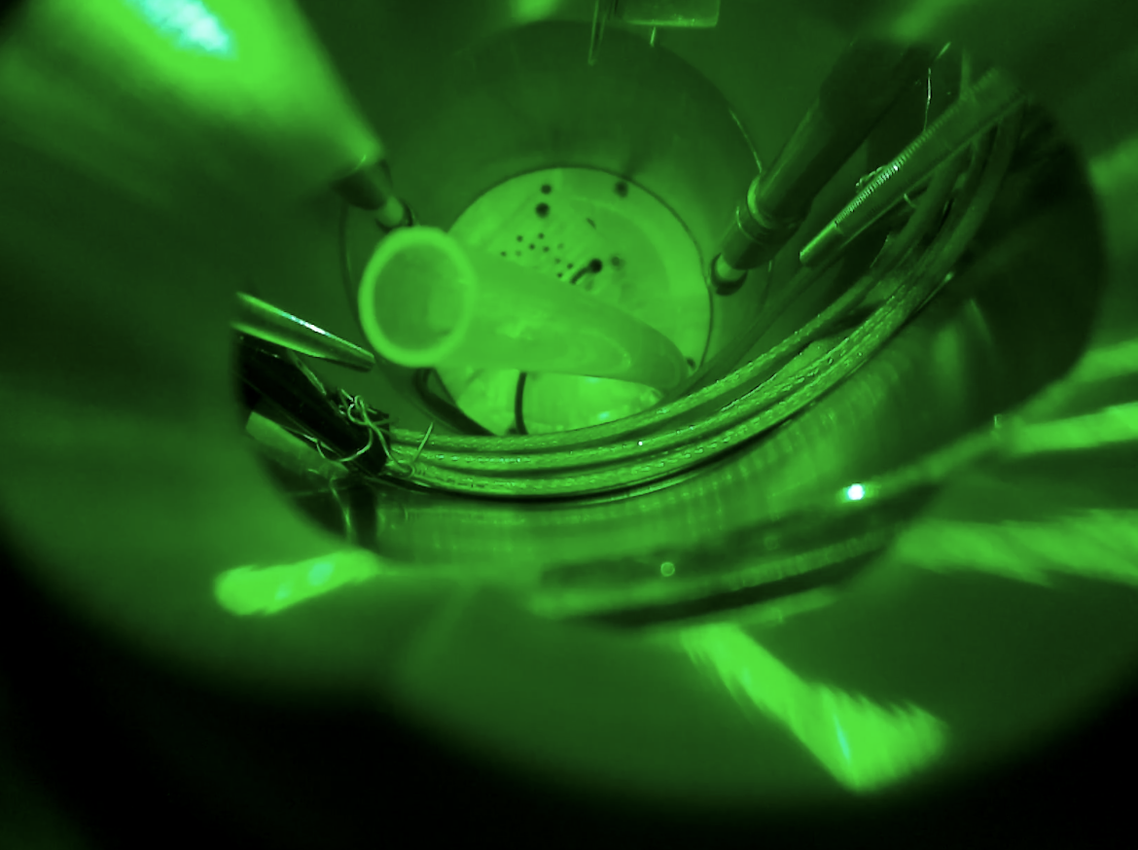
Why Noble Liquids?
Noble Liquids are widely-used target media for rare event detection. They are/allow…
Scalable
Homogeneous
Easily purified in-situ
High scintillation and ionization yields
ER/NR discrimination
Dual phase argon viewed through a port in a cryostat
Notes:
Scalable (no need to grow crystals), Ionized electrons can be drifted long distances
Homogenous and easy to fill out any detector volume
High scintillation and ionization yield means low energy thresholds
(O(10/keV) for both)

Slide 4
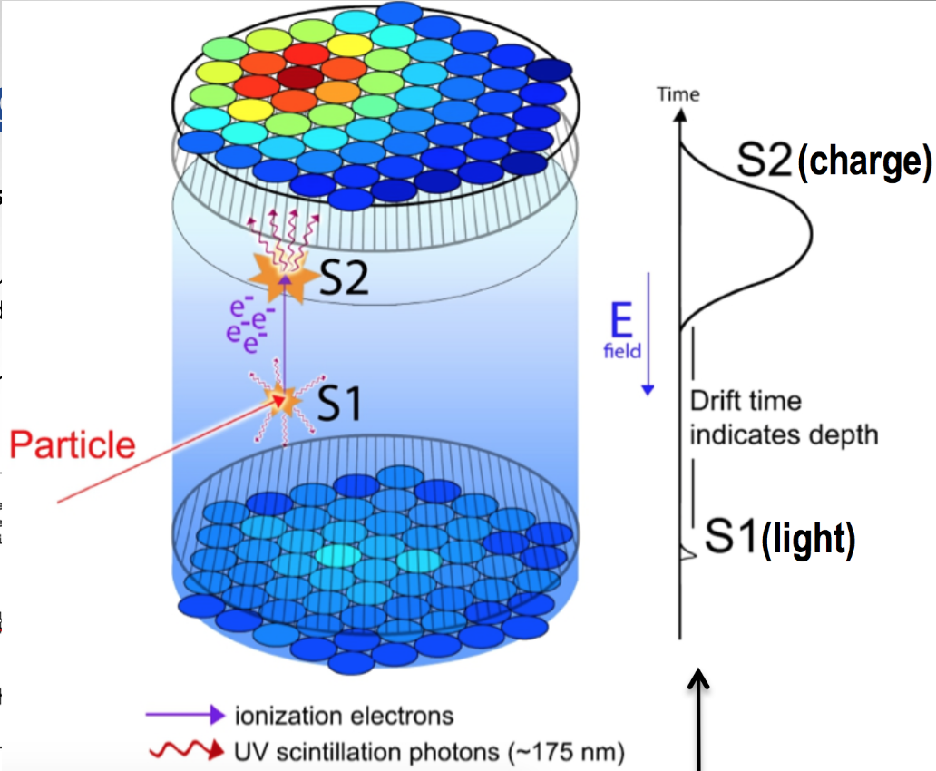
Noble Liquid Time Projection Chambers (TPCs)
A noble element dual phase TPC contains a noble element in the liquid and gas phase.
An energetic particle will generate:
Scintillation light (S1)
Ionization (S2)
Photosensors detect S1, electric field drifts electrons
S1 and S2 can tell you:
Amount of energy deposited
Particle ID
3D Position Reconstruction
Notes:
For CEVNS you likely only see S2, if you drop need for S1 S2 coincidence and operate in ionization only mode you can lower your threshold a lot, but this makes you lose 3D
Argon is nice here because of PSD

Slide 5
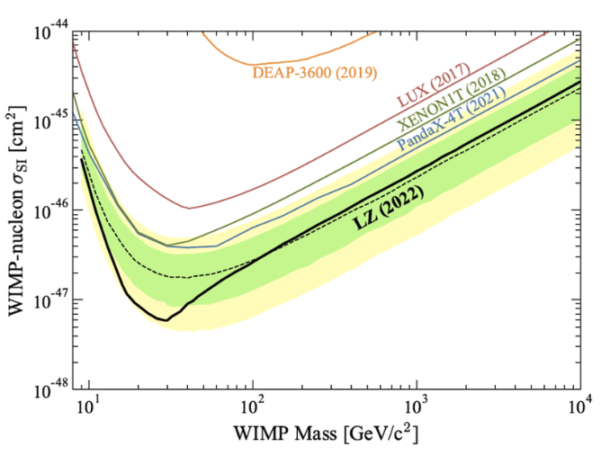
Noble Liquids for Pure Science
Historically noble liquid detectors were developed to search for WIMP dark matter – nucleon interactions
WIMP dark matter interactions:
- keV scale energy depositions
- Single scatter
- Nuclear recoils
LZ Collaboration SR1 Results (https://arxiv.org/abs/2207.03764)

Slide 6
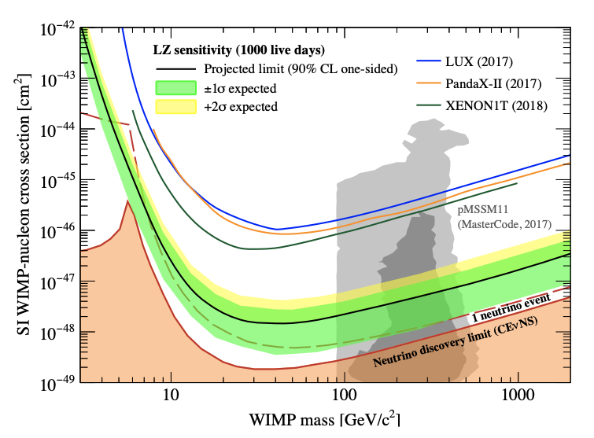
Neutrinos as a Background
Coherent Elastic Neutrino Nucleus Scattering (CENNS) is an impending background for noble liquid dark matter detectors
- keV scale energy depositions
- Single scatter
- Nuclear recoils
Known as the “neutrino floor”
Noble liquid dark matter detectors are expected to be sensitive to neutrinos through the CEVNS channel… whether we like it or not!
Projected LZ dark matter with 1000 days of live-time (LZ collaboration, https://arxiv.org/pdf/1802.06039.pdf)

Slide 7
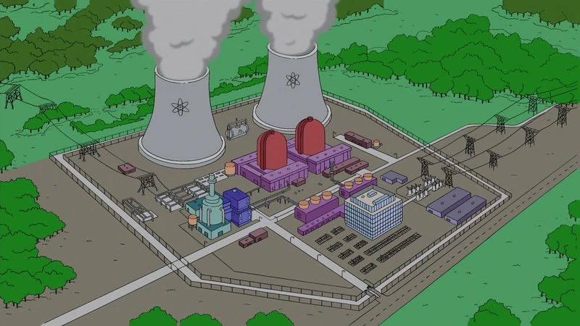

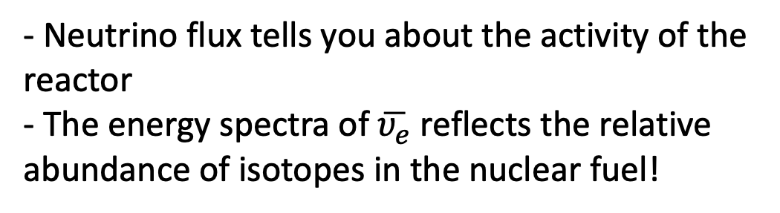
Nuclear Reactor Monitoring with CENNS?
Electron-flavored antineutrinos are produced by unstable, neutron-rich products of nuclear fission undergoing beta decay:
$${}_{Z}^{A}{B_{N}→{}_{Z+1}^{A}{C_{N−1}+e^{−}+}\overline{υ_{e}}}$$
Sense of scale: ~2*10²⁰ neutrinos/GW_{th} (and they can’t be shielded!)
- Neutrino flux tells you about the activity of the reactor
- The energy spectra of $\overline{υ_{e}}$reflects the relative abundance of isotopes in the nuclear fuel!
Two-unit pressurized water reactor in Springfield, Oregon
Could we deploy a ~100 kg noble liquid detector as a reactor monitor?

Slide 8
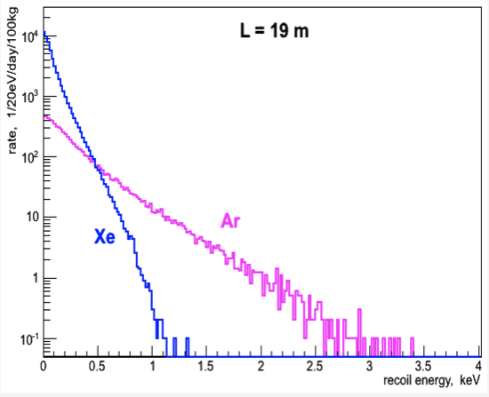
Comparison of Xenon and Argon for CEVNS
CEVNS cross section scales with N² -> more scatters for xenon (N=77) than argon (N=22)
Neutrinos are a better kinetic match to argon than xenon = more energetic recoil energies for argon
Fewer single/few electron backgrounds in cold argon
Argon vs Xenon expected CEVNS rate 19 m from the 3 GW Kalanin Nuclear Power Plant core (RED-100, https://www.mdpi.com/2624-8174/5/2/34)

Slide 9
Comparison of Xenon and Argon (More Generally)
Property | Argon | Xenon
Scintillation wavelength | 128 nm | 178 nm
Kinetic Match to Light Particles | A = 39.95 | A = 131.29
Liquid phase ionization energy | 13.4 eV | 11.7 eV
Excitation Energy | 11.6 eV | 8.3 eV
Scintillation lifetime | 1.5 us (triplet component) | 22 ns
Price | Cheap | Expensive
Notes:
Neon and He: no radioactive isotopes but have very poor electron mobility and long scintillation lifetimes
Kr and Rd are radioactive

Slide 10
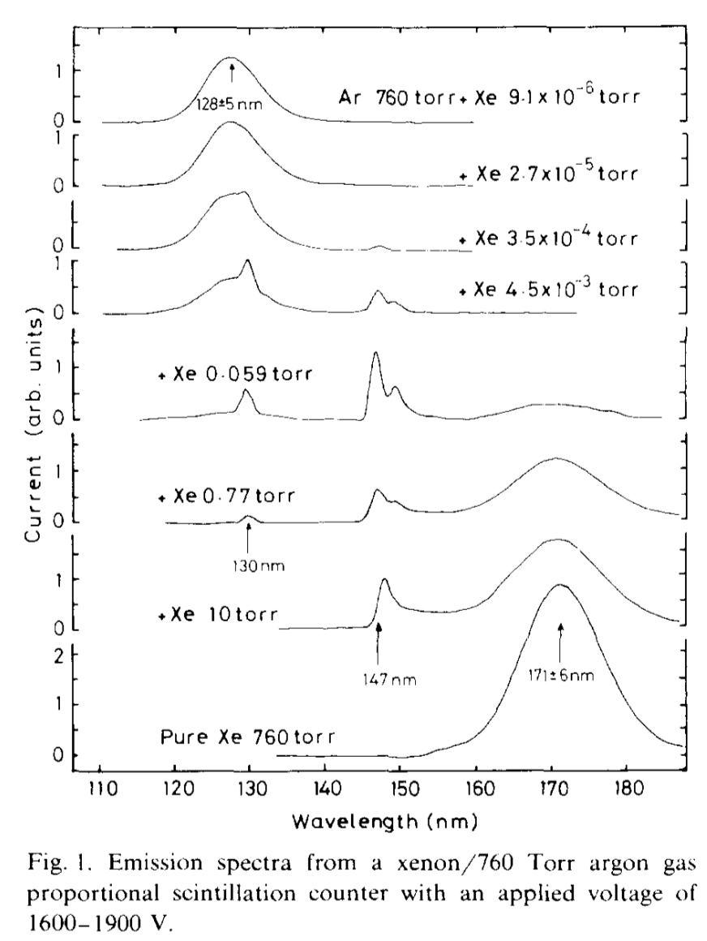
Xenon-Doping in Argon
We expect most of the S2 light will be converted from Ar₂ to ArXe and Xe₂ with ~50 ppm of Xe addition to Ar gas. (And only ~10 ppm in the liquid)
Wavelength shifting from 128 nm to 149 nm: better PDE
Sharper scintillation pulses: better timing and less pileup
Boost to ionization yield: more electrons for same energy deposition
Lower excitation energy: easier to see individual electrons and more photons for same energy deposition
Ar₂
5.9 ppm
78 ppm
ArXe
Xe₂
Emission spectra of xenon-doped argon gas mixtures at 1 atm in a gas proportional counter (T. Takahashi et al. NIM 205 591-596 (1983))
Notes:
So how much xenon must we add to argon to change the optical properties of the S2 light? Fortunately, something similar has already been done. Here is a proportional counter operating at room temperature. They start with pure argon and slowly add xenon. The xenon concentration is increasing as you move from the top to the bottom. You can see the pure argon peak vanish and Argon-xenon dimer peak grow in at 147 nm. The change in wavelength corresponds to a large improvement in VUV SiPM quantum efficiency, from 17% to 28%. Based on this experiment, we expect to realize most of the benefits of xenon doping with 50 ppm of xenon in the gas.
When liquid argon is doped with xenon at the O(ppm) level, the dominant excitation path transitions from Ar₂ dimers to Xe-containing excimers (ArXe and Xe₂)
This implies numerous detection benefits:
Wavelength shifting from 128 nm to 178 nm: better PDE!
Sharper scintillation pulses: better timing on non-beam events and less pileup!
Boost to ionization yield (due to lower ionization threshold of xenon): bigger signal!

Slide 11
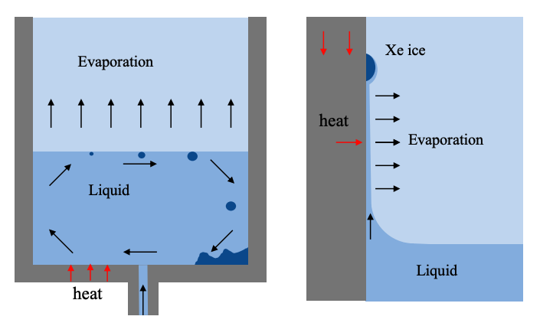
Complications from Xenon-Doping
The large temperature discrepancy between xenon and argon boiling points are a major source of system instability
T
Xe Condenses (1.8 bar): 176 K
Gas
Xe Freezes (1.8 bar): 162 K
Cooling source
Ar Condenses (1.8 bar): 93 K
Left: Condensation of Xe-rich Ar gas causes Xe to freeze if Xe pressure exceeds saturation vapor pressure
Middle: Evaporation of liquid mixture causes Xe concentration to increase in the liquid
Right: Unintended evaporation of liquid isolated by surface tension can cause Xe ice to form
0 K

Slide 12
Xenon-Doped Argon S2 Experiment
SiPM signals
Argon Gas + Xenon doping ~ 50 ppm
S1
S2
SiPM Array
Time
S2
Anticipated data
S1
SiPM Array
S2 Doped / S2 Pure Ar
1
Solubility limit
Liquid Argon + Xenon doping
0
Xe fraction in gas
Detector Vessel
Notes:
The experiment to measure the improvement in the ionization channel is simple enough: We operate a two phase argon TPC and measure the S2 signal. Then we slowly add xenon and watch the S2 signal improve. Eventually we will reach the solubility limit, where no more xenon can mix with the argon.

Slide 13
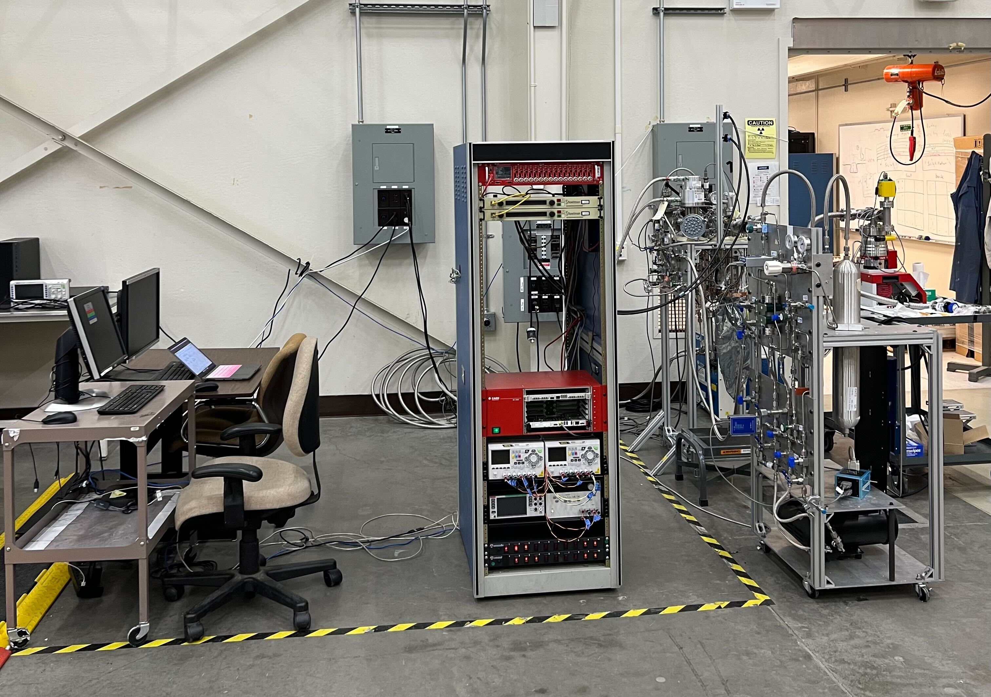
CHILLAX: CoHerent Ionization Limit of Liquid Argon and Xenon
Concept: A liter-scale dual phase xenon-doped argon TPC
Goals
Investigate stability concerns from xenon-doped argon, develop system architecture that can address these challenges.
Quantify benefits to an argon TPC’s ionization signal from xenon doping

Slide 14
Circulation Design
To pump and getter
Gas << 35 ppm Xe
Secondary Cooling
Gas ~35 ppm Xe
Evaporation &
Condensation
Gas 35 ppm Xe from pump and getter
Liquid 23,500 ppm Xe
Primary cooling
Liq ~35 ppm Xe
Heater
Heater
Ar Condenser
Detector Vessel
Notes:
The large Henry’s law coefficient has strong implications for circulation design, because the argon preferentially evaporates, leaving the xenon behind. This immediately rules out the standard two-phase heat exchanger used in many noble liquid systems, because the xenon concentrates at the location of evaporation, which would move it all into the heat exchanger.
In our system, we evaporate at the detector liquid surface, which leaves the xenon in the detector, where we want it. Argon is pumped from above the detector, cleaned through a getter, and returned to the heat exchanger, where it is condensed. Note that the concentration of xenon in the heat exchanger is much lower than in the detector, by a factor of Henry’s constant. This greatly reduces the chance of xenon ice accumulation in the heat exchanger.

Slide 15
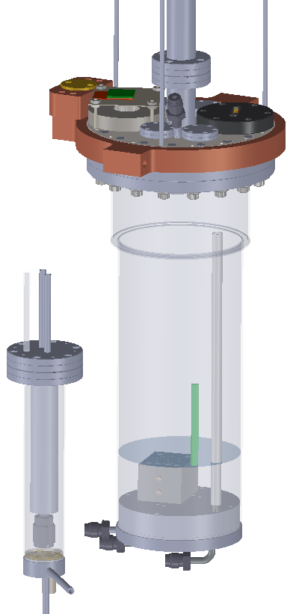
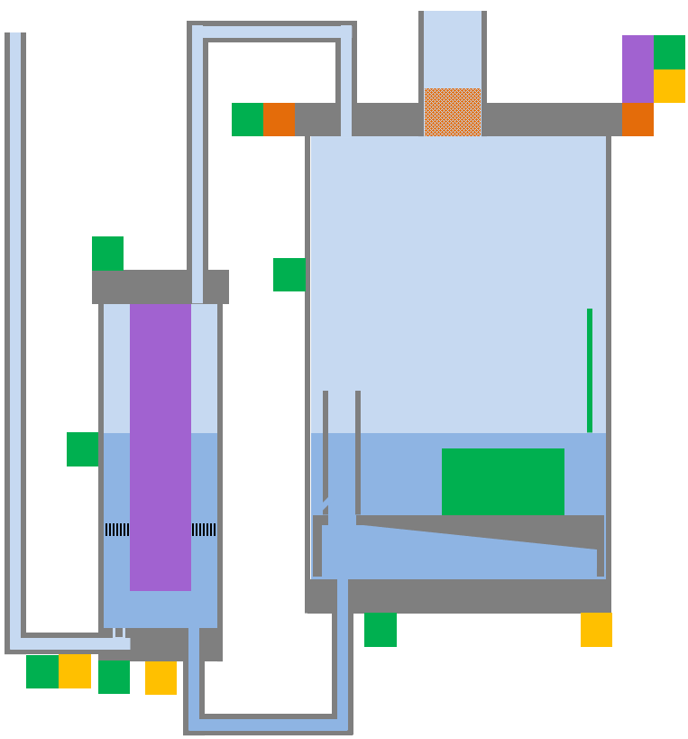
Circulation Design
Camera
Level meter
Conc meter
Bubble router
Thermometers
Heaters
Notes:
The large Henry’s law coefficient has strong implications for circulation design, because the argon preferentially evaporates, leaving the xenon behind. This immediately rules out the standard two-phase heat exchanger used in many noble liquid systems, because the xenon concentrates at the location of evaporation, which would move it all into the heat exchanger.
In our system, we evaporate at the detector liquid surface, which leaves the xenon in the detector, where we want it. Argon is pumped from above the detector, cleaned through a getter, and returned to the heat exchanger, where it is condensed. Note that the concentration of xenon in the heat exchanger is much lower than in the detector, by a factor of Henry’s constant. This greatly reduces the chance of xenon ice accumulation in the heat exchanger.

Slide 16
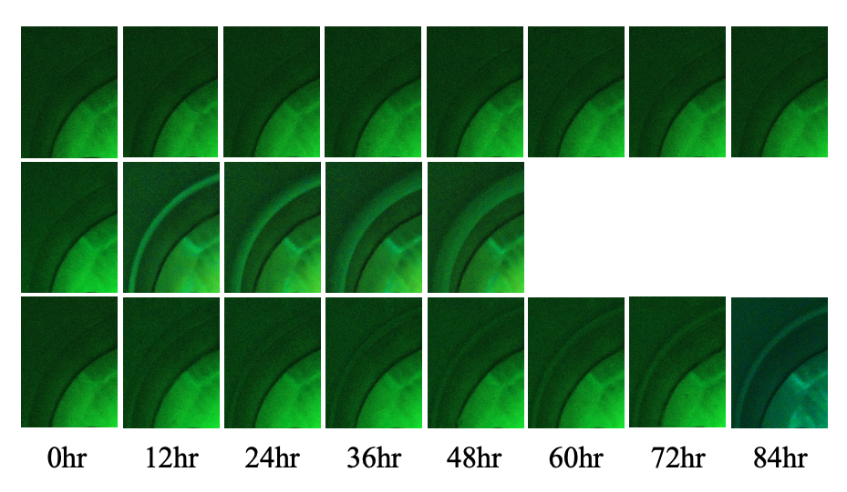
Stability Tests with Controlled vs Uncontrolled Detector Temperature Gradient
Controlling thermal profile with thermosiphon at top of detector greatly enhances xenon stability in detector volume.
Change in xenon concentration results in change in signal characteristics. Detrimental for any detector’s performance!
Camera
TSU off
Camera
TSU on
170K
93.5k
heat
heat
Ice
93K
93K
Capacitance meter
Capacitance meter
Published in PRC October 2022!
https://journals.aps.org/prc/abstract/10.1103/PhysRevC.108.045503
A 95 K temperature gradient results in rapid ice buildup
Maintaining a 0.5 K temperature gradient prevents ice buildup with 2.35% xenon concentration for at least 3.5 days

Slide 17
Chapter 2: What I’ve done during my HEPCAT Fellowship

Slide 18
Much of 2023: Development of a Dual Phase Xenon-Doped Argon TPC
The Top Silicon Photomultiplier (SiPM) Array will capture S2 light and allow for XY position reconstruction.
Phase 1: Successfully stabilize % level xenon-doped liquid argon at the liter scale inside a cryostat [Complete]
Phase 2: Design and install a TPC inside the cryostat to generate and measure ionization signals from xenon-doped argon [Ongoing]
High-Voltage (HV) feedthroughs will deliver high voltage for establishing an electric field to drift ionized electrons.
Field-Shaping rings surround the target volume to maximize electric field uniformity.
The Bottom SiPM Array will capture additional S1 prompt light.
The Capacitive Meter quantifies xenon concentration by measuring the dielectric constant

Slide 19
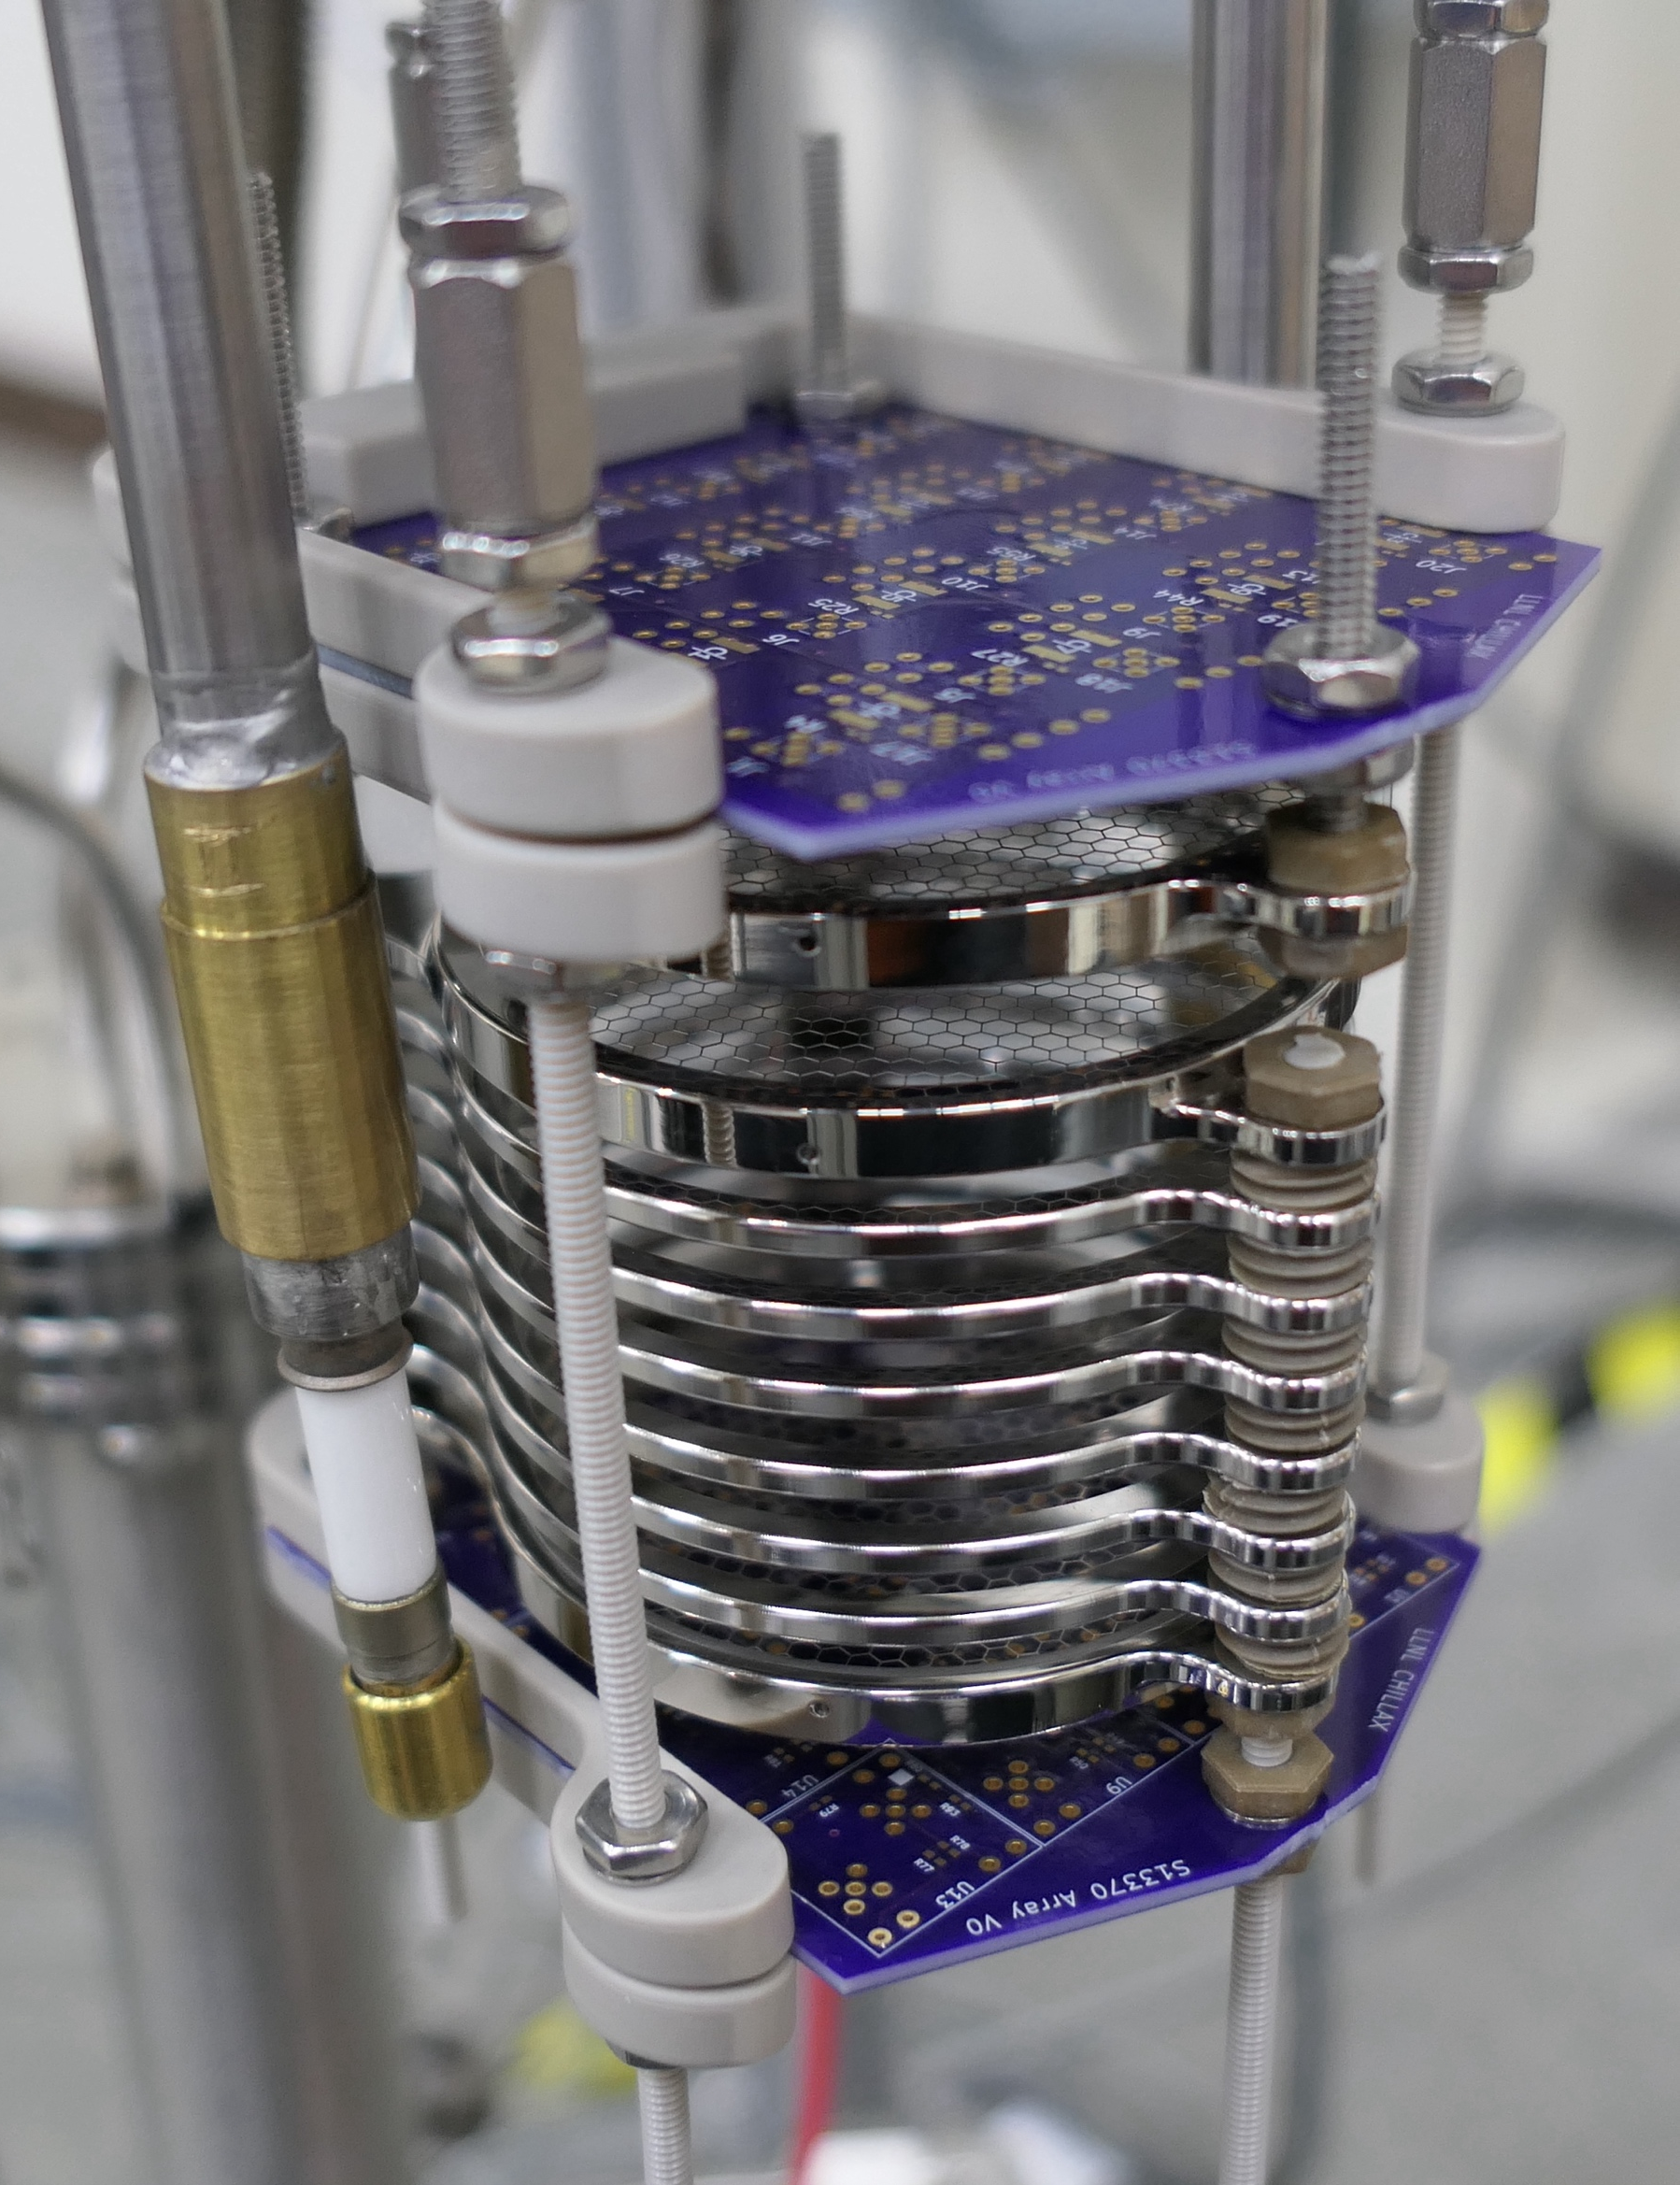
Development of a Dual Phase Xenon-Doped Argon TPC
Mentality of designing CHILLAX TPC:
Radius of active volume is constrained by HV feedthroughs, height is constrained by relation to radius (too small is a waste, too tall is diminishing returns with poor light collection efficiency)
Design + order some TPC components, custom make other parts myself (LOTS of thought)
Determine max amount of SiPMs that could fit in CHILLAX then design + fabricate boards
Notes:
We have tested the HV feedthroughs in a cooldown with no TPC and have demonstrated stability in liquid argon on each feedthrough at -20 kV (target: ~-10 kV)
TPC is mostly fabricated!
To-Do’s:
Surface mount solder circuit components to SiPM boards and mount SiPMs to boards
Test SiPM board performance (e.g. SNR)
Wire feedthroughs to TPC grids
Test HV performance with TPC installed and with cryostat filled with liquid argon
Confirm ability to detect S2s!

Slide 20
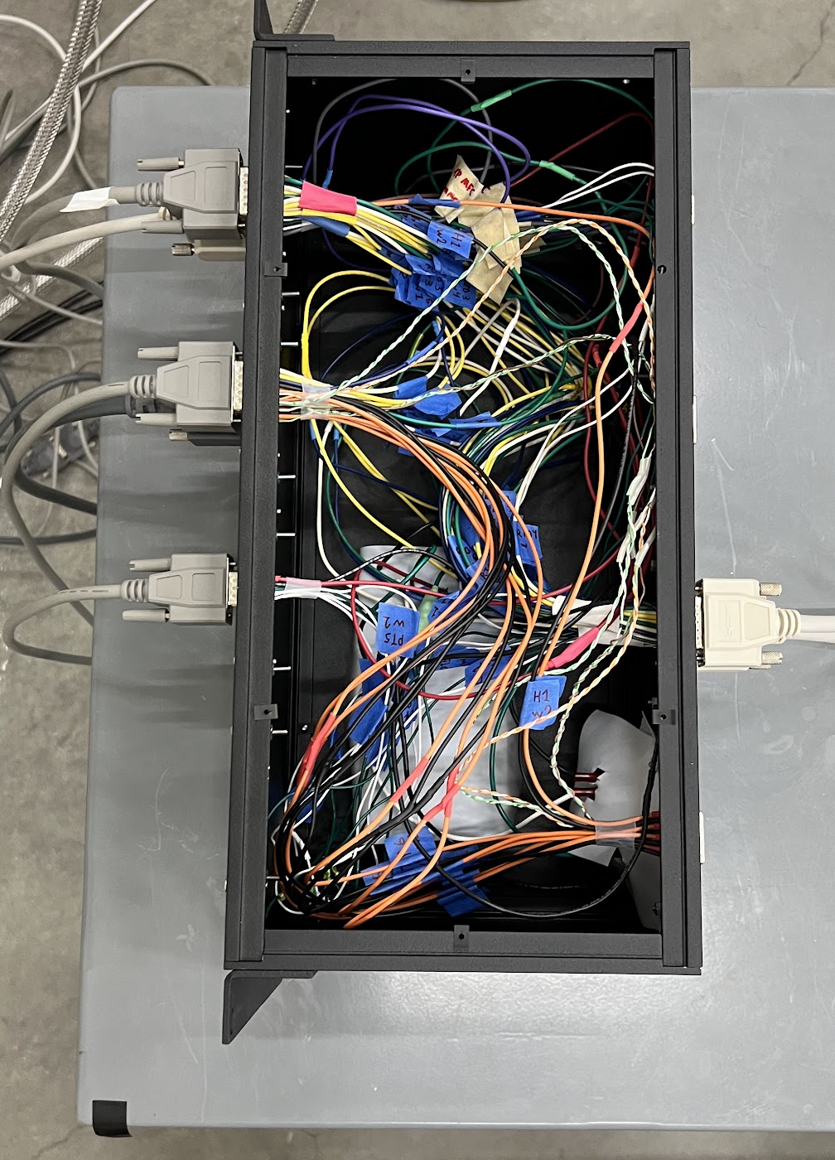
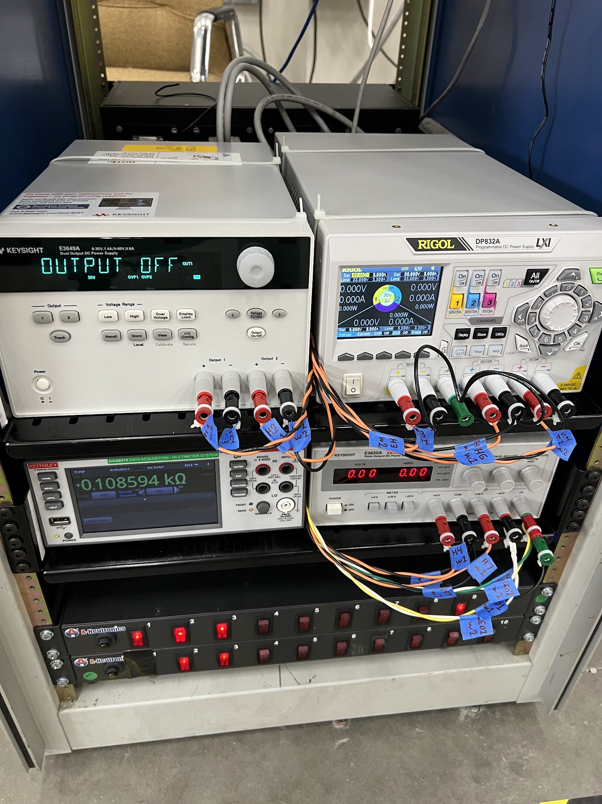
An Aside: Other Stuff Done in 2023
CHILLAX Run 14 (December 2023):
New HV feedthroughs (no TPC)
Test upgraded SC hardware/software
Modified plumbing + other hardware
Turn on HV for first time in pure LAr, -20 kV on each feedthrough (stable!)
Over twice amount of LAr condensation than before to accommodate desired liquid levels
Uncovered issues:
Leaky thermosyphon, could not cool down top flange to LAr temp
Leaky memory and unreliable connection with Keithley daq and Keysight power supply
Heat leak from cryostat bottom, O(10) bubbles from bottom of cryostat, unacceptable for eventual TPC
Complete overhaul / redesign of slow control wiring + hardware and upgrades to software to allow more advanced features (multiple mass flow controllers, multiple power supplies, and more)

Slide 21
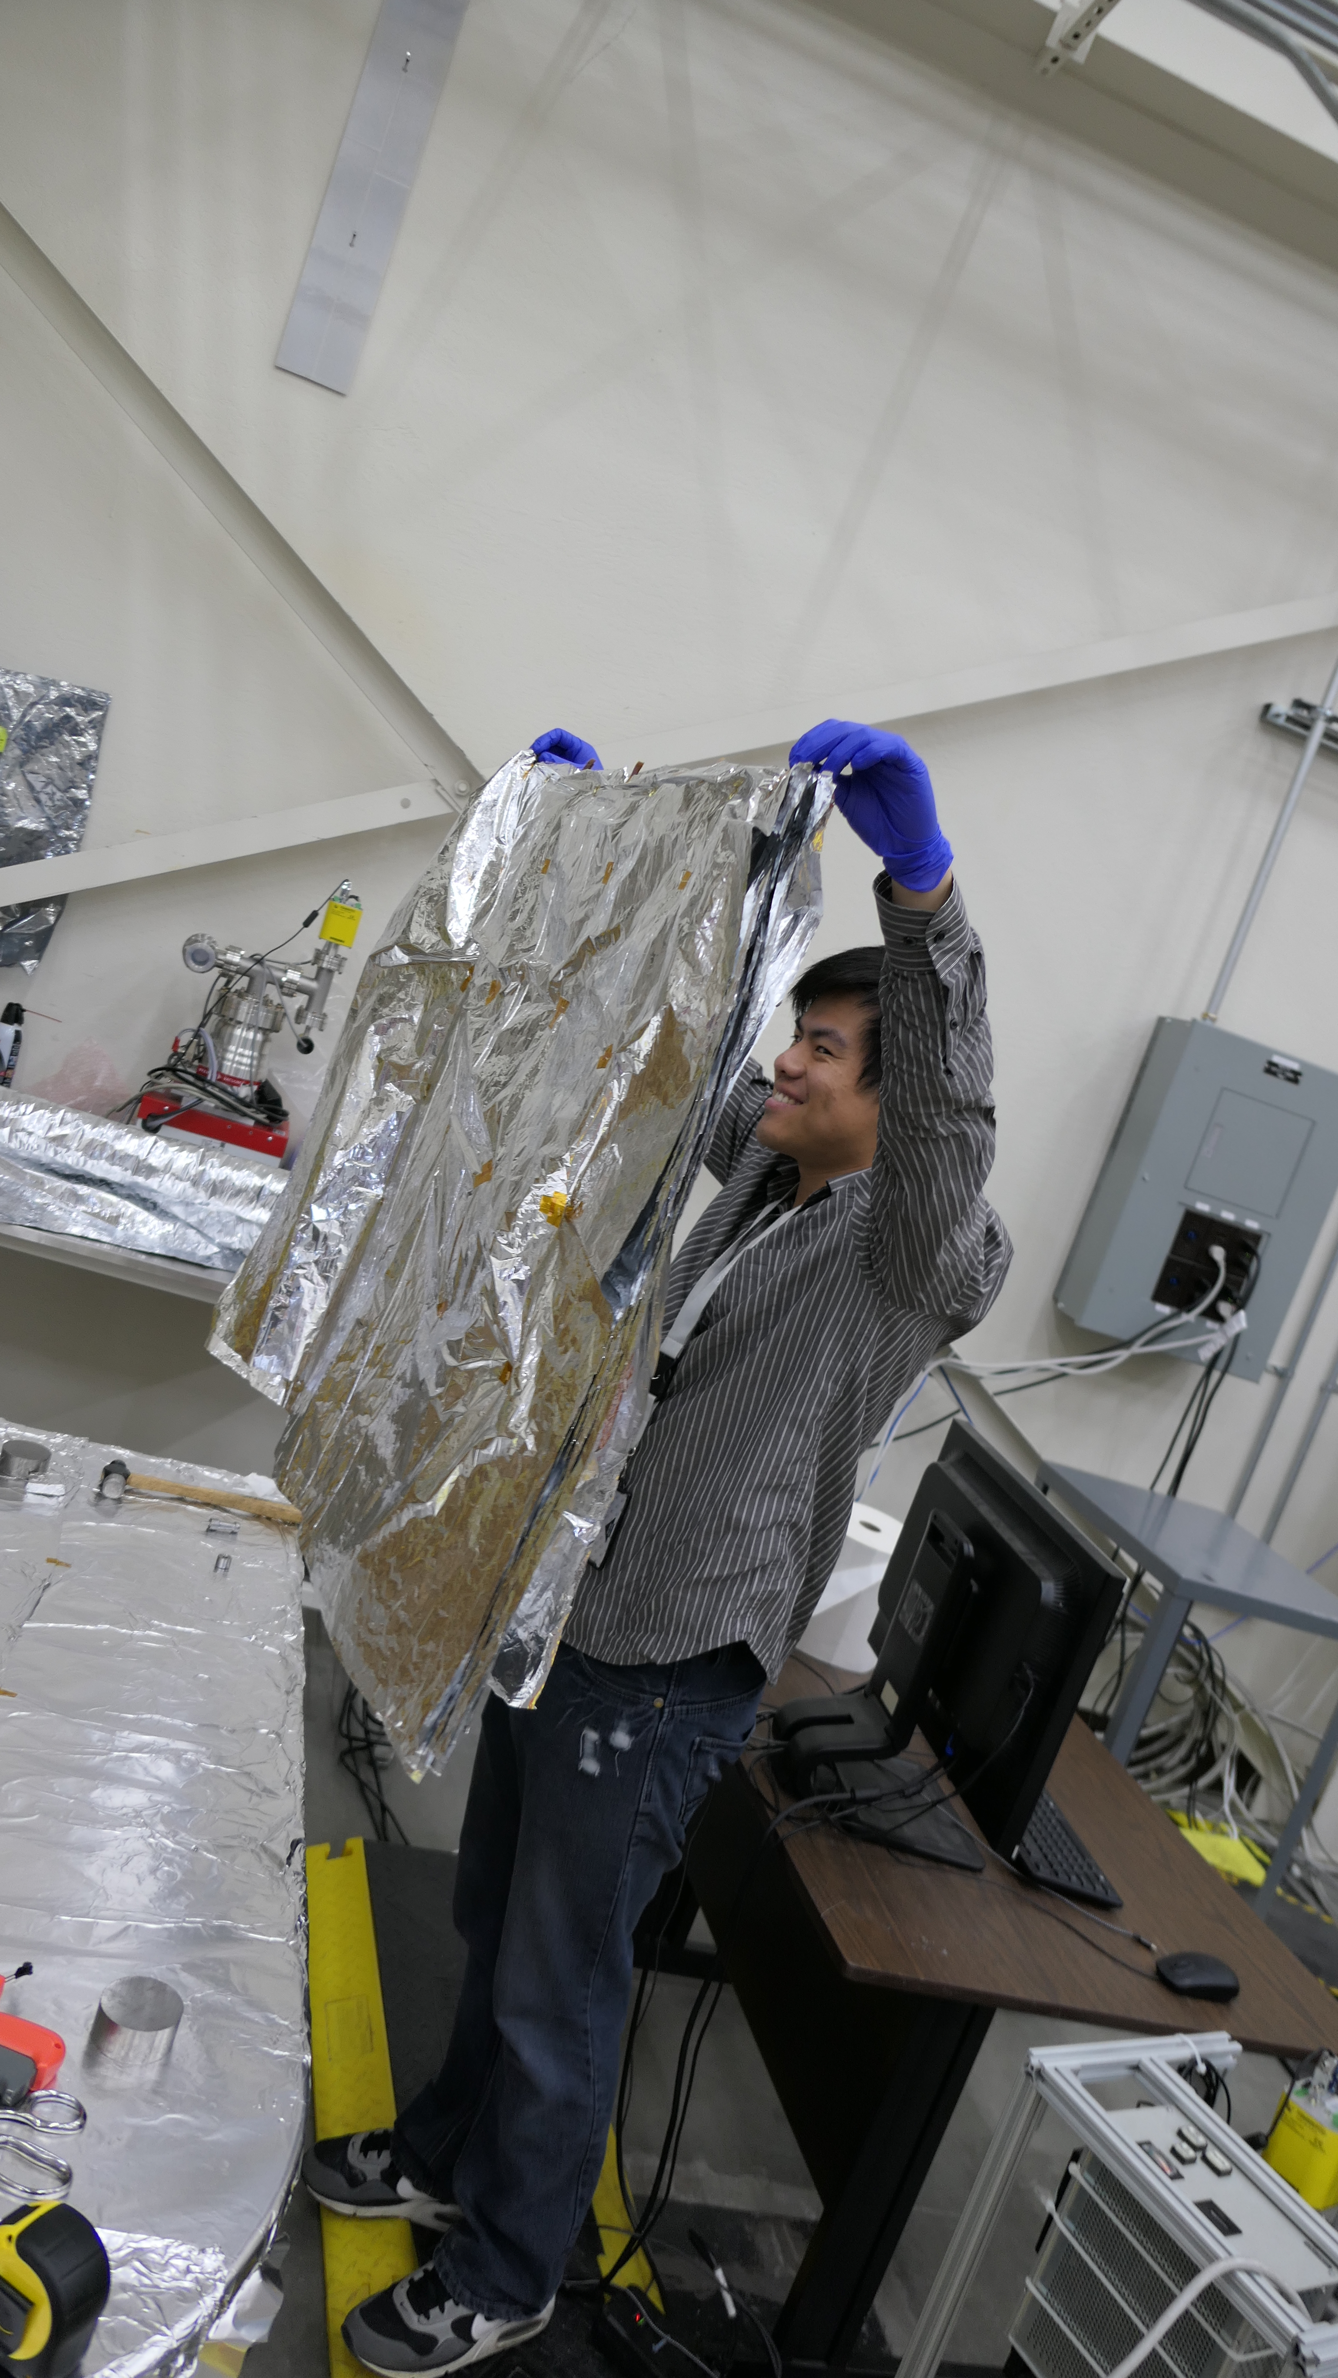
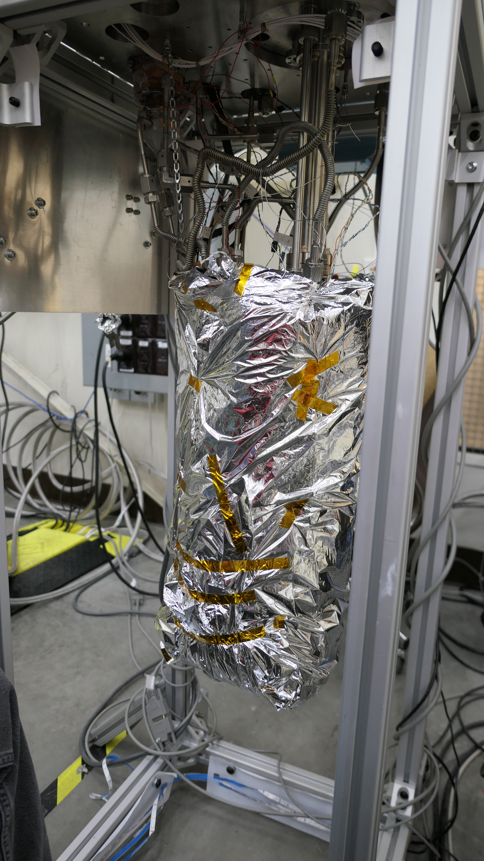
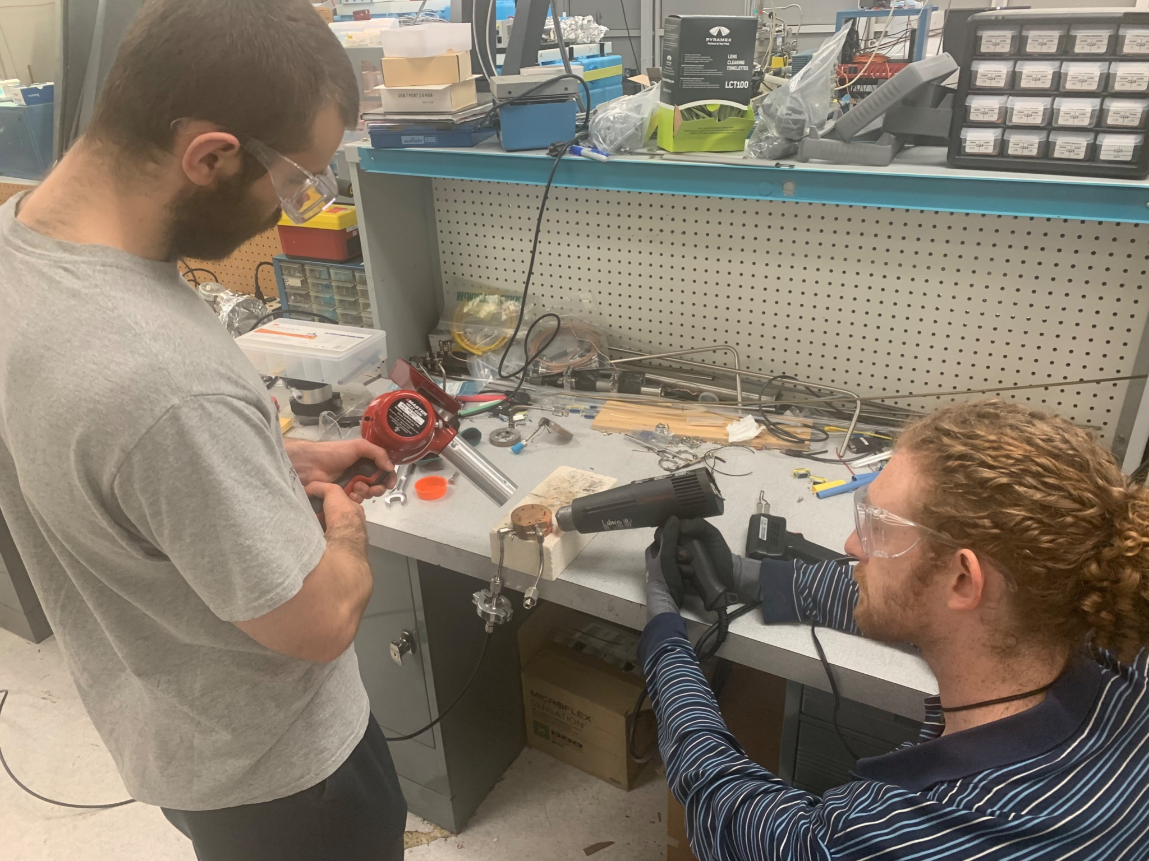
First tasks in 2024: Fixing Issues from Run 14
Remaking upper TS condensation volume (Alec for scale)
Revised SC code to utilize less memory, added feature to check for and destroy serial connections with lost connections and rebuild them, upgraded SC computer to have twice the memory, and more…
Superior MLI for bubbling issue (Jianyang for scale)

Slide 22
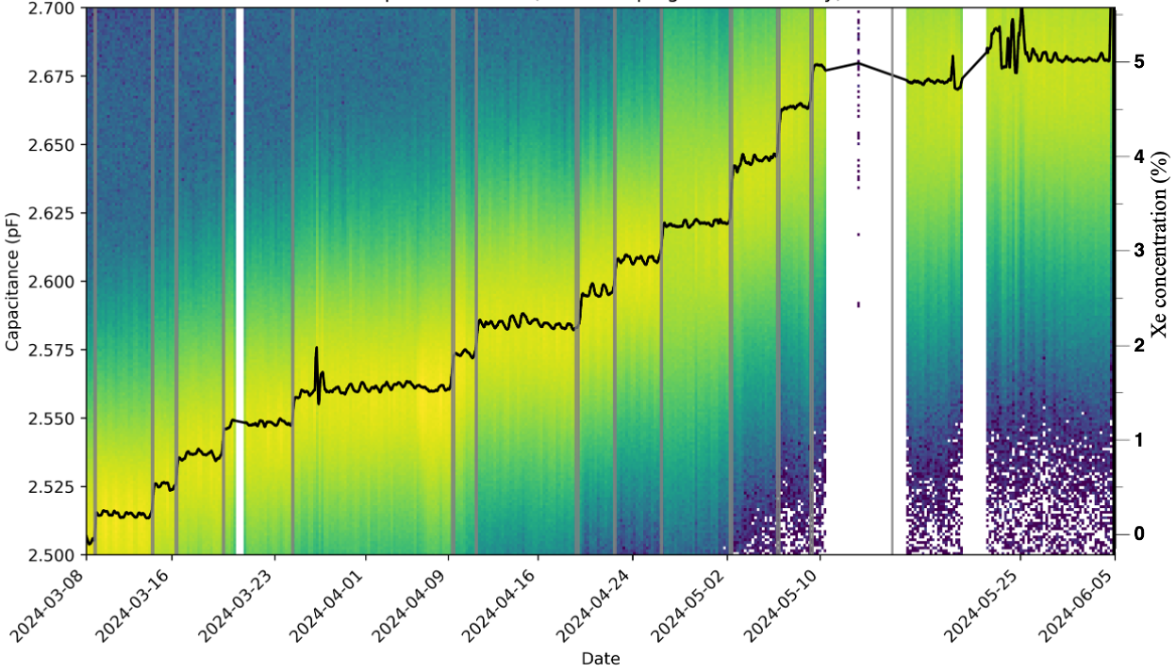
CHILLAX Run 15 (March 2024 – June 2024): Return to Xe Doping
Purpose of Run 15: reestablish ability to xenon dope with all the hardware upgrades from the past 1.5 years
Venting to set liquid level
 | Run 13 (Published Run, 2022) | Run 15
Xenon Concentration | 2.35% in liquid at 1.8 bar (~30 ppm in gas); | ~5.27% in liquid at 2.125 bar (~70 ppm in gas);
Total Liquid Volume | 0.687 L | 1.414 L (over twice as much to achieve desired liquid height)
Timescale | 3.5 days | Weeks
Xenon Doping Periods in Gray
Missing data corresponds to glitches in capacitance meter and human error
instabilities at the end of the run correspond to a failing heater

Slide 23
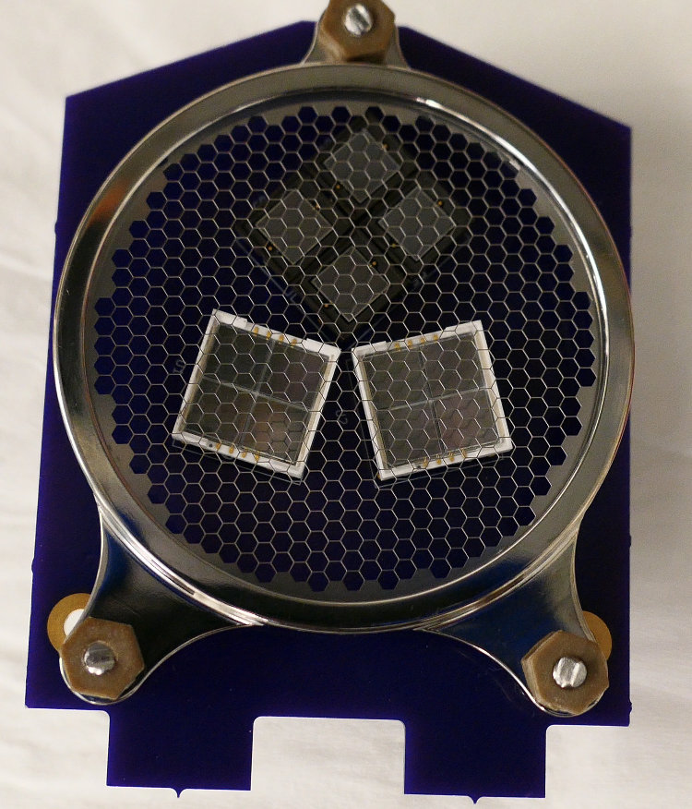
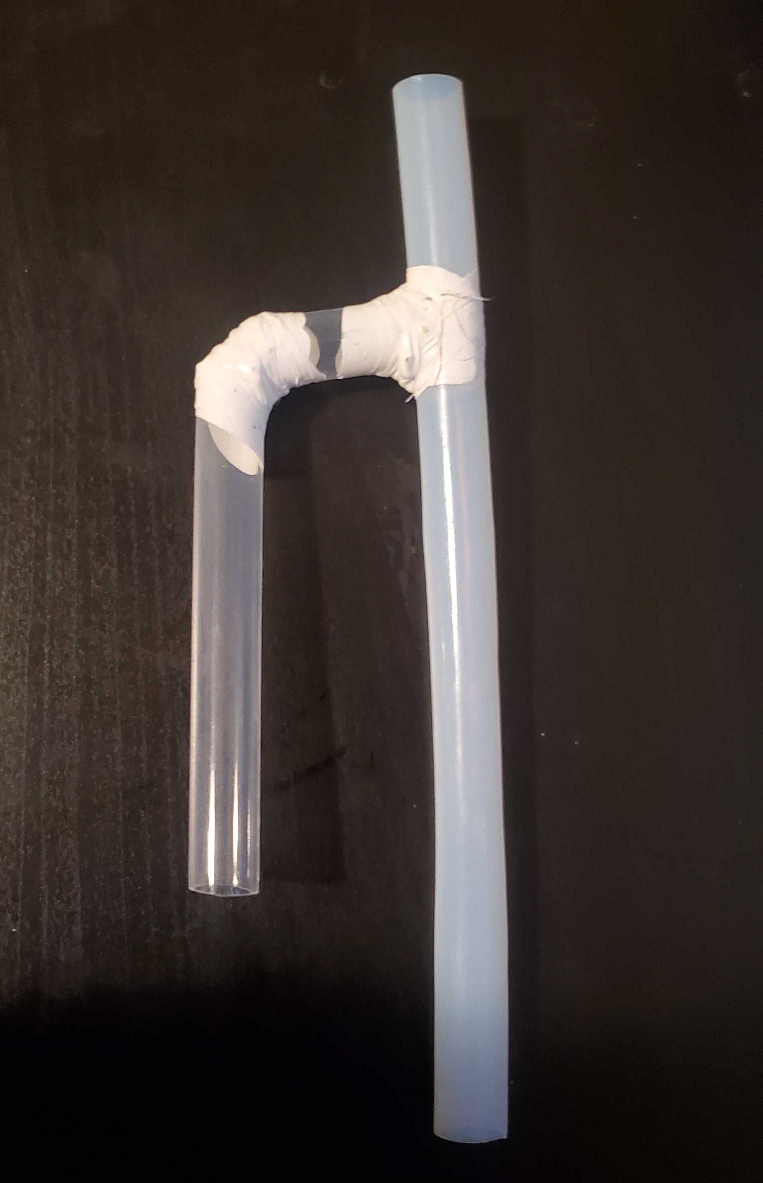
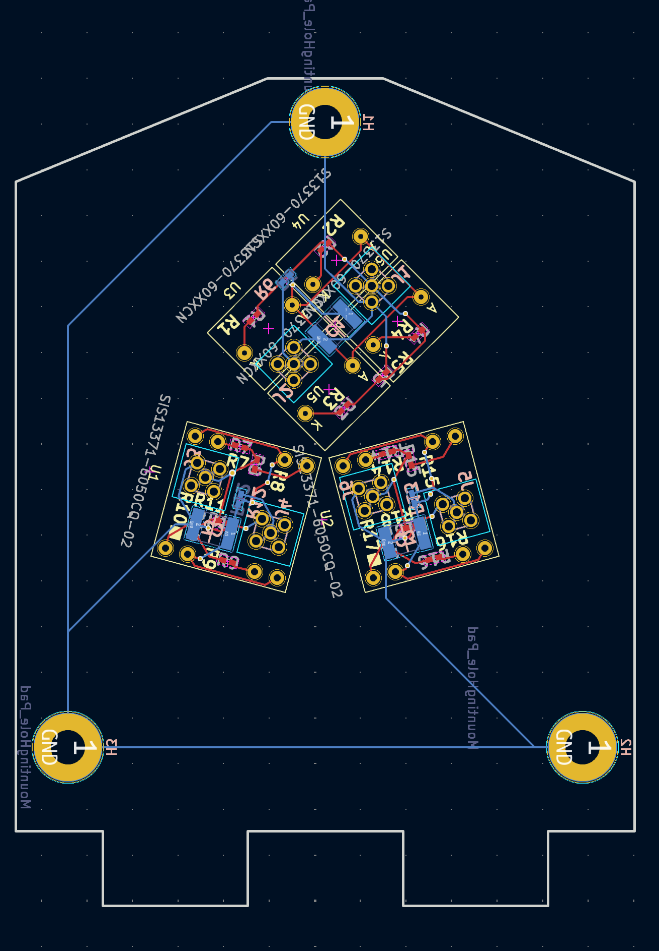
Summer + Fall 2024: Prep for Run 16 (The Big One)
Run 16 is when we finally install TPC + SiPMs and (hopefully) observe S2 ionization signals
No quartz window
Excess liquid return to main bath
Gas bubble routing line
No quartz window
Cryostat liquid level
Quartz window (should block Ar₂ light)
Bubbly liquid delivery line
More advanced bubble router design to prevent bubbles from disturbing liquid surface
SiPM top and bottom arrays (simpler scheme for first run, more details next slide)

Slide 24
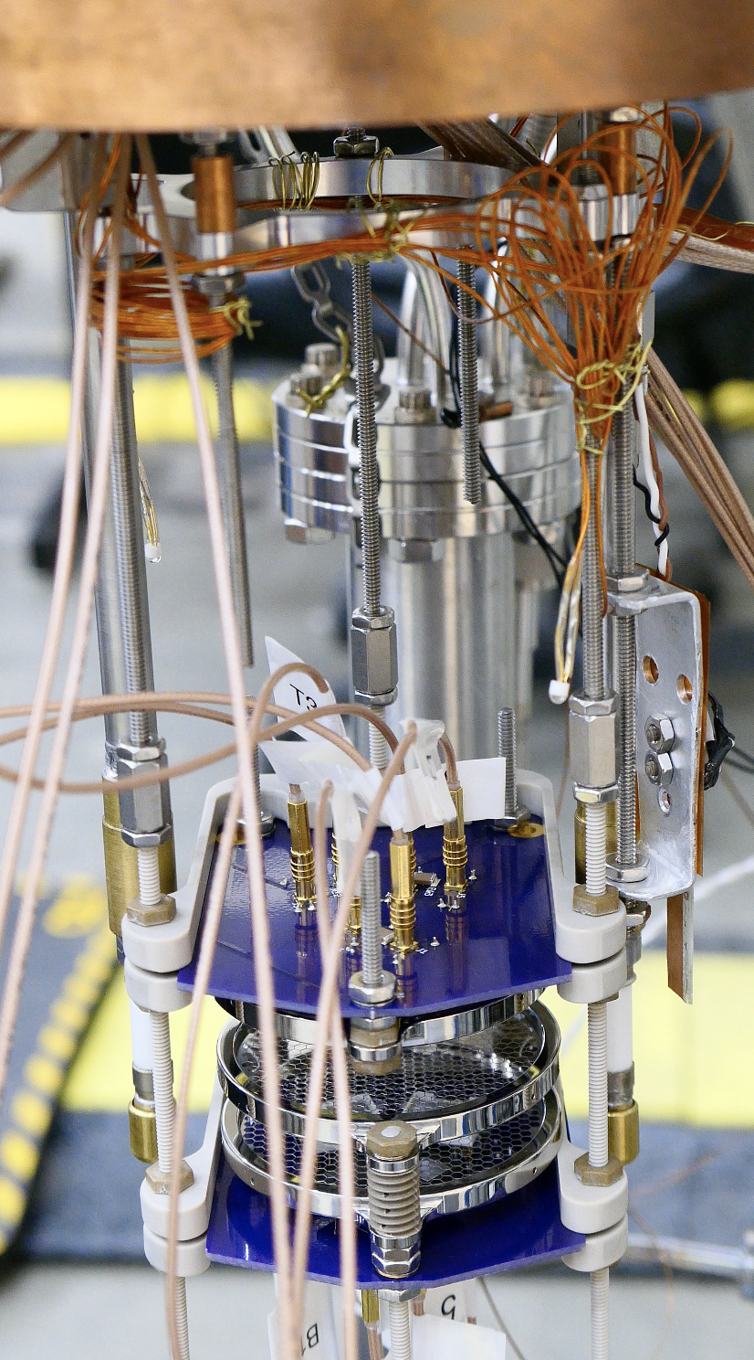
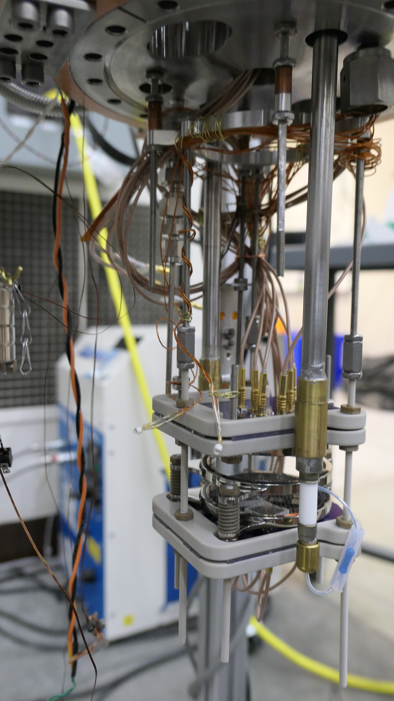
Run 16 TPC Internals: 2 Grid TPC Prototype
Proof of Concept
Two Grid TPC, only 1 active HV feedthrough (easier to avoid HV breakdown)
3 SiPM top, bottom array (fewer cables/feedthroughs to manage)
Other Tools
Two LEDs + Camera for monitoring bubbling, ice, rain (you read that right)
RGA straw for superior gas sampling
Dual RTD level meter (+/-0.5 mm precision)
Capacitor for monitoring xenon concentration

Slide 25
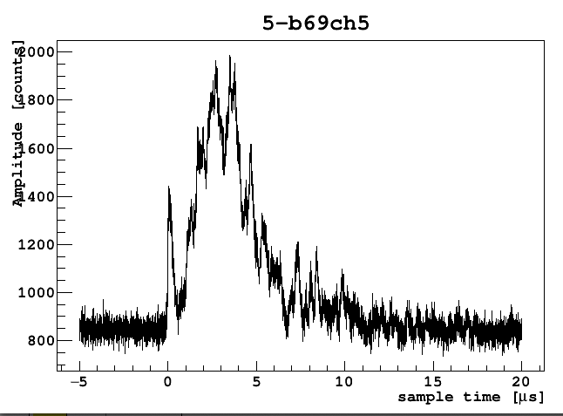
First S2s in CHILLAX (Pure LAr)
Windowless Channel (not trigger)
Windowless Channel (trigger)
Windowed Channel (mostly opaque to Ar₂ light)
S2
S1
Example S2 waveforms seen on oscilloscope with Am-241 (60 keV gamma) source
Example sS2 waveform recorded on Struck digitizer

Slide 26
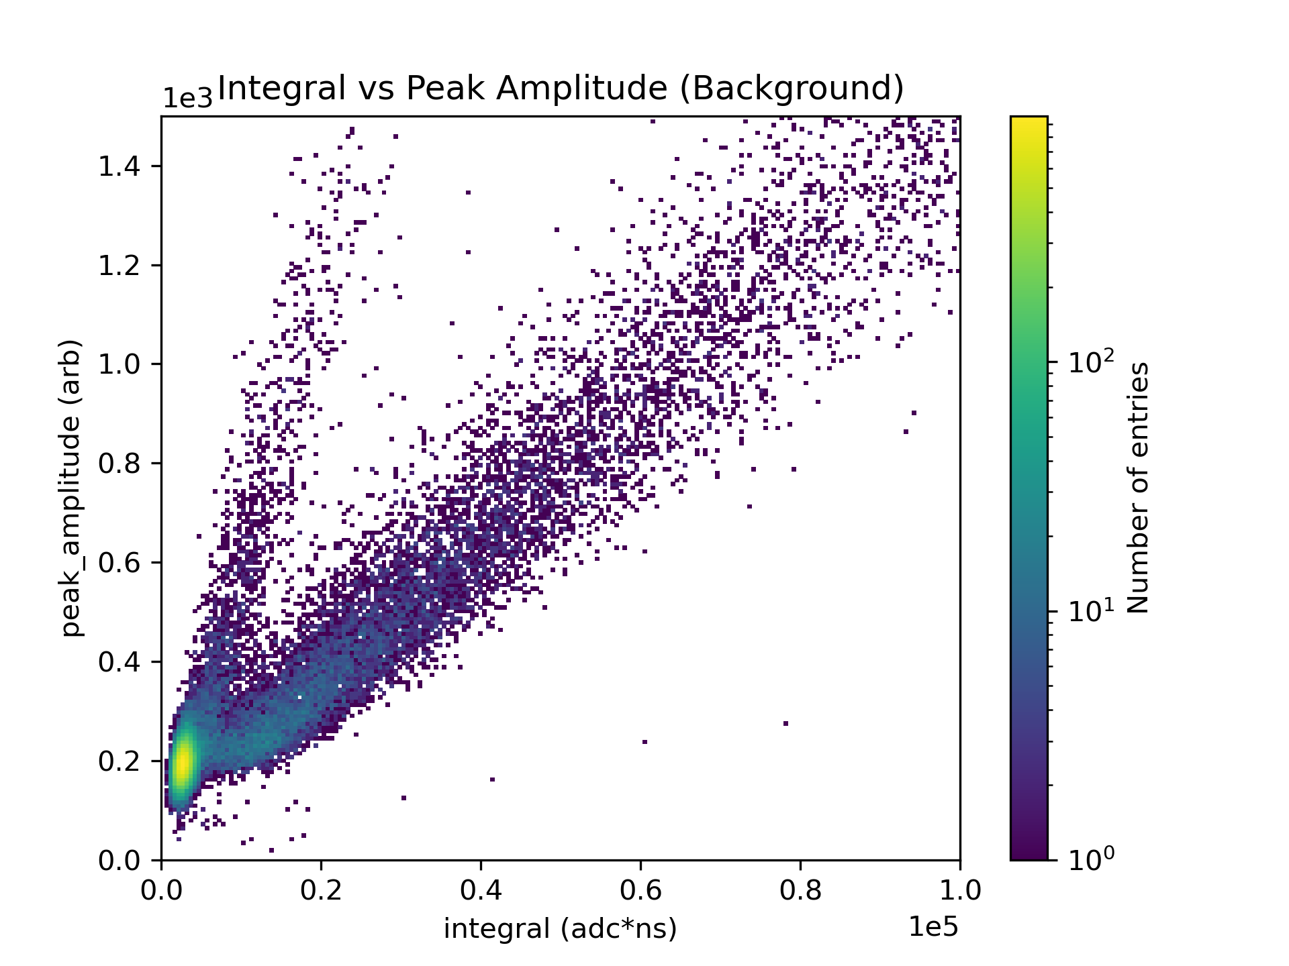
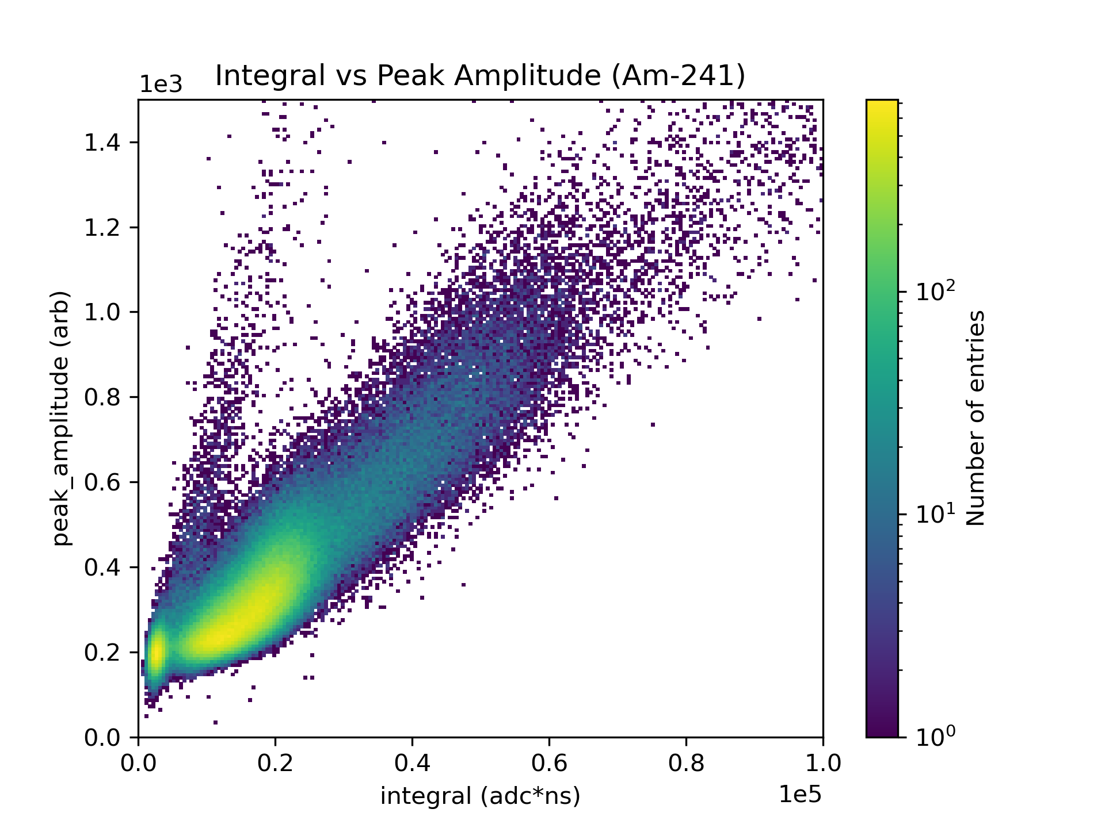
Preliminary Data with Pure Liquid Argon
Hot off the press! More coming soon… (Watch for Jianyang Qi’s Presentation at CPAD 2024)

Slide 27
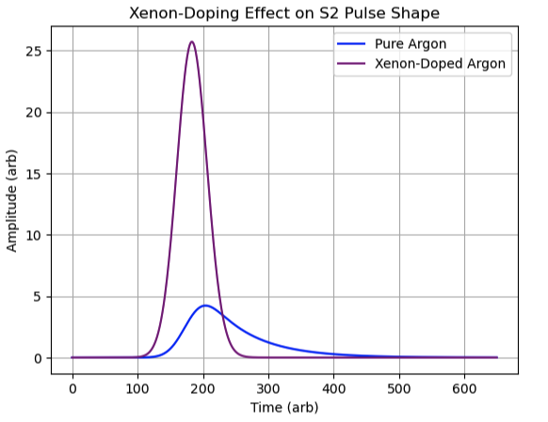
Next Steps for CHILLAX
Current run is to observe behavior of S2 as function of xenon concentration
Future upgrades:
Add more SiPMs
Activate 2nd HV feedthrough for independent drift field / extraction field control
Add field-shaping rings, increase target volume
Future studies:
Disentangle benefits to S2 (ionization yield, single e- size)
Electron extraction efficiency measurement
We currently hope to see:
Sharper S2 waveform, Larger S2 area

Slide 28
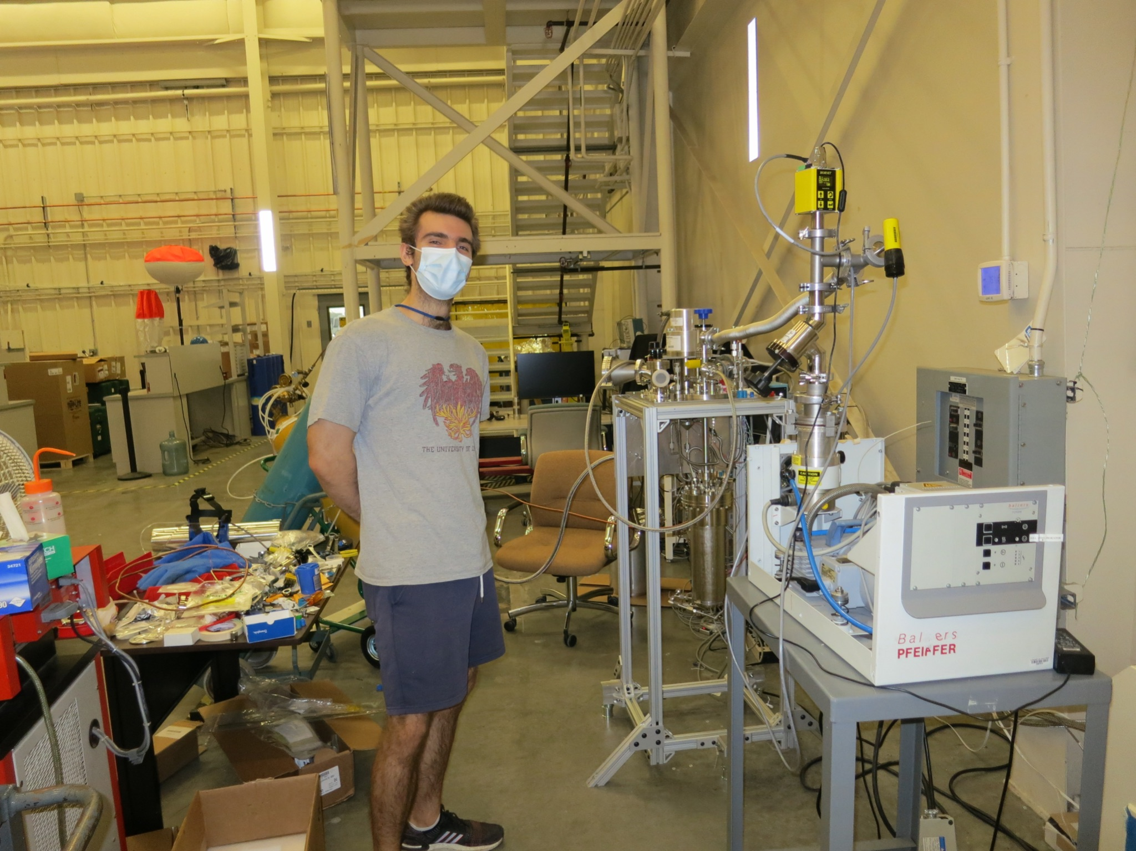
Thank you! Questions?
This material is based upon work supported by the Department of Energy National Nuclear Security Administration through the Nuclear Science and Security Consortium under Award Number DE-NA0003996.

Slide 29
Acknowledgements
This report was prepared as an account of work sponsored by an agency of the United States Government. Neither the United States Government nor any agency thereof, nor any of their employees, makes any warranty, express or implied, or assumes any legal liability or responsibility for the accuracy, completeness, or usefulness of any information, apparatus, product, or process disclosed, or represents that its use would not infringe privately owned rights. Reference herein to any specific commercial product, process, or service by trade name, trademark, manufacturer, or otherwise does not necessarily constitute or imply its endorsement, recommendation, or favoring by the United States Government or any agency thereof. The views and opinions of authors expressed herein do not necessarily state or reflect those of the United States Government or any agency thereof.
This work performed under the auspices of the U.S. Department of Energy by Lawrence Livermore National Laboratory under Contract DE-AC52-07NA27344.

