Slide 1
2024 HEPCAT report: kinetic inductance phonon-mediated detectors
Zoë Smith
Me!

Slide 2
Why we need phonon mediated detectors
Sub-GeV dark matter candidates require sub keV energy resolution.
In Si target, 100 MeV dark matter would deposit ~1eV.
Resolutions of ~3 eV have been shown in TES based detectors.
Phonon absorption and quasiparticle poisoning also important question in QIS community
O.Wen Journal of Low Temperature Physics (2022) 209:510–517

Slide 3
Outline
Device Principle
KIPM Fabrication @ Stanford
Low Tc KIPM development
Trapped flux problem
Phonon collection measurements
MEMs mirror setup for KIPMs

Slide 4
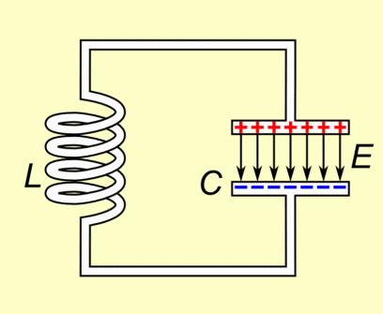
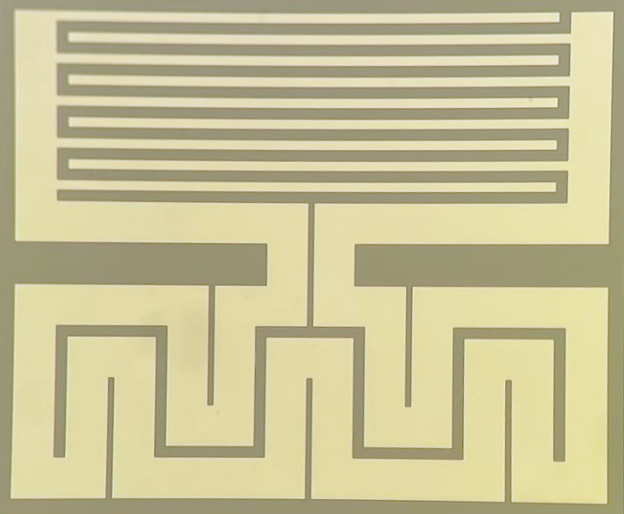
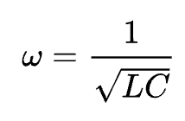
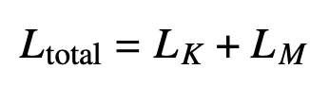
MKIDs utilize Kinetic Inductance.
KI comes from charge carriers resisting change in motion in a changing electric field
KI changes with the number of charge carriers!
L
C

Slide 5
MKIDs as phonon Detectors
Some dark matter candidates can create phonons in crystal substrate
Phonons that are absorbed into superconducting Al can break cooper pairs
Broken cooper pairs change KI, and therefore resonant frequency and dissipation of MKID

Slide 6
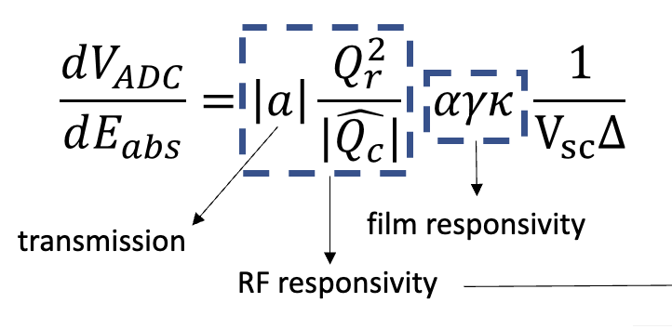
Designing KIDs for Dark matter = KIPMs
Phonon collection efficiency… need this to be high!
Ways to tune KIPMs for large signal to noise:

Slide 7
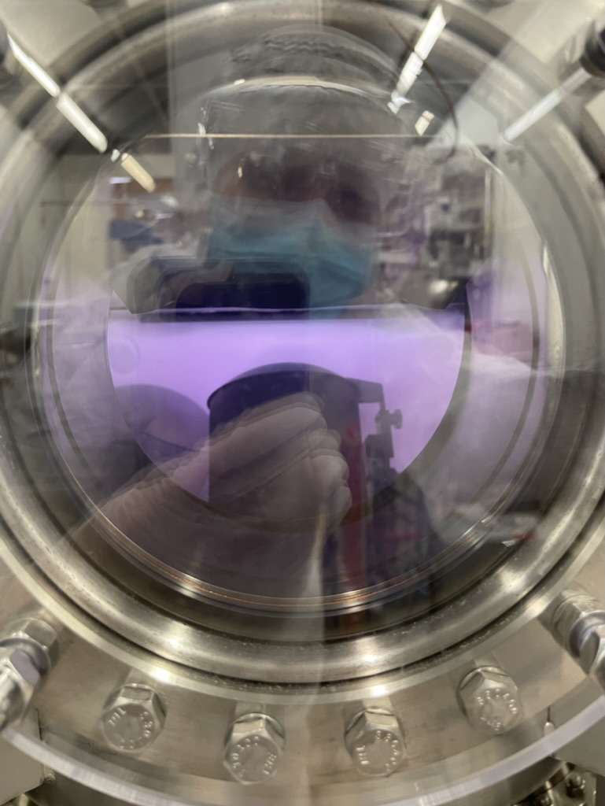
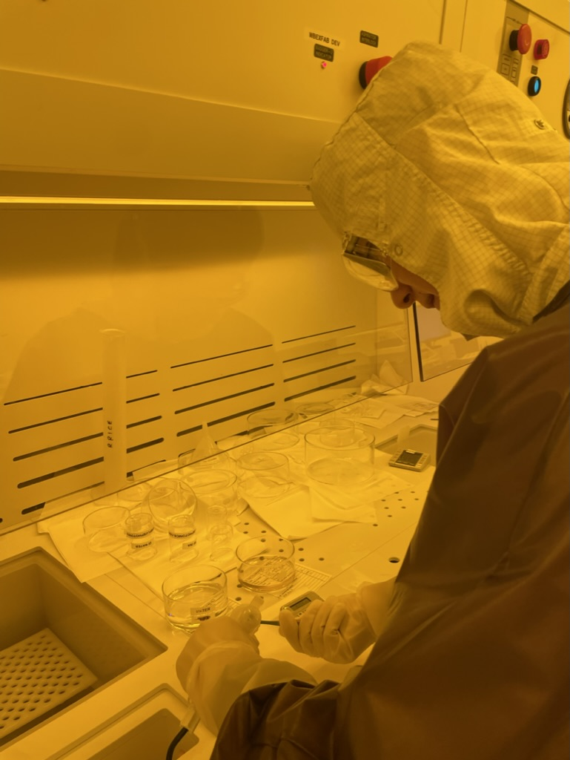
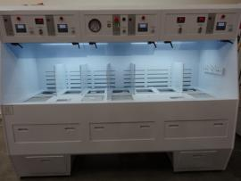
KIPM fabrication at Stanford
1. RCA Clean Si Wafer
2. RF clean and sputter Al, AlMn or Hf
3. Expose Pattern
4. Develop PR
5. Etch metal:
Al/AlMn- wet etch in Al Etchant
Hf- wet etch in HF
Nb- Dry etch
Repeat steps 2-5 if including Nb wiring.

Slide 8
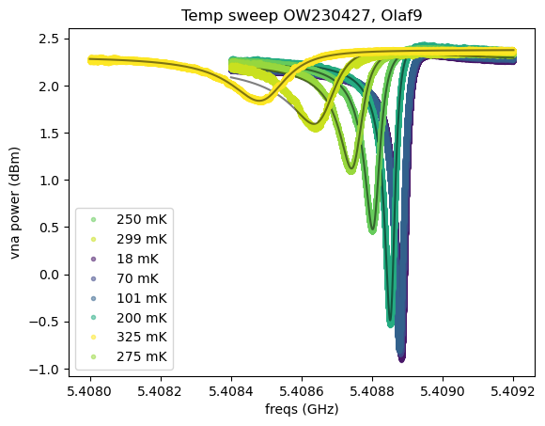
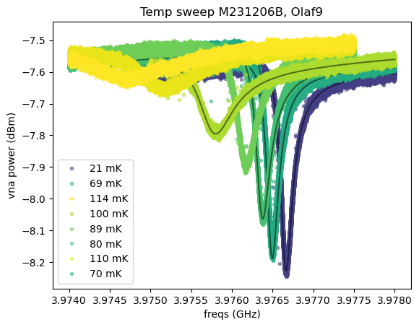
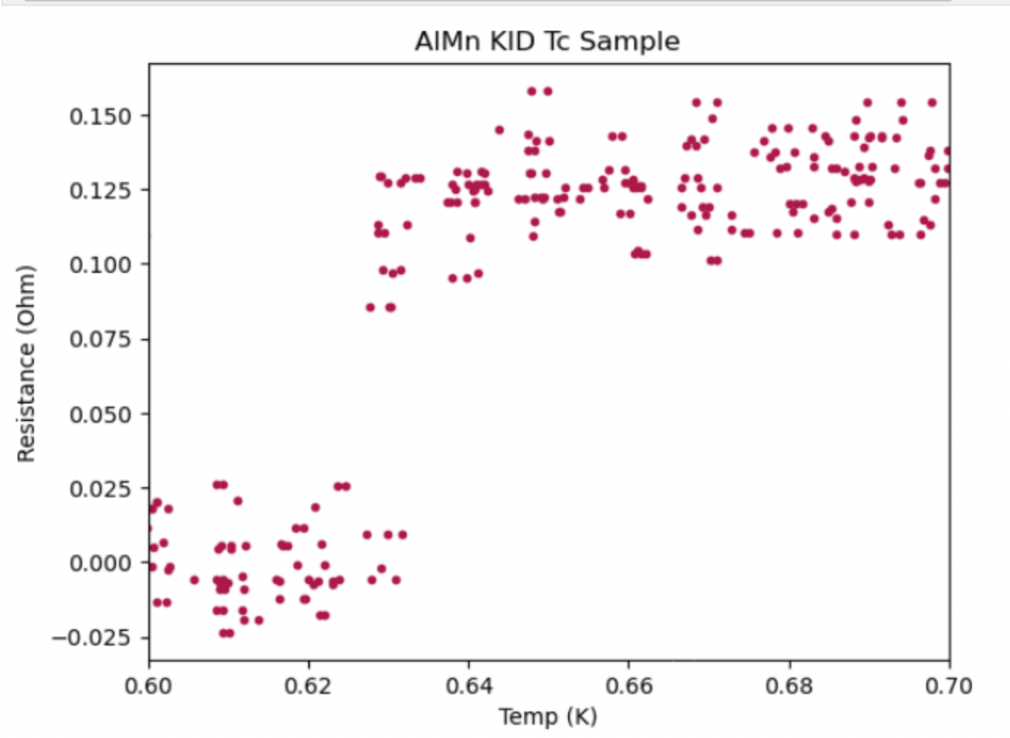
Low-Tc KID development
Making and testing Low Tc MKIDs
Resolution increases by decreasing superconducting gap
Hafnium device fabbed by Miguel Daal from UCB
Aluminum device fabbed by Osmond Wen at Caltech
AlMn by me, working on getting Hf at Slac
Al
Tc: 1.2K
AlMn
Tc: 630 mK
Hf
Tc: ~400mK

Slide 9
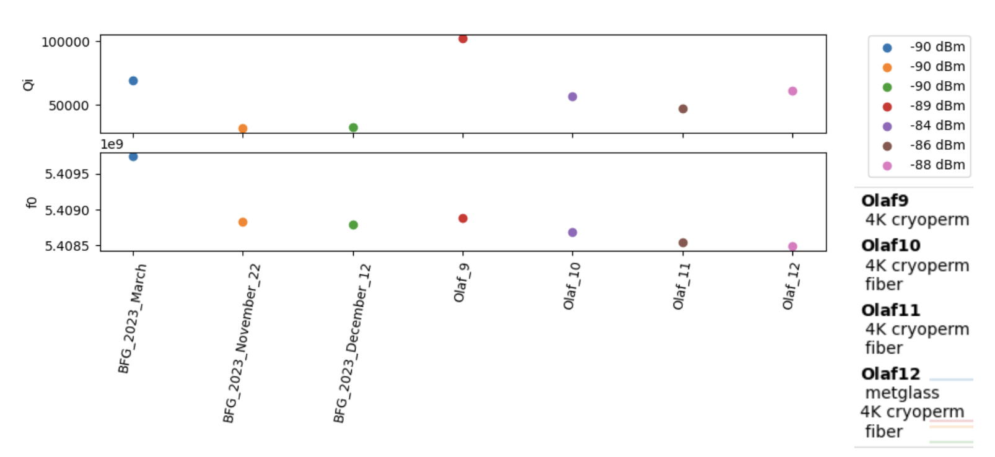
Losses from trapped vortices
struggled to get consistent quality factors
Believe trapped vortices in the superconducting films contributes to this
Adding flux traps can mitigate this

Slide 10
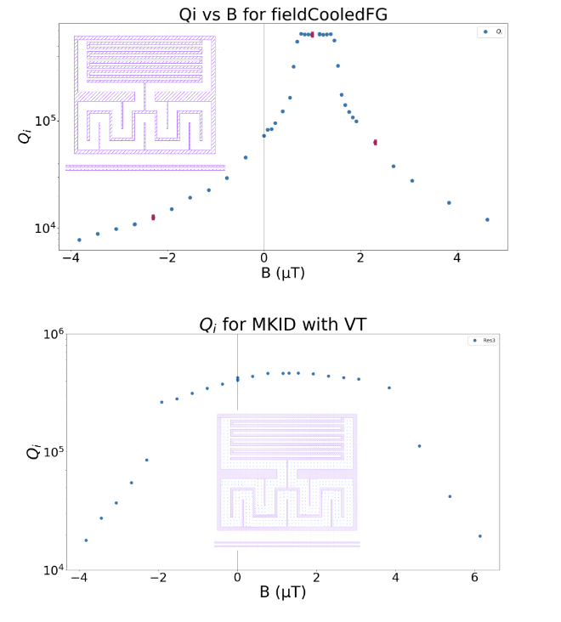
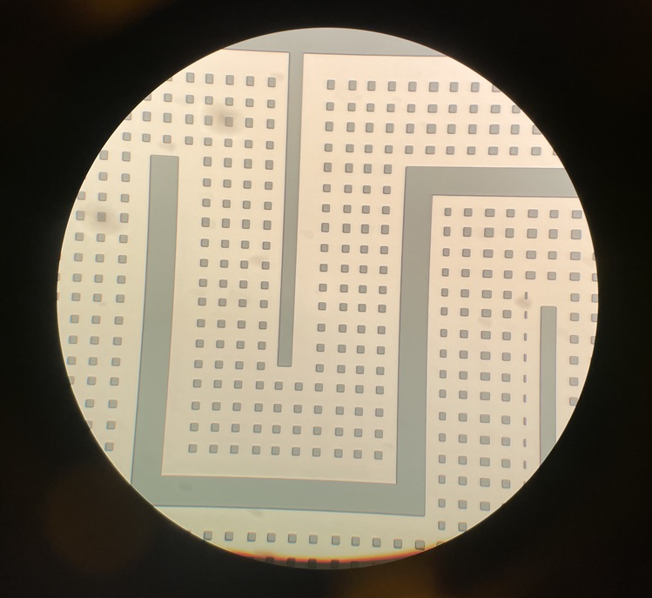
Field cooling measurements & fab by K. Okubo @ Syracuse
I. Nsanzineza and B. Plourde, Phys. Rev. Lett. 113, 117002 (2014)

Slide 11
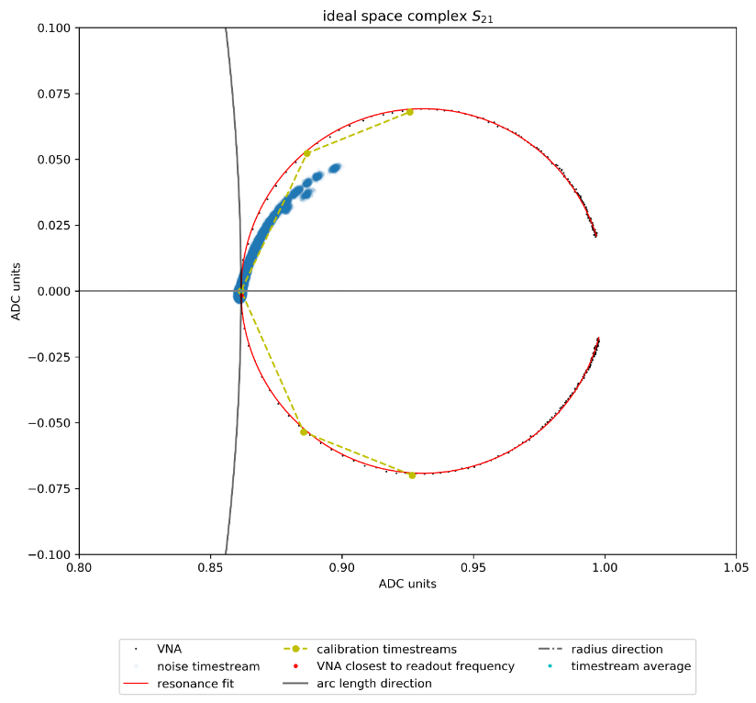
KIPM phonon setup
Installed RF readout and optical fiber chains into our cryostat
We pulse an LED on the back of KIPM while cold and measure changes in RF transmission.

Slide 12
Phonon resolution measurements
Implementing phonon collection efficiency measurement
this has become a standard technique we use for KIDs, based on success with TES-based detectors
Fitting mean vs variance allows for establishing an absolute energy scale due to photon variance
In progress…

Slide 13
Phonon collection efficiency problem
Collaborators at Caltech & Fermilab have shown ~2eV baseline resolution, but <1% phonon collection efficiency using the shot noise measurement
Many possible losses to balance
High gap superconductor
Detector
Si
Rough edges
Gold or copper mounts
Gold or copper mounts
Sources of phonon loss

Slide 14
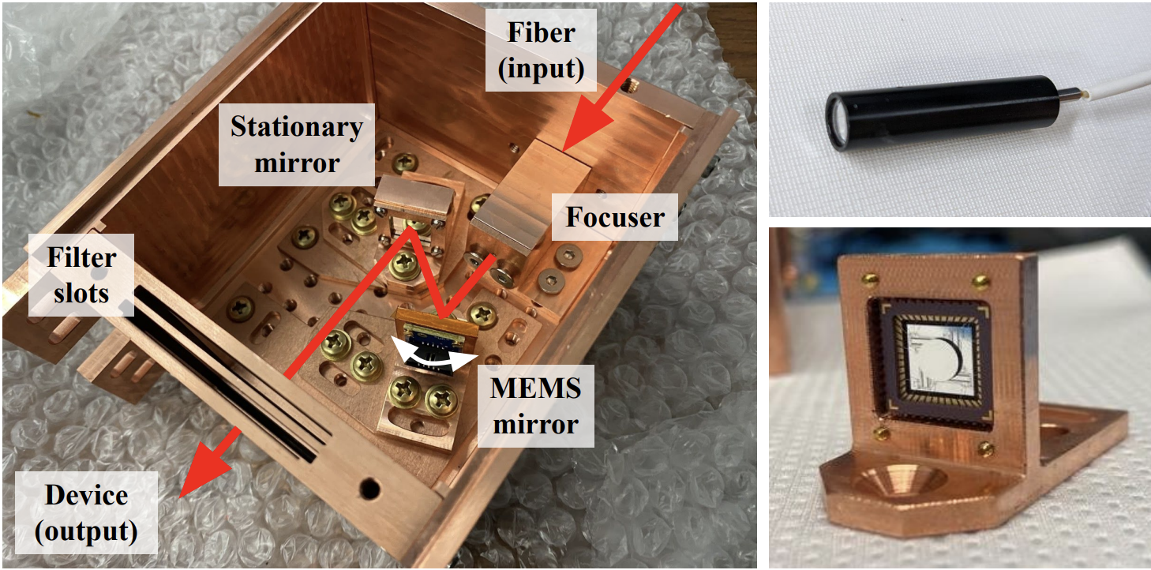
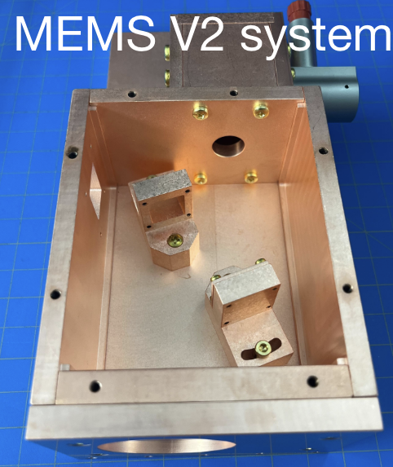
Next up: changing where LED hits chip
Fermilab designed a prototype MEMs system to steer beam.
SLAC group resigned to fit inside 5” cryoperm can
Enables testing in a light-tight & low magnetic field environment
lid for Magnetic Shield
K. Stifter arXiv:2405.02258)
Notes:
reflective collimation and fixed positions of mirrors based on v1 design

Slide 15
Thanks to the support of HEPCAT I have…
gained valuable instrumentation experience installing RF and optical systems into cryostats
designed multiple fabrication recipes for superconducting detectors
helped maintain vacuum and cryogenic systems for fabrication
applied shot noise measurements for KIPMs

Slide 16
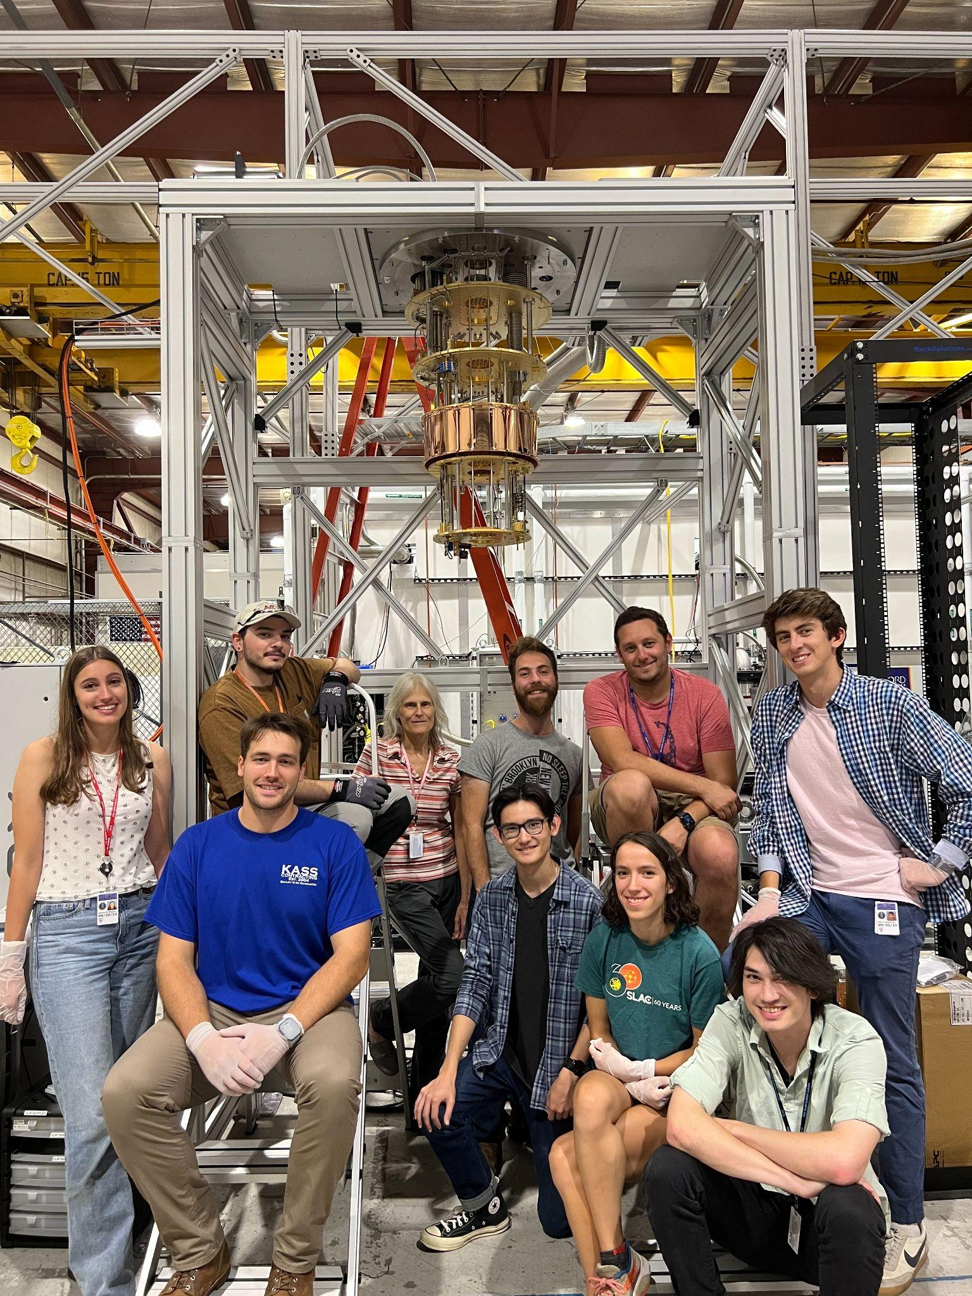
Thank you!
DMQIS group…
Noah Kurinsky (Scientist)
Kelly Stifter (Scientist)
Betty Young (SC Faculty)
Nico Linton (Technician)
Sidney Stevens (Mech. Eng.)
Jamie Ryan (Postdoc)
Chiara Salemi (Porat Fellow)
Taylor Aralis (Postdoc)
Jadyn Anczarski (Stanford grad)
Taj Dyson (Stanford grad)
Aviv Simchony (Stanford grad)
Zoe Smith (Stanford grad)
Hannah Magoon (Stanford grad)
Tonya Peschel (SLAC post-bac)
Giana Perez (Stanford ugrad)
Anthony Nunez (Stanford ugrad)
Elizabeth Panner (Tufts ugrad)
Charles Snipp (Stanford ugrad)

Slide 17
MKIDs are LC circuits.
LC circuits are harmonic oscillators
Their resonance frequency is:
L
C

Slide 18
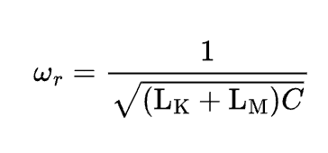
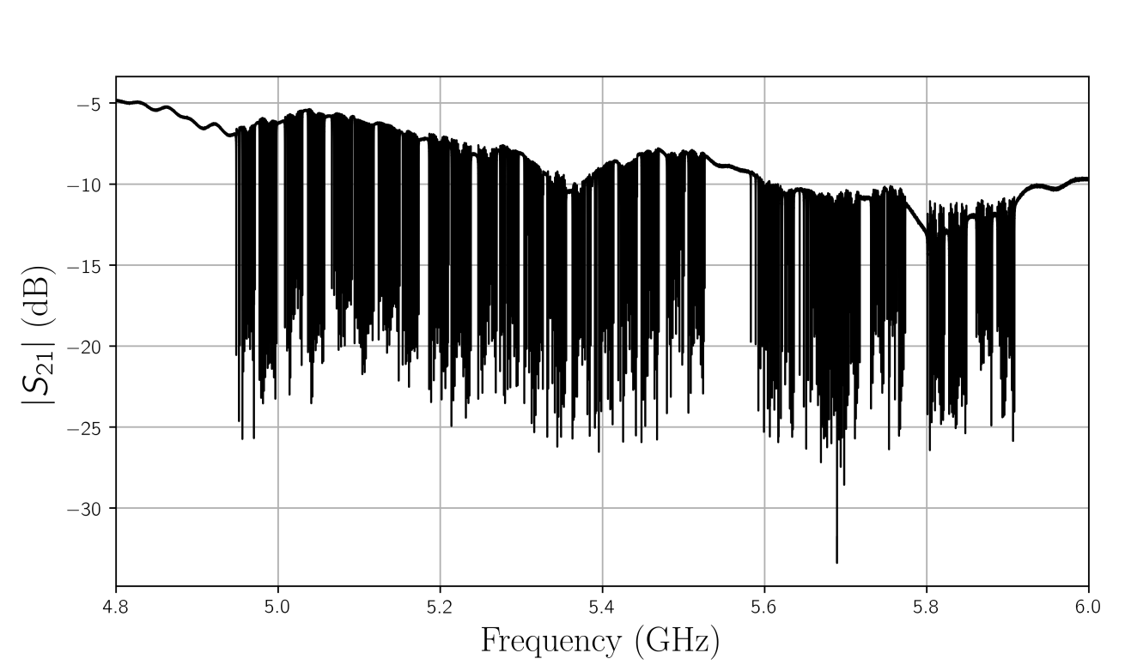
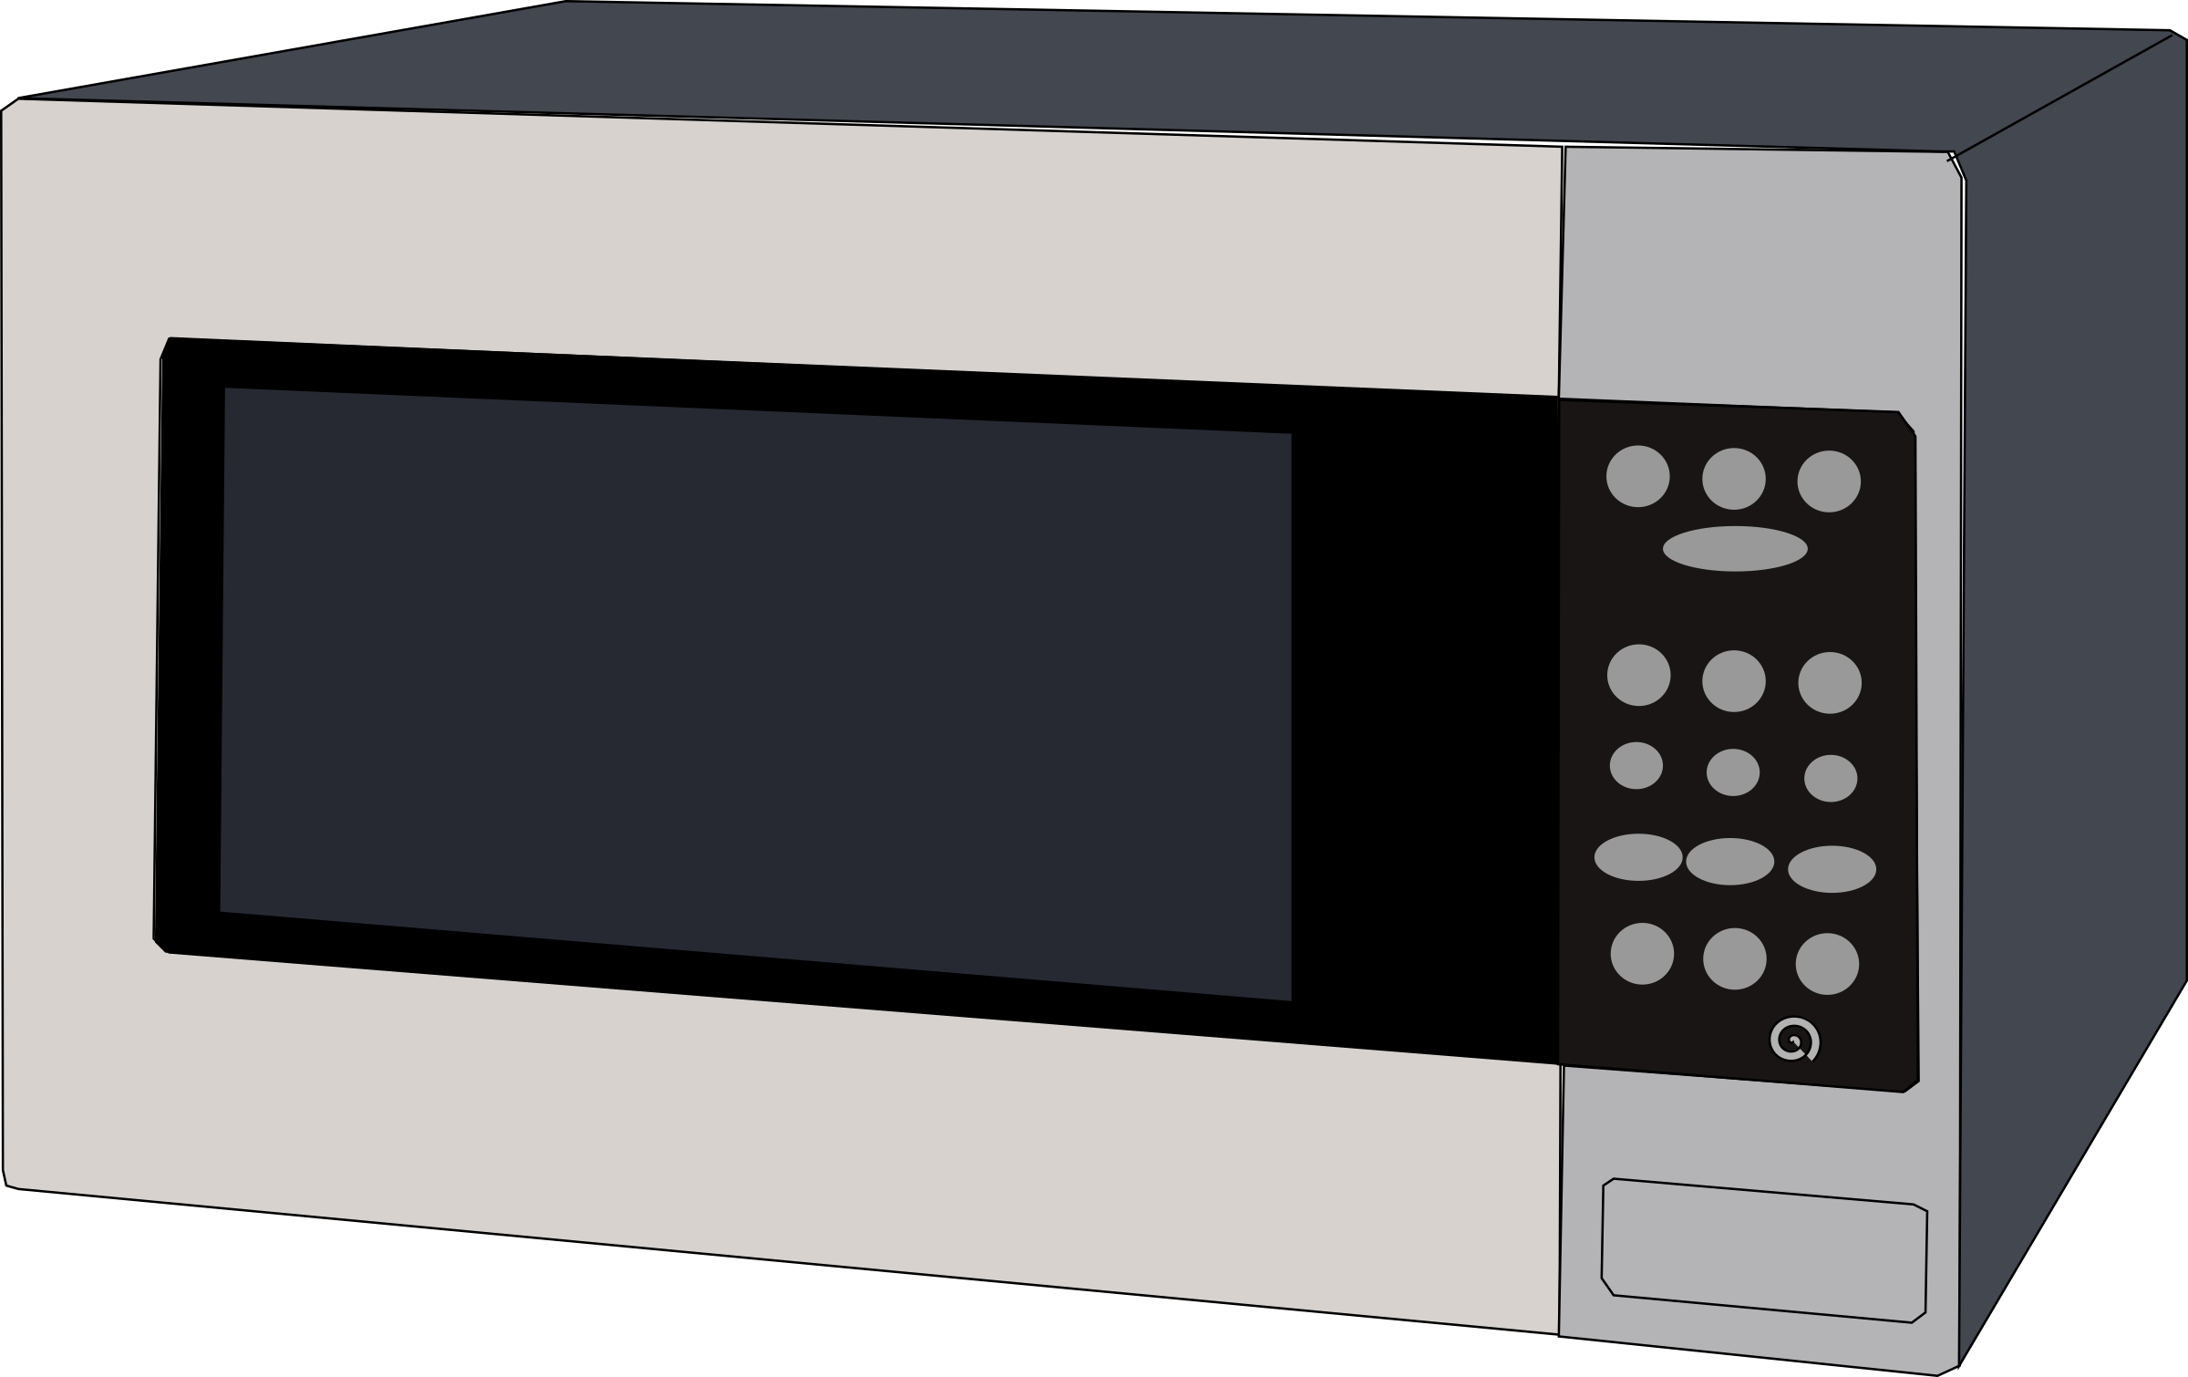
MKIDs operate at Microwave Frequencies.
shelf electronics in microwave regime
MuWe design our LC circuits to be in 4-8 GHz regime for various reasons:
KI better when charges travel shorter distance
Keep resonance frequency much lower than gap frequency
Off the ltiplexing!
Shawn W. Henderson, 2018

Slide 19
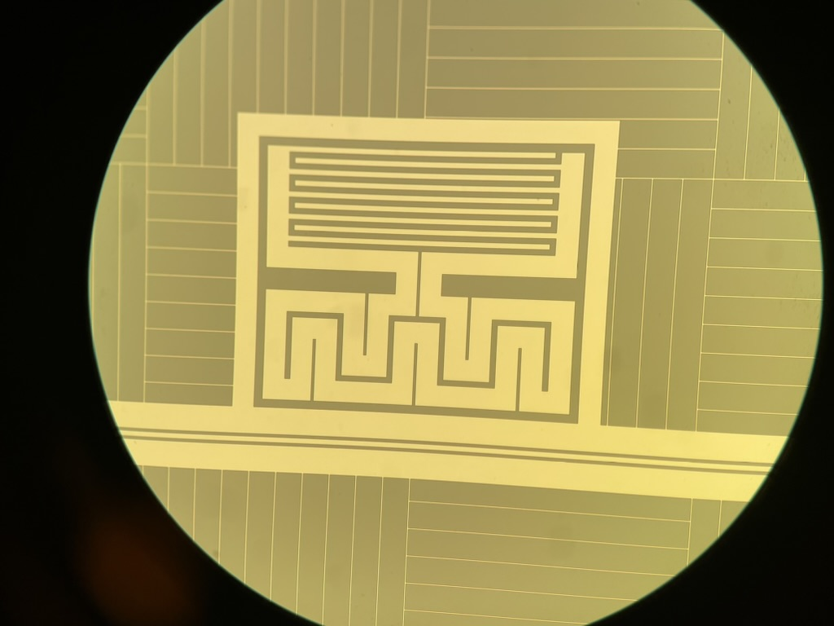
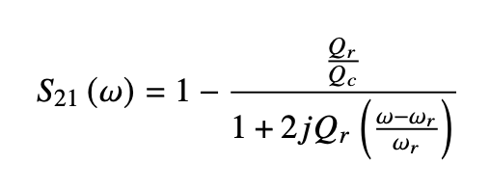
We couple the MKID to a transmission line.
Send microwave with known phase and amplitude down feedline
Couple a device (MKID!) to feedline & distort microwave:
Qr total quality factor (Qi+Qc)/(QiQc)
Qc depends on coupling to feedline
is fixed for given design
Qi relates to dissipation of energy in the film
1
(in)
2
(out)
DUT

Slide 20
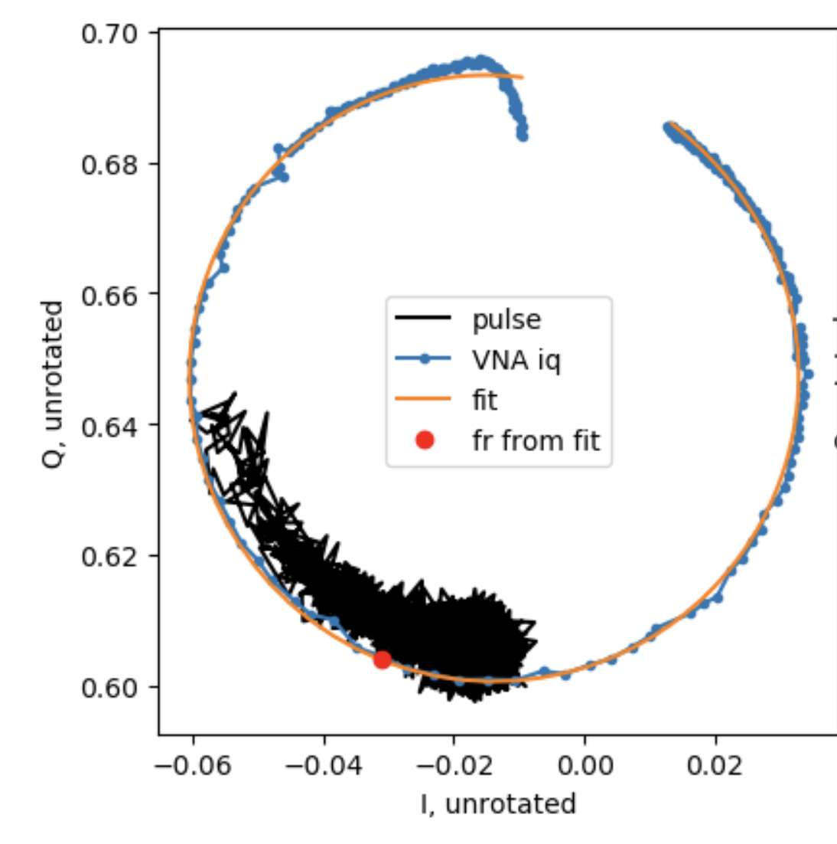
Backup: Pulses!
df/f
Samples

Slide 21
Multiplexing and Quality factors:
$Qr≡\frac{resonant frequency}{FWHM}$
How dense can you pack them?
|S21|
FWHM
fr
Frequency

Slide 22
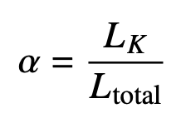
MKIDs utilize Kinetic Inductance.
KI comes from charge carriers resisting change in motion in a changing electric field
KI changes with the number of charge carriers!
Geometric Inductance… does not
Want to increase KI fraction (within reason):
L
C

Slide 23
Backup: Magnetic Shields!

