Slide 1
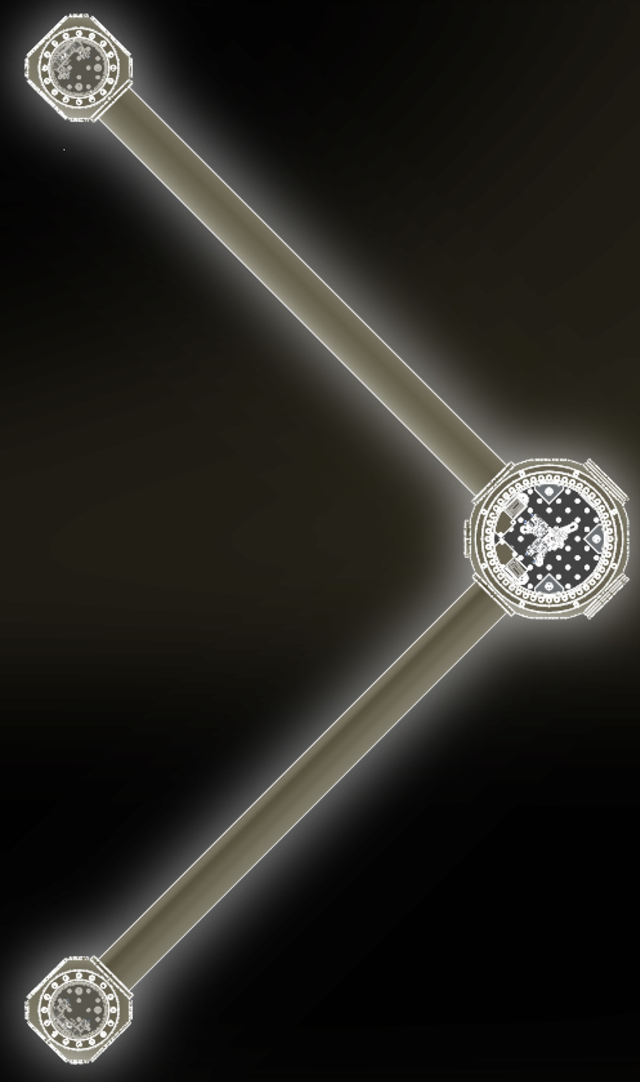
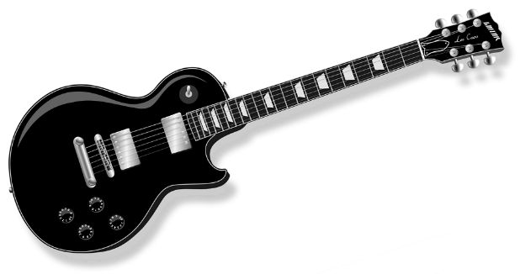
Precision measurements searching for dark matter
Nancy Aggarwal, NOV 2 2024

Slide 2
Today’s talk

Slide 3
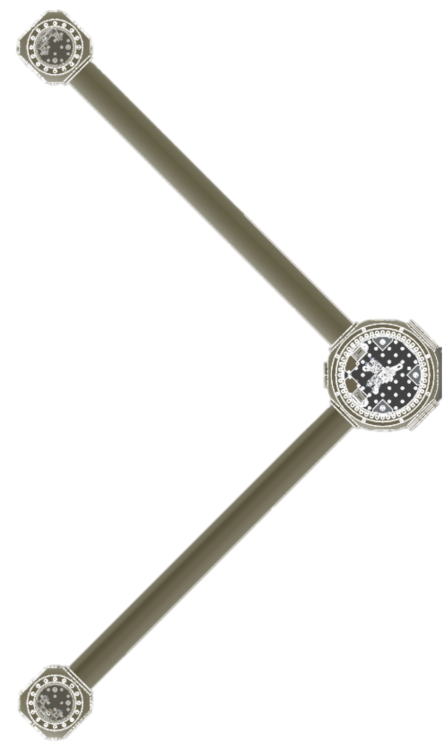
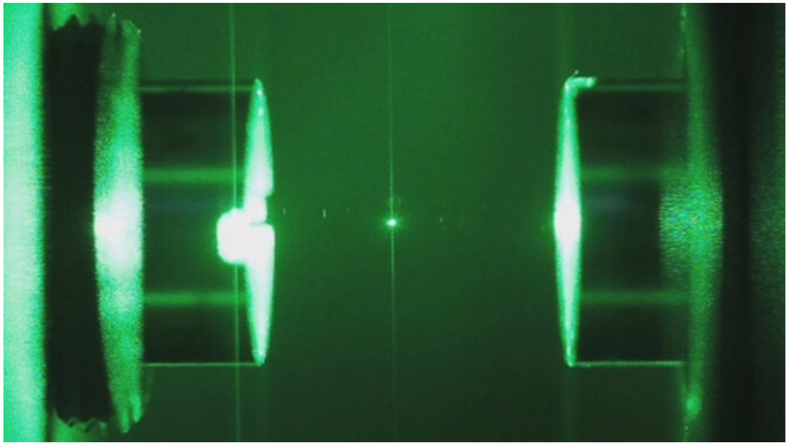
DM TELEVISION
Dark Matter TEsts using LEVItated Sensor Interferometer Observatory Network
Notes:
Sure they have low recoil, but are they even trappable?

Slide 4
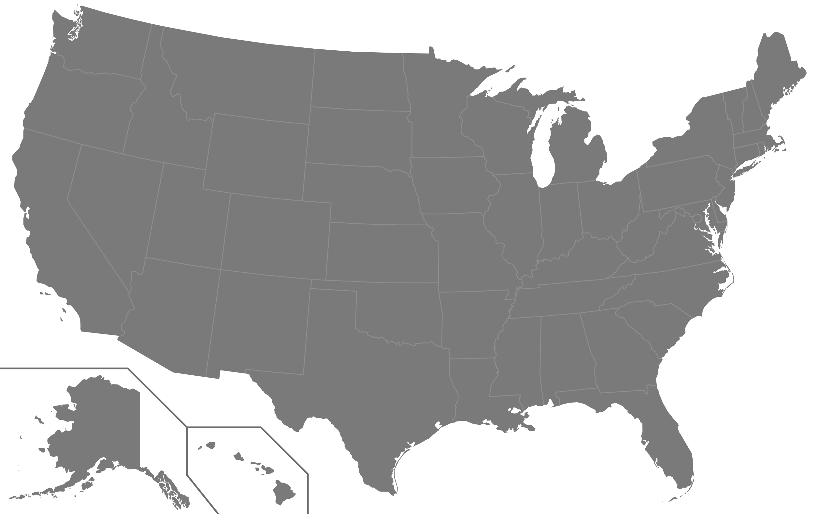
Levitated sensor detector for dark matter
Network of miniature GW detectors
Uses optically levitated objects
Tunable detection frequencies
L
Searching for new physics with a levitated-sensor-based GW detector
Aggarwal et al PRL 128, 111101

Slide 5
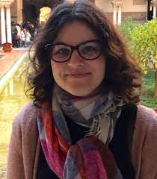
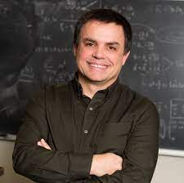
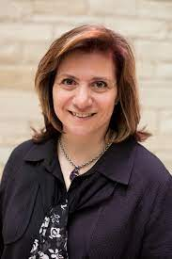
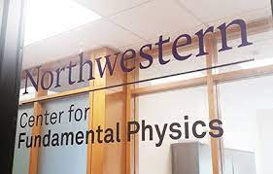
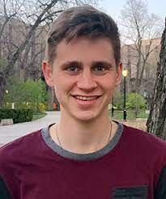
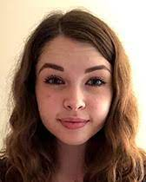

Slide 6
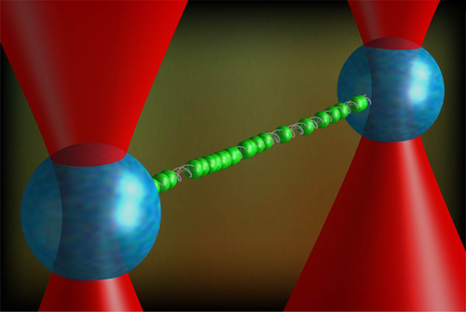
Optical trapping
$$U\left(\vec{r}\right)=−\frac{1}{2}α (\vec{r} ) E^{2}(\vec{r})$$
Niklas Elmehed, Nobel Media
K. Schakenraad et al

Slide 7
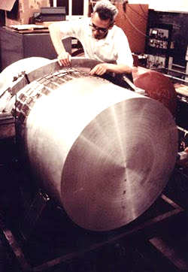
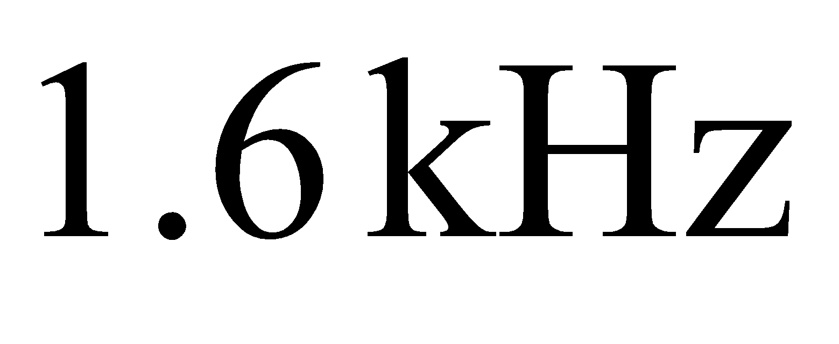
Gw detector using optical traps
$$L$$
Arvanitaki and Geraci,
PRL 110, 071105 (2013)
$$ΔL=\frac{h}{2}L, Δx_{a}=ΔL, Δx_{s}=\frac{h}{2}x_{s}$$
$Δx_{GW}=Δx_{s}−{Δx}_{a}=\frac{h}{2}(x_{s}−L)$, maximized at $x_{s}→0$
$$F_{GW}=MΩ_{T}^{2} Δx_{GW} =M Ω_{T}^{2}\frac{L}{2} h_{0}\cos{Ω_{GW}t}$$

Slide 8
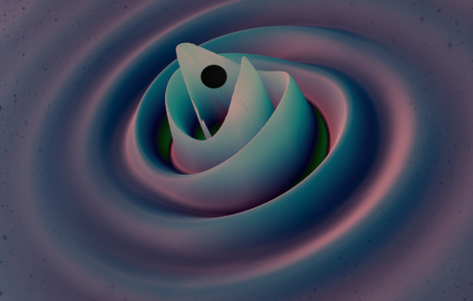
Science case
BH Superradiance
Masha Baryakhtar
Primordial black holes
+ inflation, phase transitions, cosmic strings etc
Deborah Ferguson, Karan Jani, Deirdre Shoemaker, Pablo Laguna | Georgia Tech, MAYA Collaboration
The unknown unknowns???

Slide 9
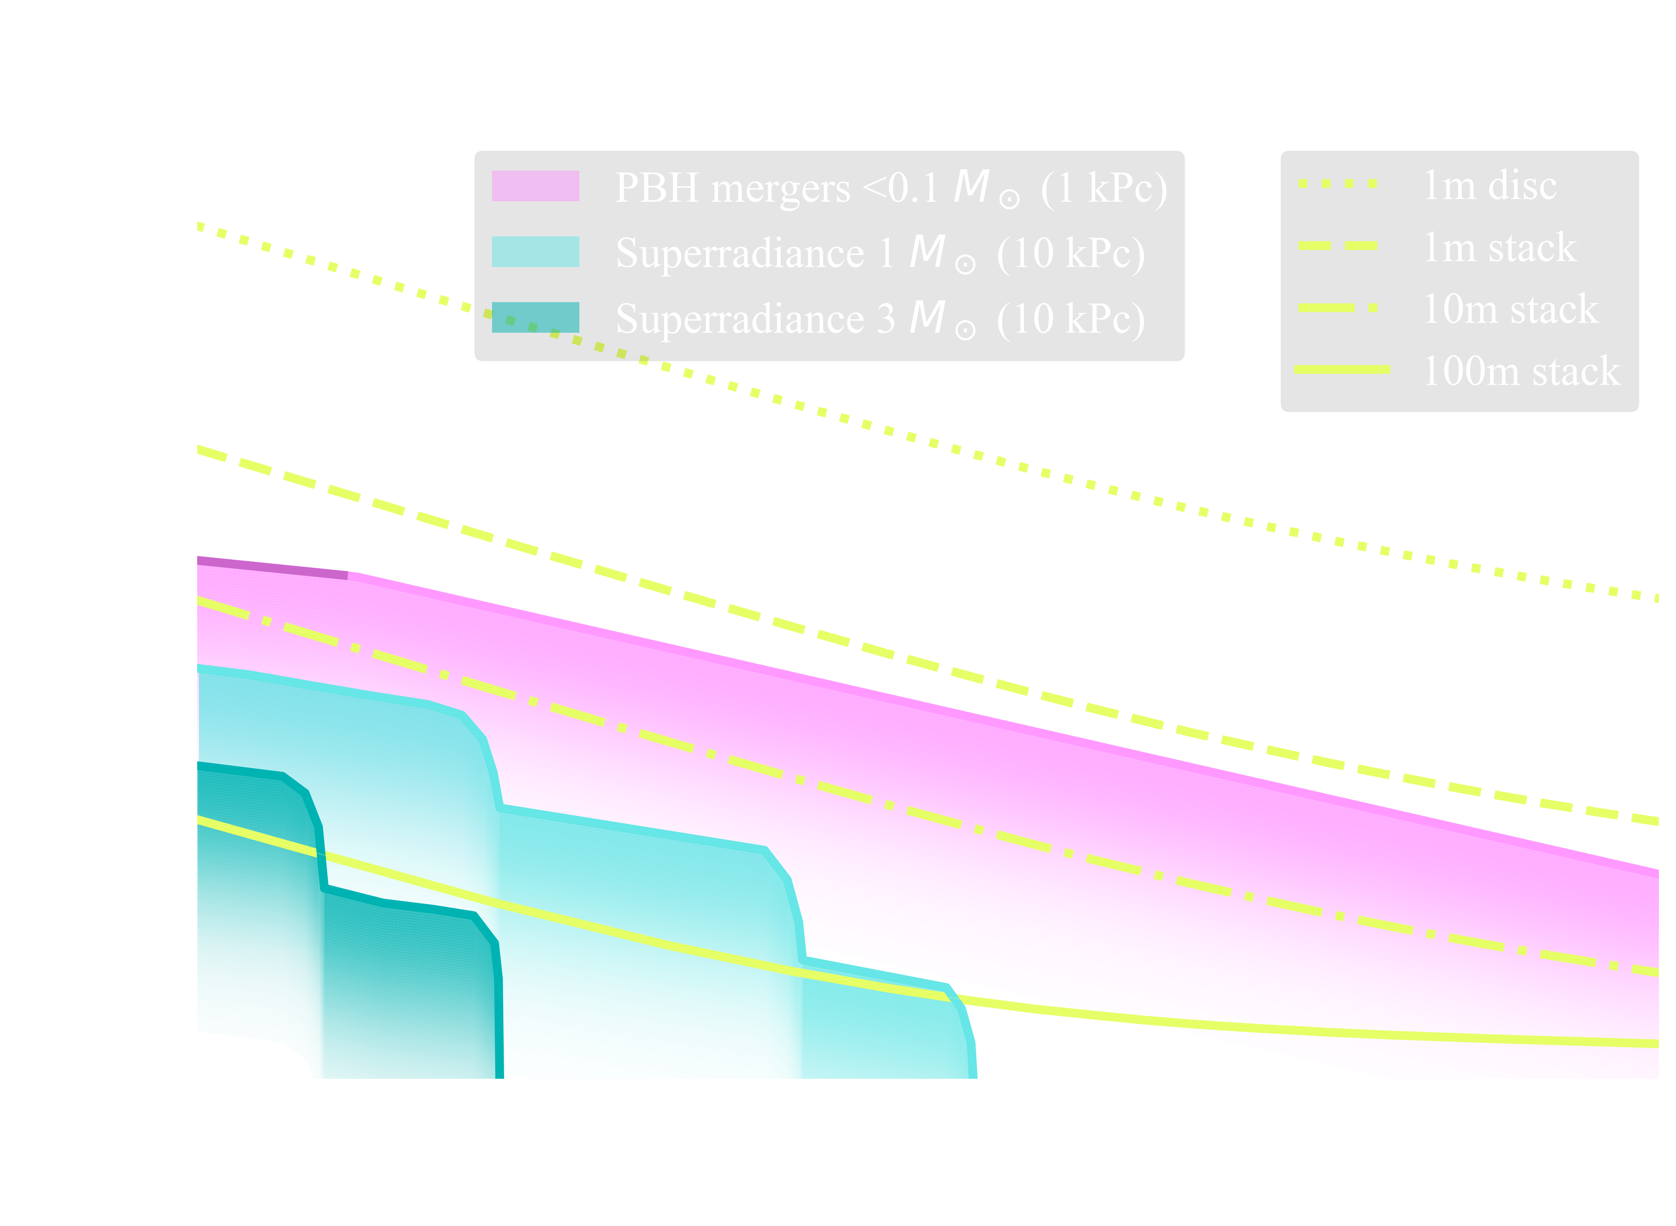
Optical Trapping for GW detection
L = 1m, disc
L = 1m, stack
L= 10 m, stack
L = 100 m, stack
Required:
Existence of axions/other bosons at these masses
Existence of spinning black holes (nearby preferred)
Not required:
A particular axion density (as would be from DM)
A particular coupling constant with the standard model
Searching for new physics with a levitated-sensor-based GW detector
Aggarwal et al PRL 128, 111101

Slide 10
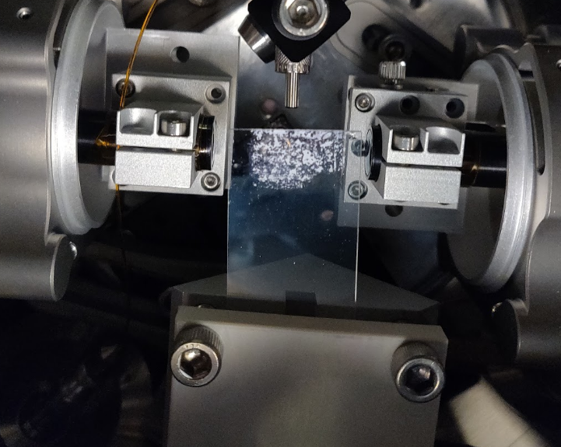
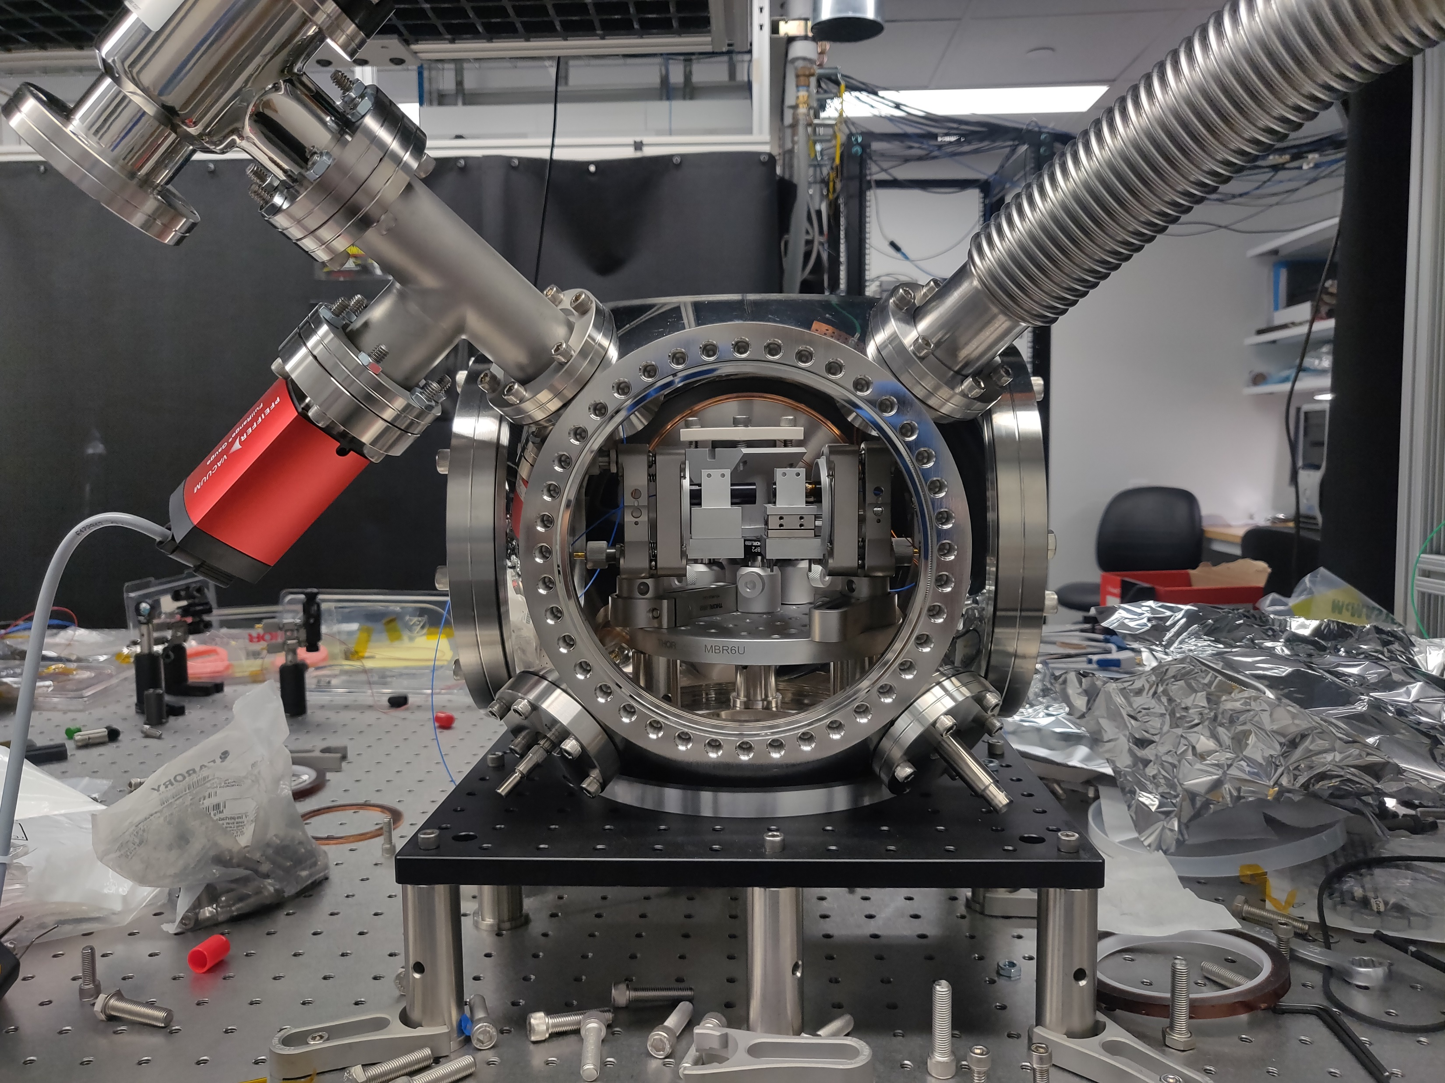
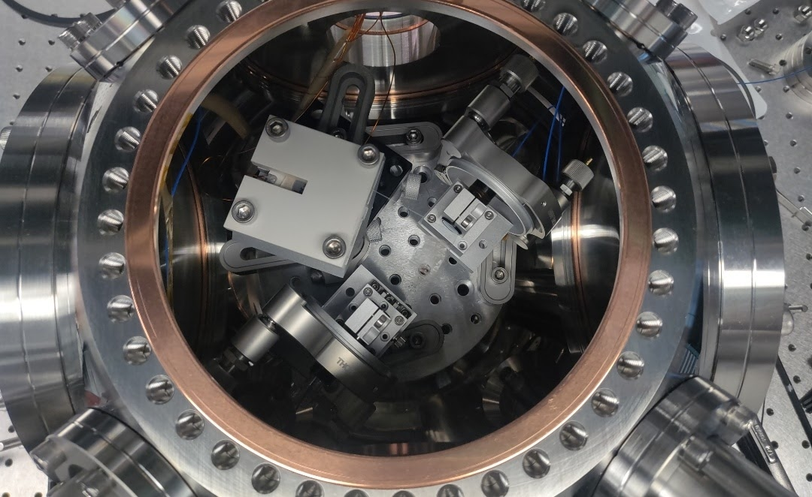
Trapping of flat objects In the lab…

Slide 11
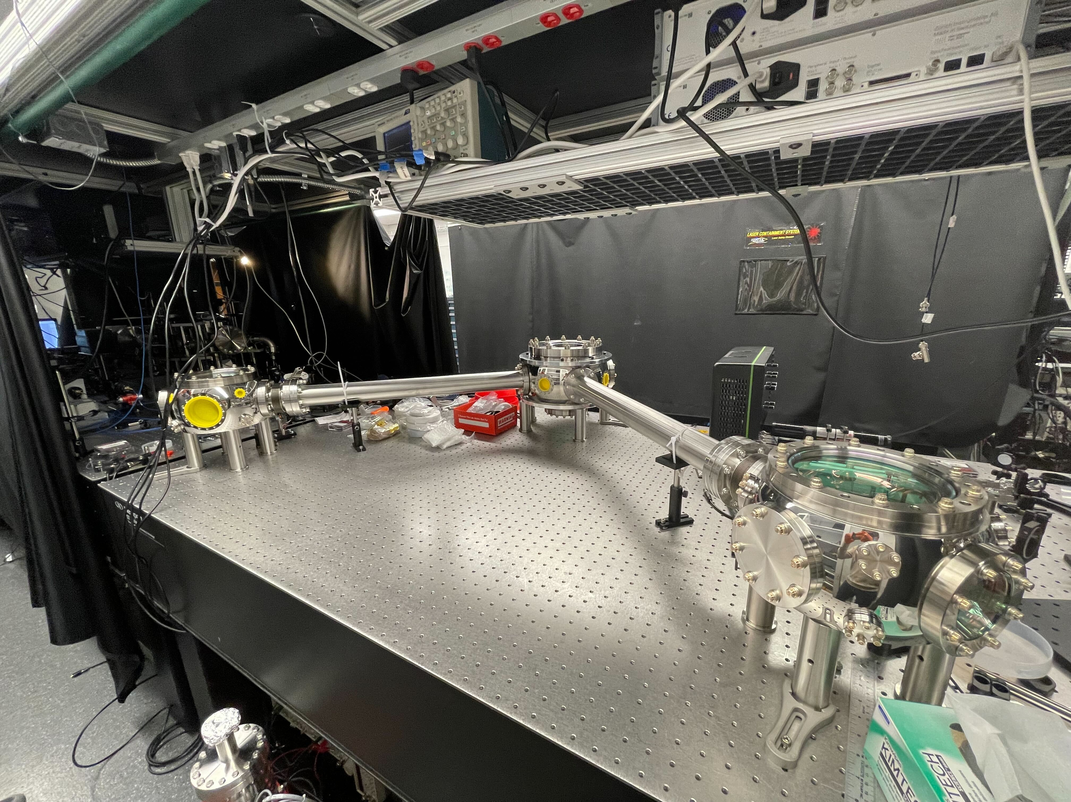
Stay tuned…
New initiative for building high-frequency GW detectors
Miniature GW detector based on levitated nanoparticles to probe GWs in 10 kHz – 300 kHz band
Will set independent limits on BH superradiance and primordial black holes
Further improvements can be achieved by xylophone configuration and/or increasing mass

Slide 12
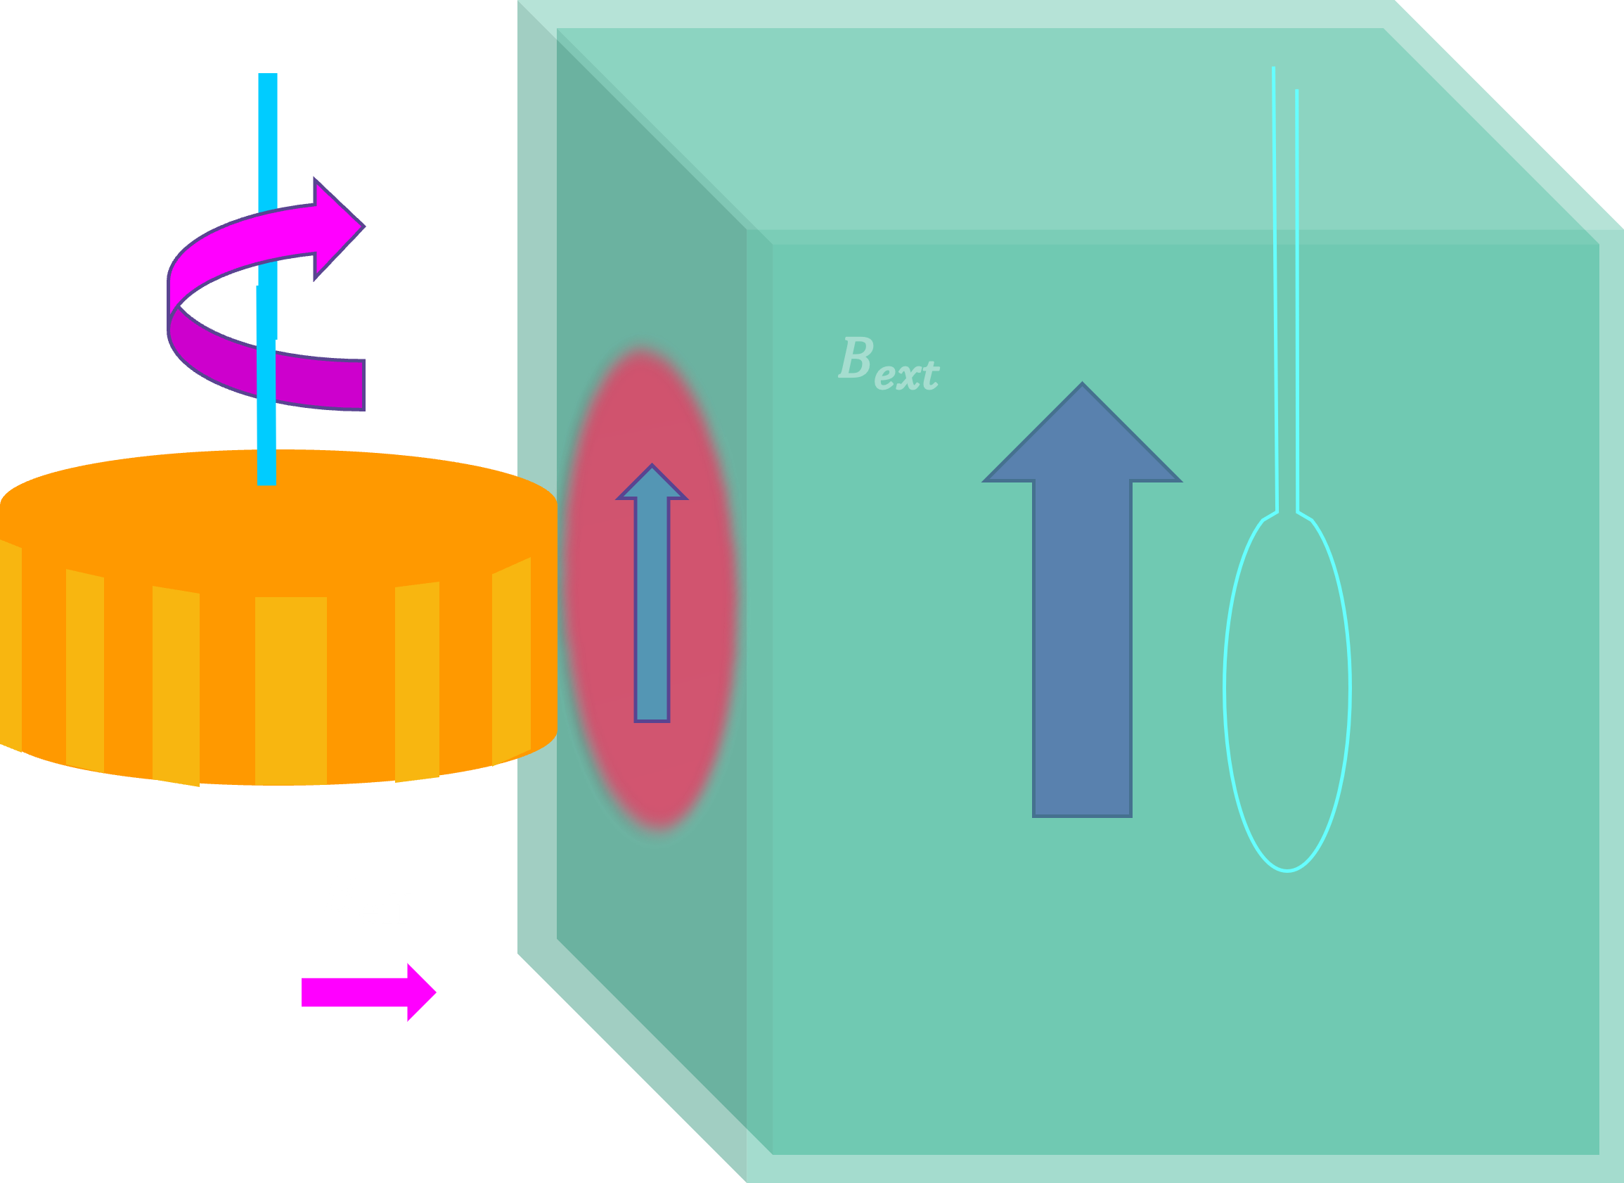
ARIADNE
Axion Resonant InterAction DetectioN Experiment

Slide 13
Ariadne collaboration
Grant No. PHY-1509176, 1510484, 1506508, 1806671, 1806395, 1806757
Northwestern
Indiana
Stanford
CAPP
KRISS
PTB
Andrew Geraci, Alex Hipp
Mike Snow, Josh Long, Chen-Yu Liu, Austin Reid, Inbum Lee,
Aharon Kapitulnik, Alan Fang, Sam Mumford
Yannis Semertzidis, Yun Shin, Dongok Kim, Youngeun Kim
Yong-Ho Lee
A. Schnabel, J. Voigt, S. Knappe-Grueneberg, W. Kilian
Center for Fundamental Physics (CFP)

Slide 14
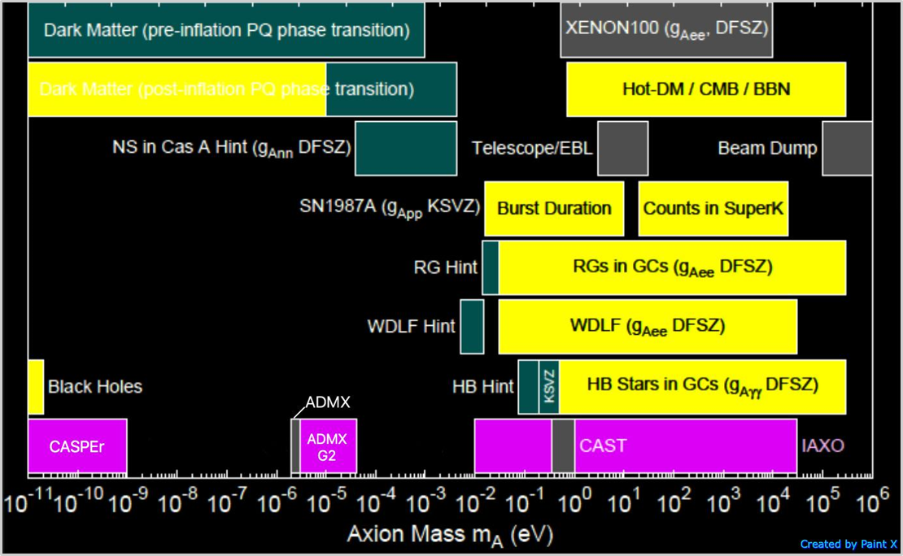
Axion parameter space
Astrophysical Bounds
Dark Matter (post-inflation PQ phase
Hints
Experimental Bounds
Current Experiments
ARIADNE
ALPHA
DM radio, LC circuit, ABRACADABRA
Adapted from http://pdg.lbl.gov/2015/reviews/rpp2015-rev-axions.pdf

Slide 15
Ariadne goal
Only experiment to directly test for nuclear couplings mediated by QCD axion in the lab
Source
Coupling
 | Photons | Nucleons | Electrons
Dark Matter (Cosmic) axions | ADMX, HAYSTAC, DM Radio, LC Circuit, ABRACADABRA MADMAX,Orpheus | CASPEr | QUAX
Solar axions | CAST IAXO
Lab-produced | Light-shining-thru- walls (ALPS, ALPS-II) | ARIADNE

Slide 16
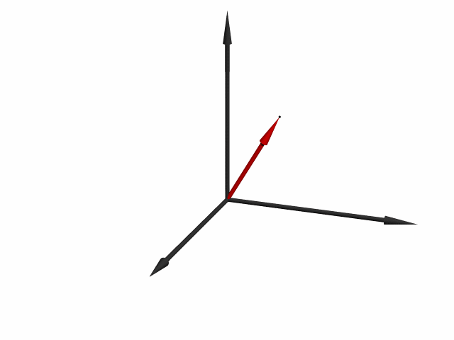
Nuclear magnetic resonance to detect axions
$$U_{sp}\left(r\right)=\frac{ℏ^{2}g_{s}^{N}g_{p}^{N}}{8 π m_{N}}\left(\frac{1}{r λ_{a}}+\frac{1}{r^{2}}\right)e^{−\frac{r}{λ_{a}}}\left(\vec{σ}⋅\hat{r}\right)≡\vec{σ}⋅{\vec{B}}_{eff}$$
Axion does not need to be dark matter
$$\vec{r}$$
$$m_{N}$$
$$\vec{σ}$$
Larmor precession
$$B_{ext}$$
$$B_{eff}$$
Resonance if $ω=ω_{L}$
$${ℏ ω}_{L}=2 {\vec{μ}}_{N}⋅{\vec{B}}_{ext}$$
$${\vec{B}}_{eff} →B_{⊥}\cos{ωt }$$

Slide 17
ARIADNE Experiment concept
Quartz block with superconducting shield
$$U_{sp}\left(r\right)=\frac{ℏ^{2}g_{s}^{N}g_{p}^{N}}{8 π m_{N}}\left(\frac{1}{r λ_{a}}+\frac{1}{r^{2}}\right)e^{−\frac{r}{λ_{a}}}\left(\hat{σ}⋅\hat{r}\right)$$
$$B_{ext}$$
Source
Squid pickup loop
Spins in hyperpolarized Helium-3 gas
Transverse modulation by rotating a wheel with gear shaped pattern
NMR-like transition if modulation matches He Larmor frequency
Axion field doesn’t obey Maxwell’s equations, SM fields shielded using a superconductor
³He spin
Z
Y
$$B_{axion}$$
Ellipsoid ³He cell
X
$$B_{axion}\sim {10}^{−20}T$$
$$ω_{L}=11 ω_{rot}$$

Slide 18
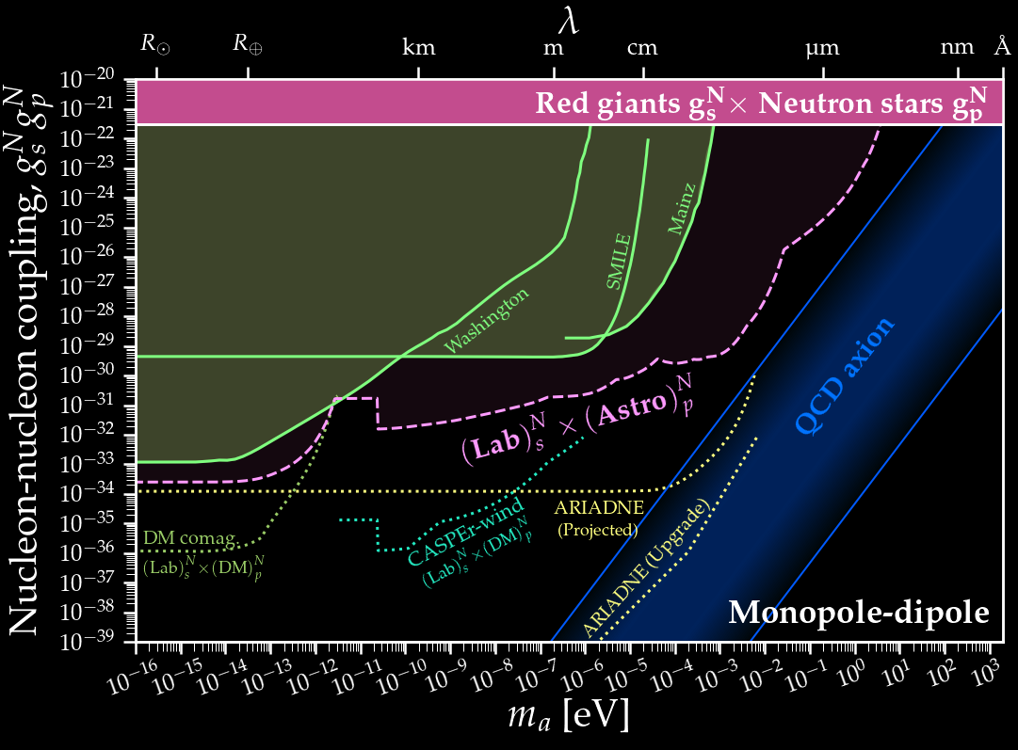
State of the art in $g_{s}g_{p}$
probe into the PQ axion parameter space with ~ 10⁸ improvement over previous techniques
O’Hare & Vitagliano, PRD 102 115026 2021

Slide 19
Exponentially decaying interaction…
Quartz block with superconducting shield
$$U_{sp}\left(r\right)=\frac{ℏ^{2}g_{s}^{N}g_{p}^{N}}{8 π m_{N}}\left(\frac{1}{r λ_{a}}+\frac{1}{r^{2}}\right)e^{−\frac{r}{λ_{a}}}\left(\hat{σ}⋅\hat{r}\right)$$
$$B_{ext}$$
Source
Squid pickup loop
³He spin
$λ_{a}=\frac{ℏ}{m_{a}c}$ (Compton wavelength)
$λ_{a}=200 μm \left(\frac{{10}^{−3}eV/c^{2}}{m_{a}}\right)$
Requires source and Helium to be close-by for the effect to be seen (~ human hair)
Z
Y
$$B_{axion}$$
Ellipsoid ³He cell
X

Slide 20
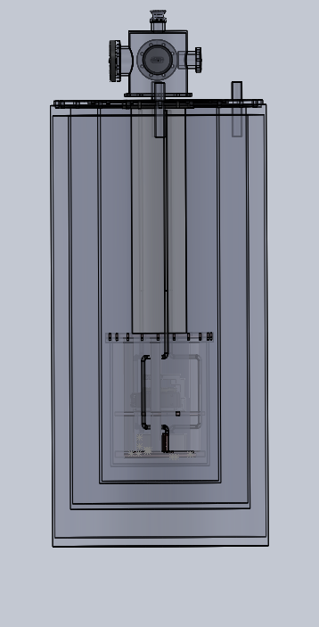
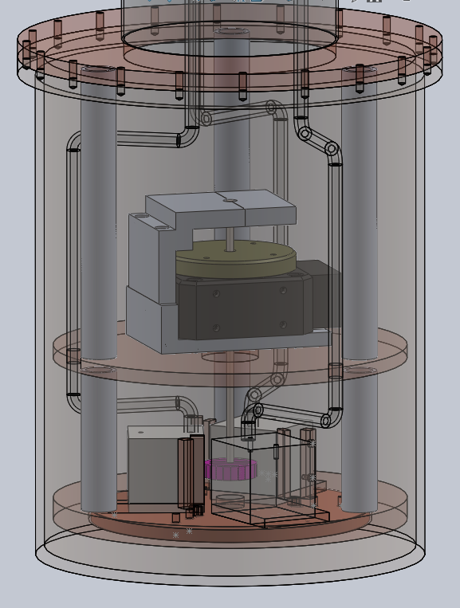
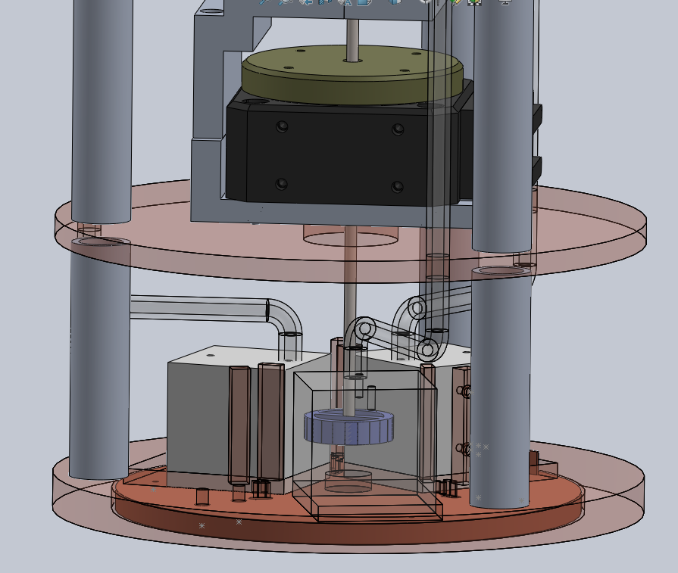
Custom cryo design for $B_{eff}\sim {10}^{−21}T$
Motor
³He glass tubes
Exchange gas
Vacuum can
Non-magnetic
Low vibration
multi-temperature
Liquid He
Block with He-3 gas
Vacuum+ superinsulation
Source mass rotor

Slide 21
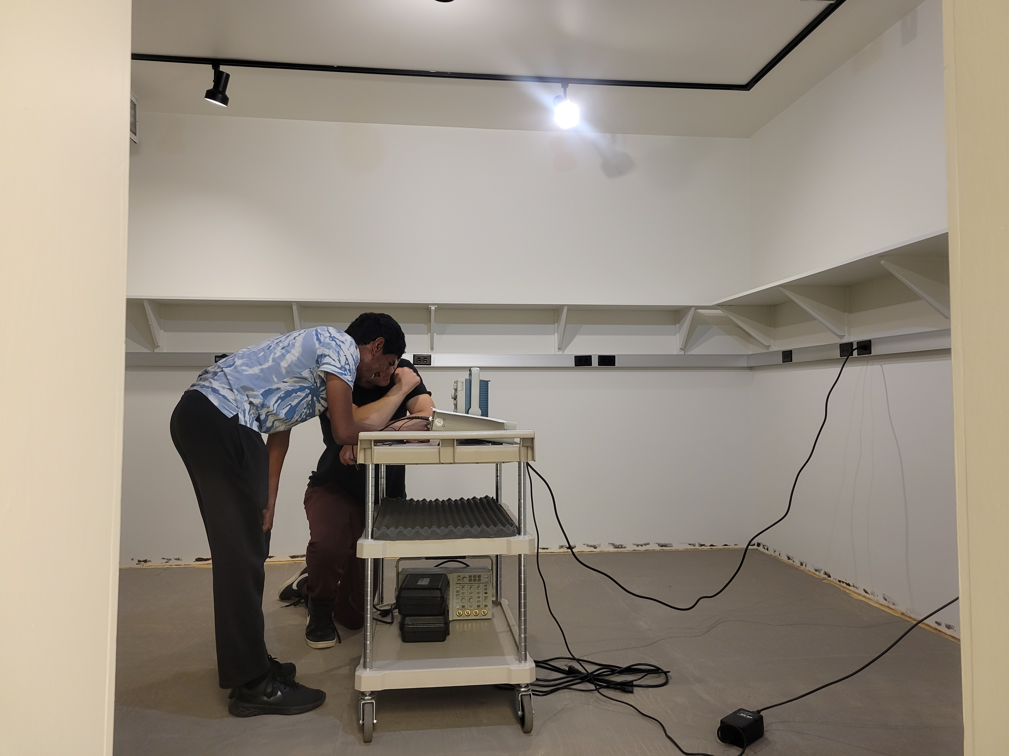
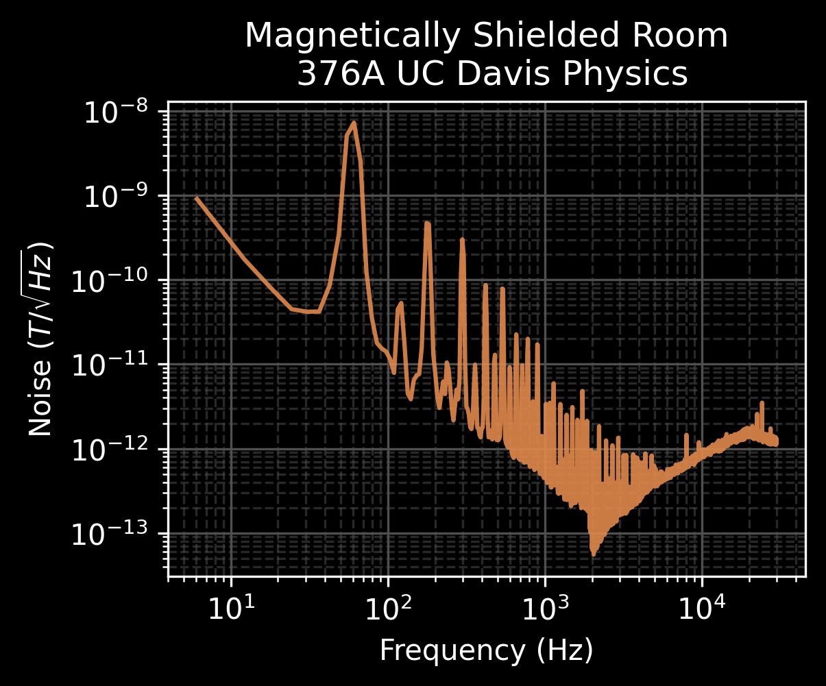
Precision magnetometry at UC DAVIS
large volume magnetically shielded room – undergoing characterization and renovation
First, “dirty” measurement

Slide 22
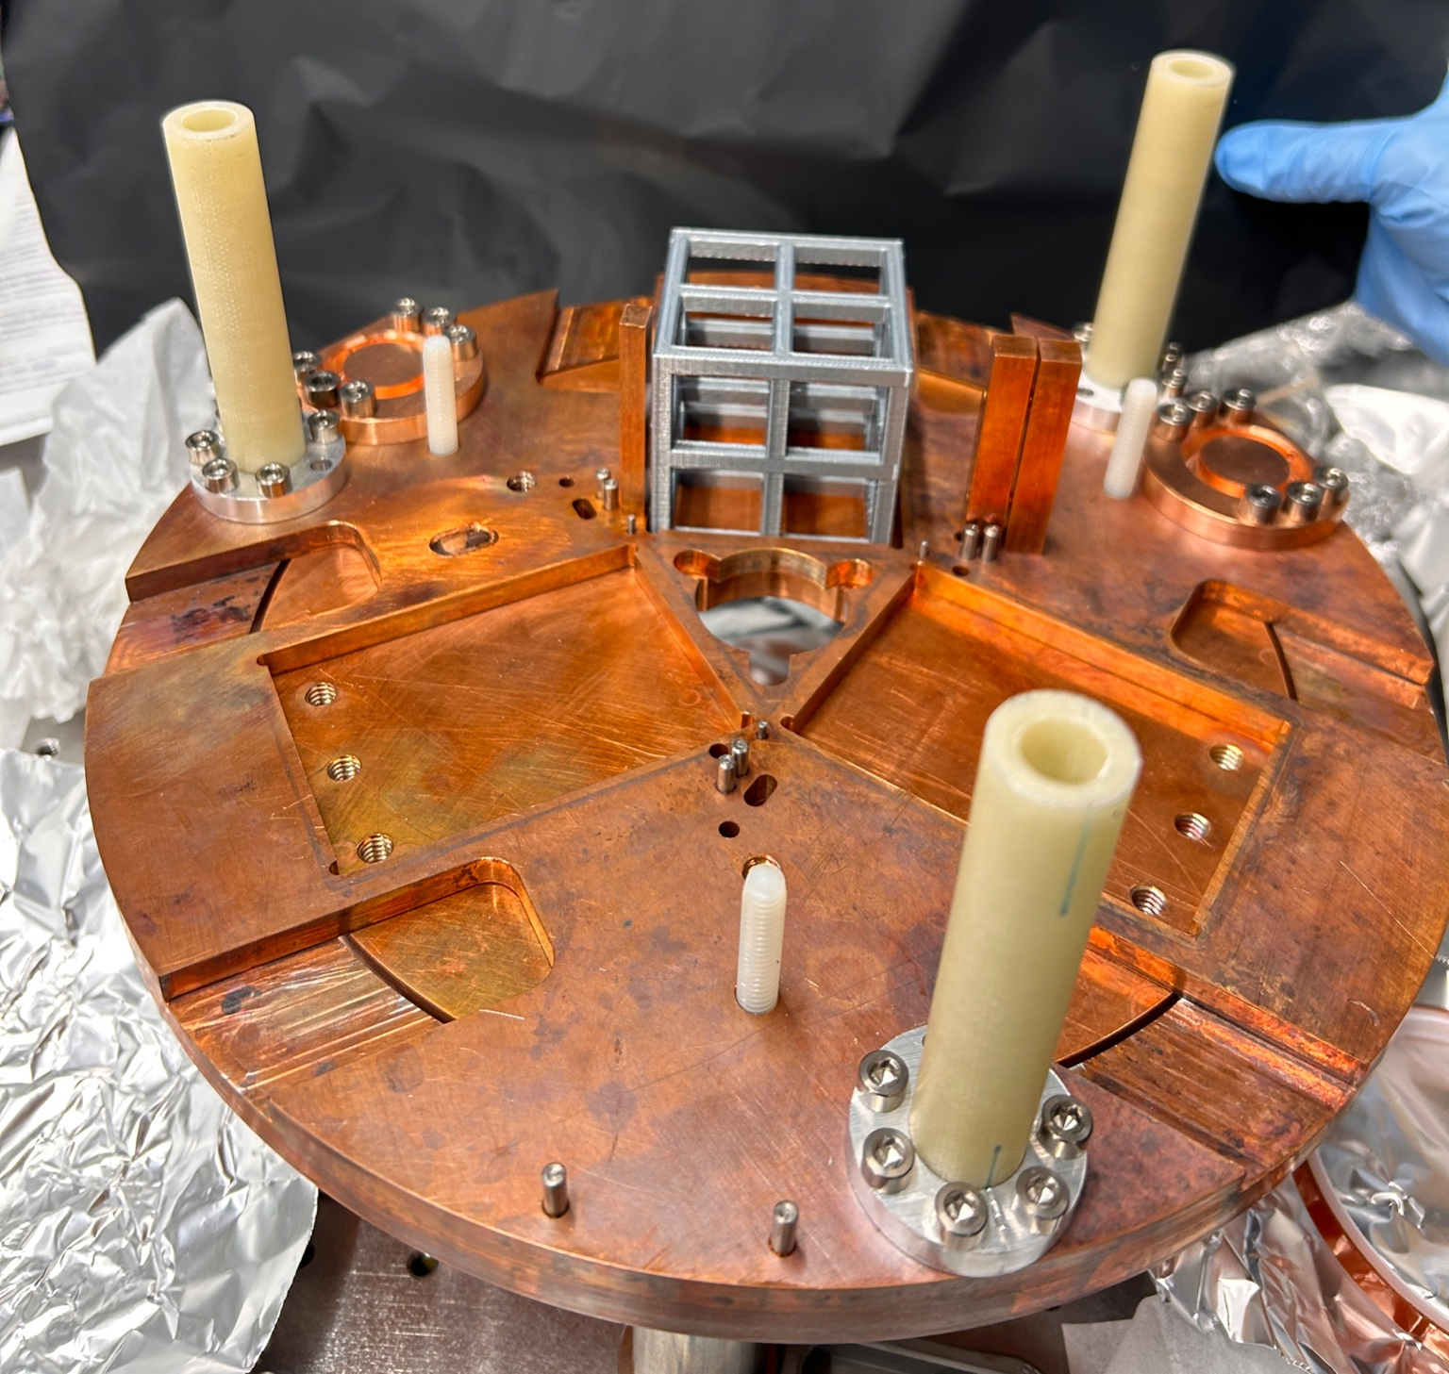
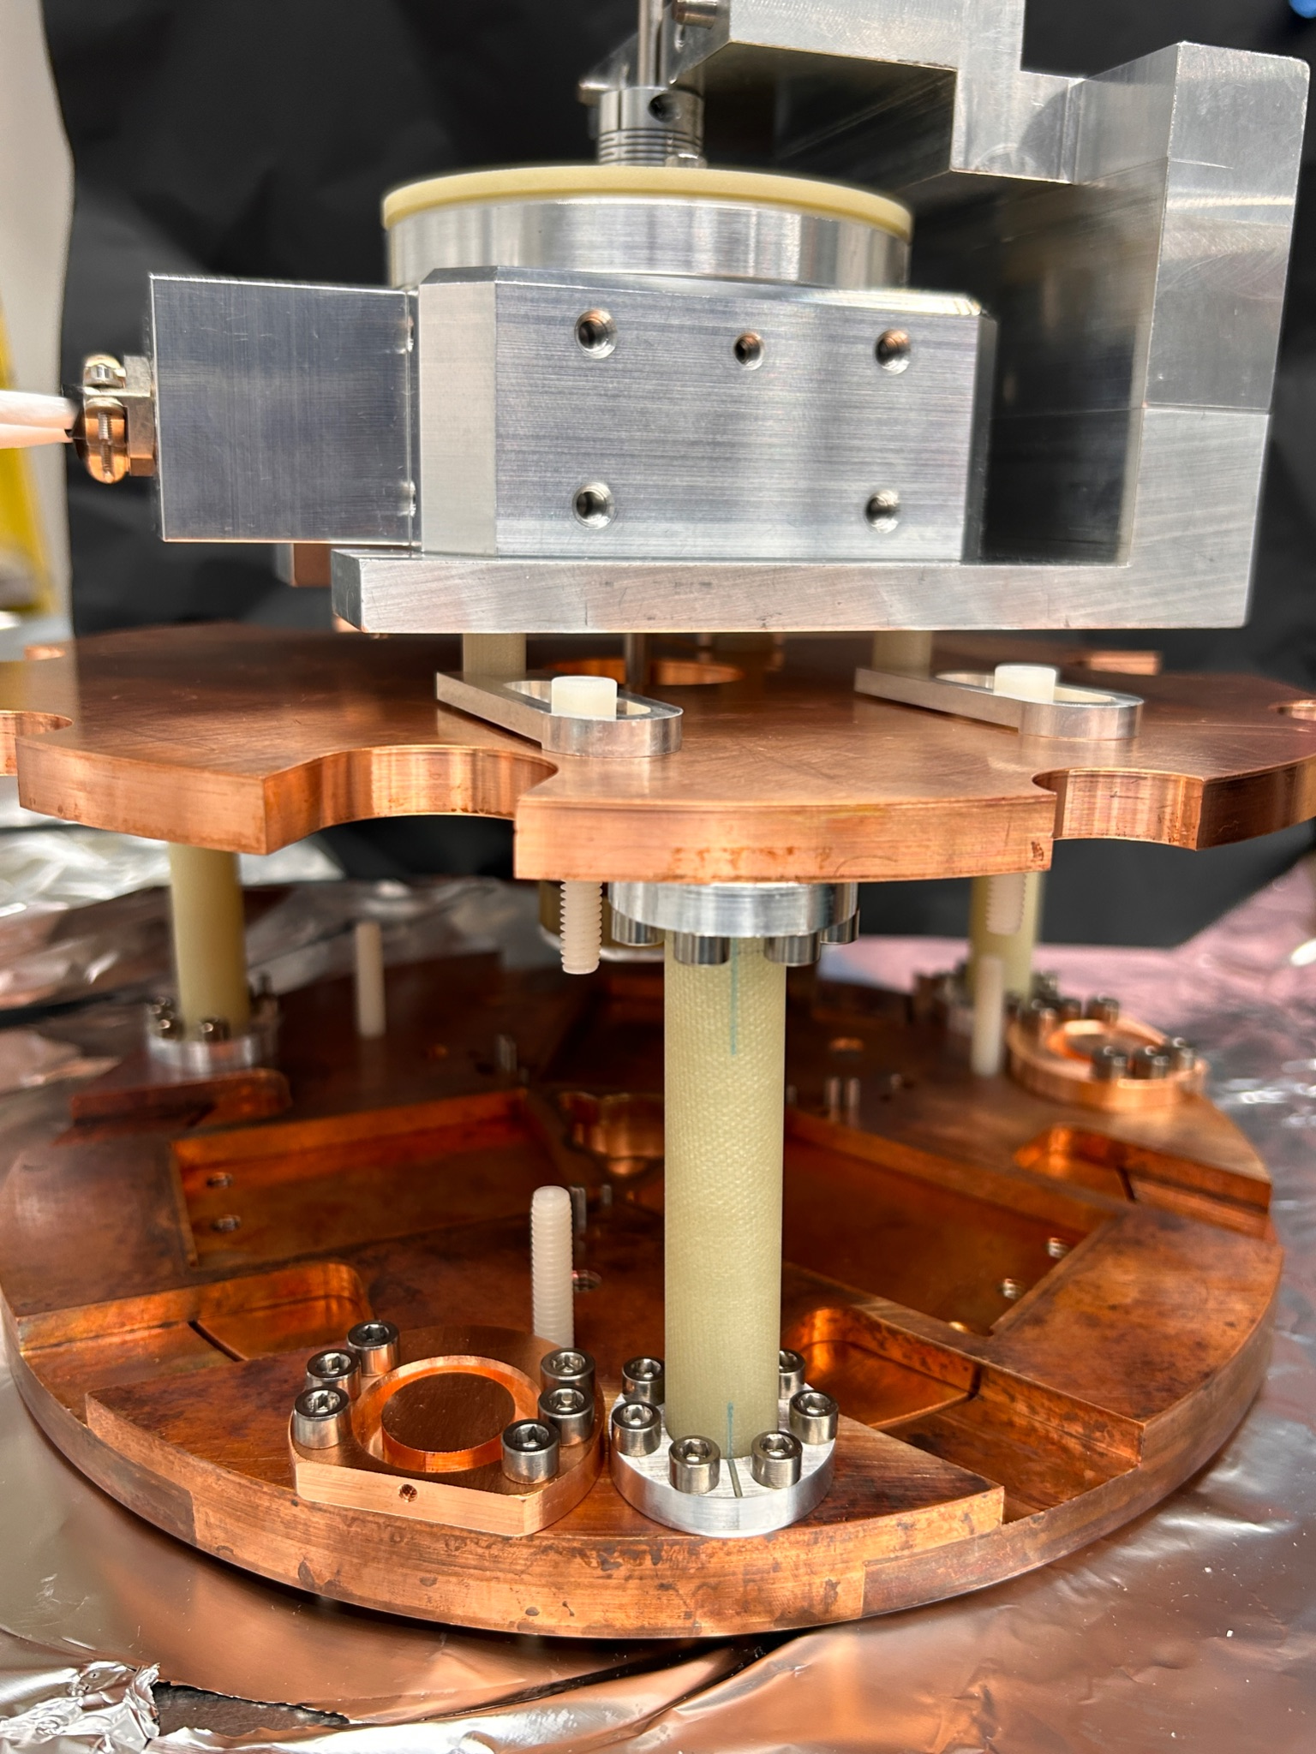
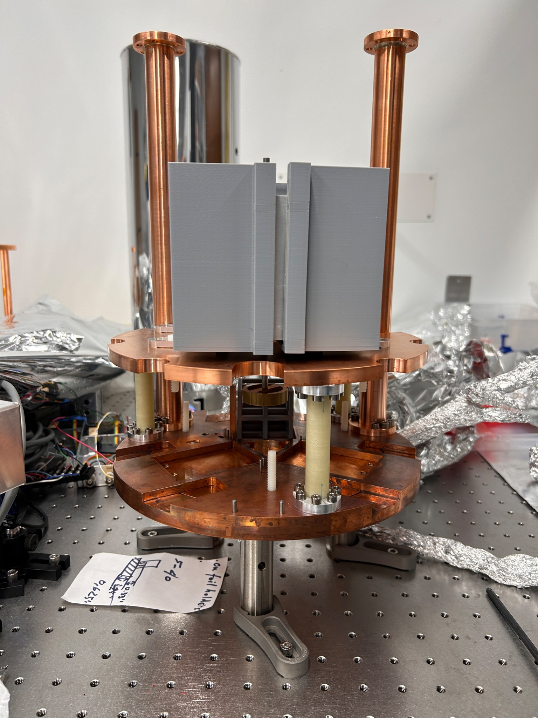
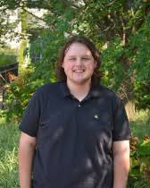
Parts delivered finally after years of covid delays!!

Slide 23
Conclusion and future projection
The ARIADNE experiment would set a world leading limit on spin-dependent forces
Parameter space explored would be a compliment to other axion searches in the field
Only experiment with projected sensitivity to a locally produced axion
Implementation requires a lot of cutting-edge systems coming together

Slide 24
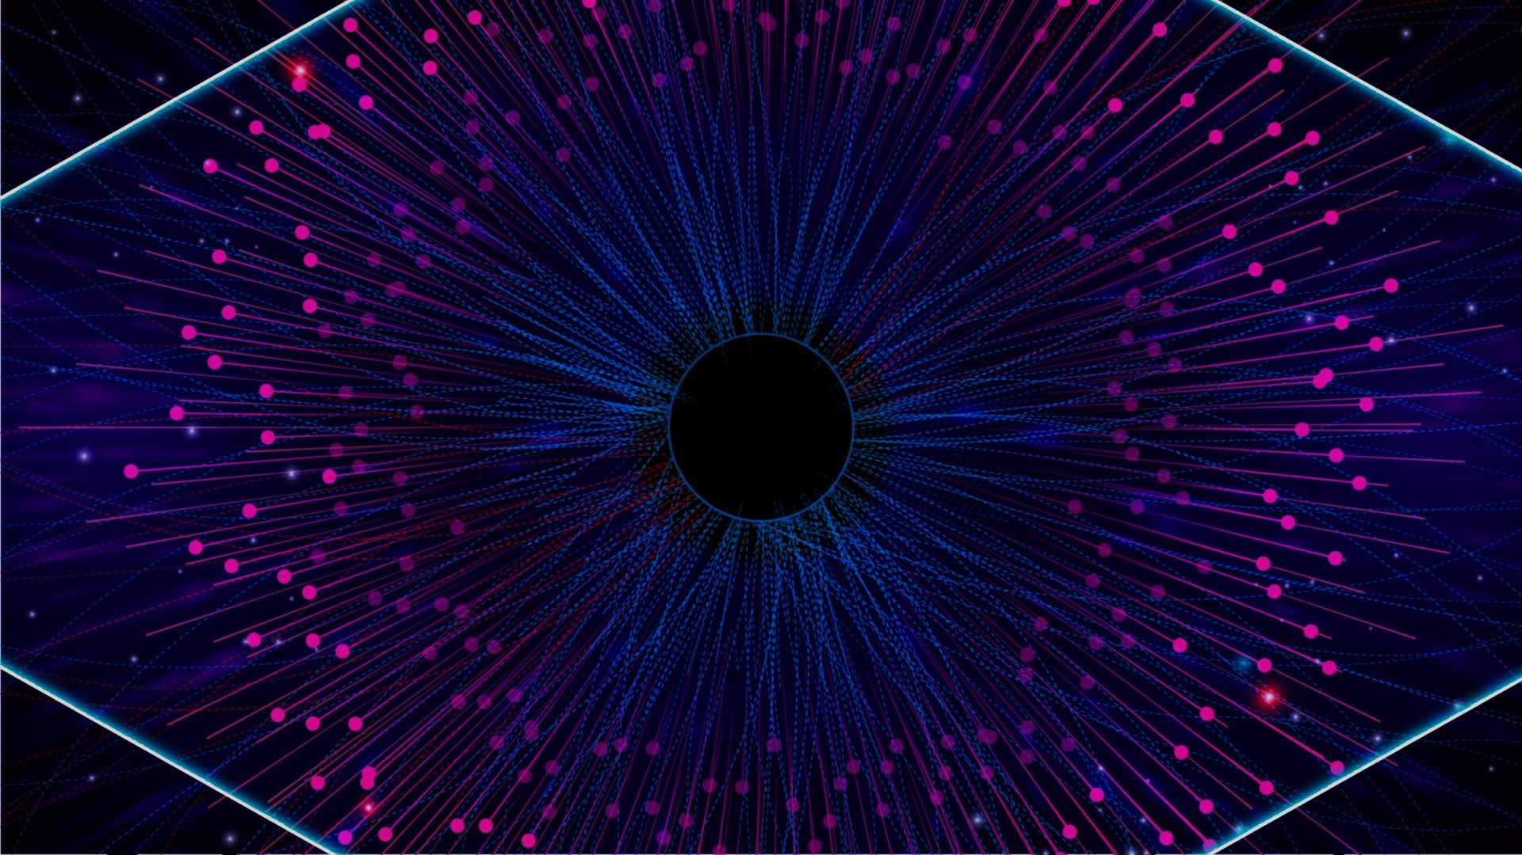
Thank you
PBS

