Slide 1
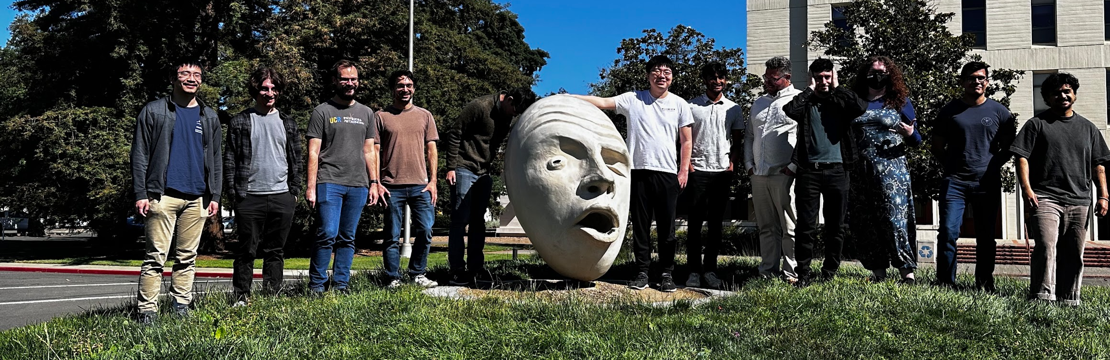
2025 ”NATCAT” Summer School
Eric Prebys, UC Davis

Slide 2
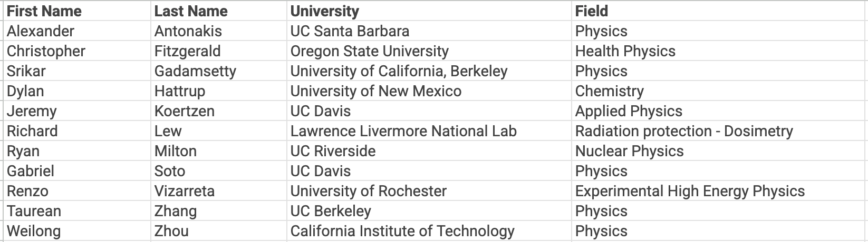
Summary
This year, we combined our traditional Nuclear Analytical Techniques (NAT) summer school with a summer school for the High Energy Physics Consortium for Advanced Technology (HEPCAT)
-> NATCAT
This took place from June 8-13 at UC Davis
Started with 14 students, but 3 local students dropped out, so 11 completed the program

Slide 3
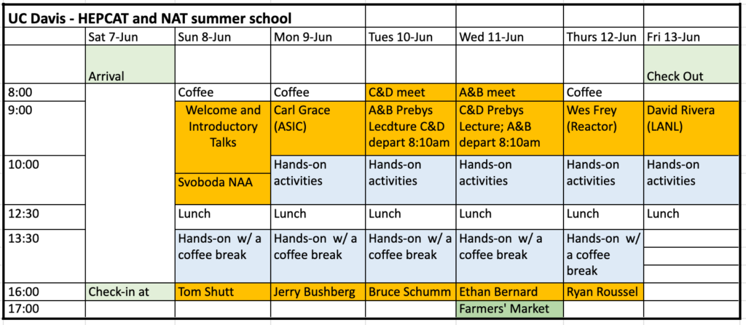
Schedule
Most days had lectures at the beginning and the end of the day, with morning and afternoon 2.5-hour lab activities

Slide 4
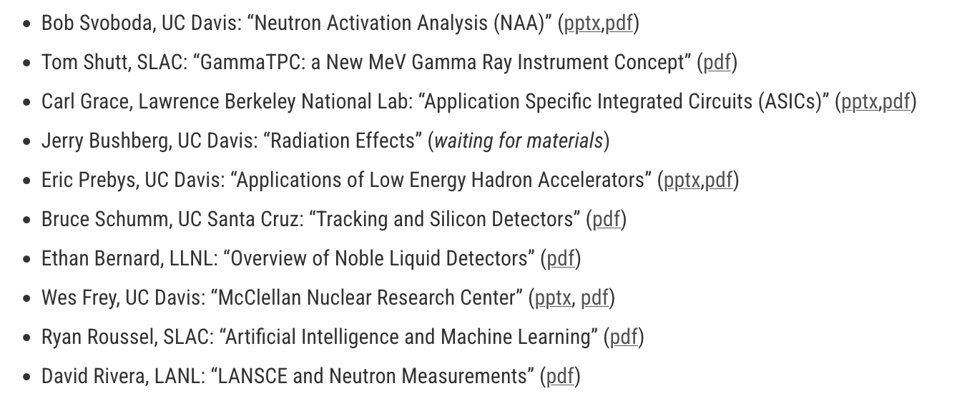
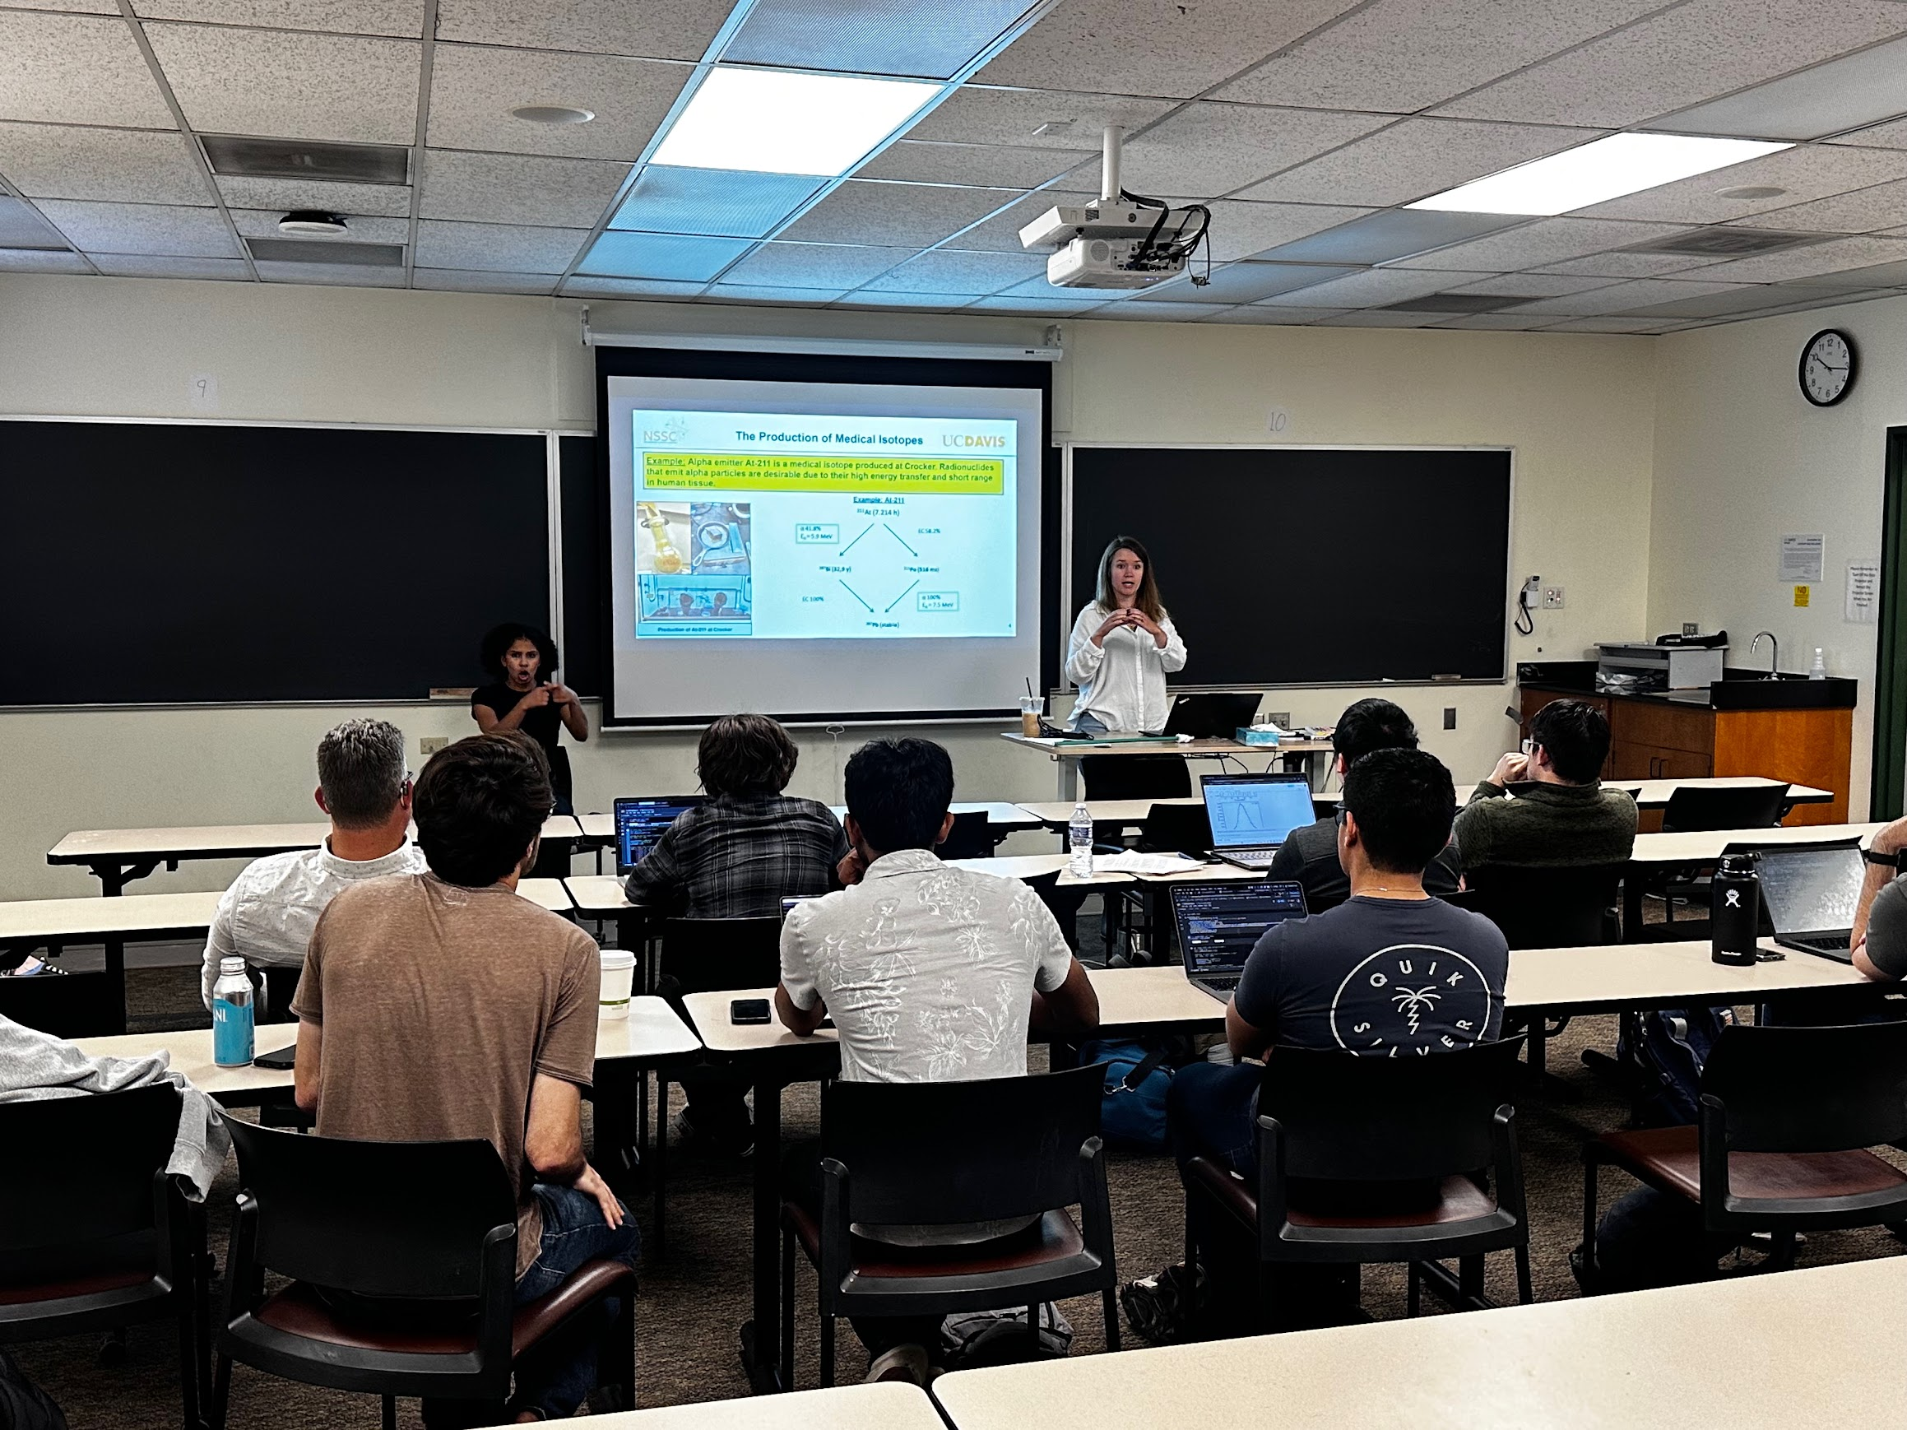
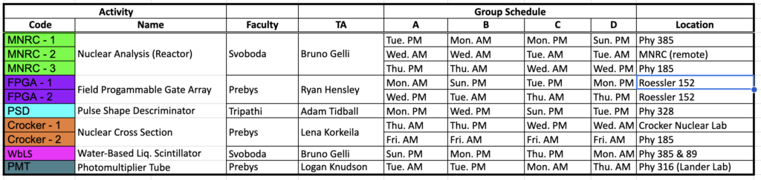
Talks and Labs

Slide 5
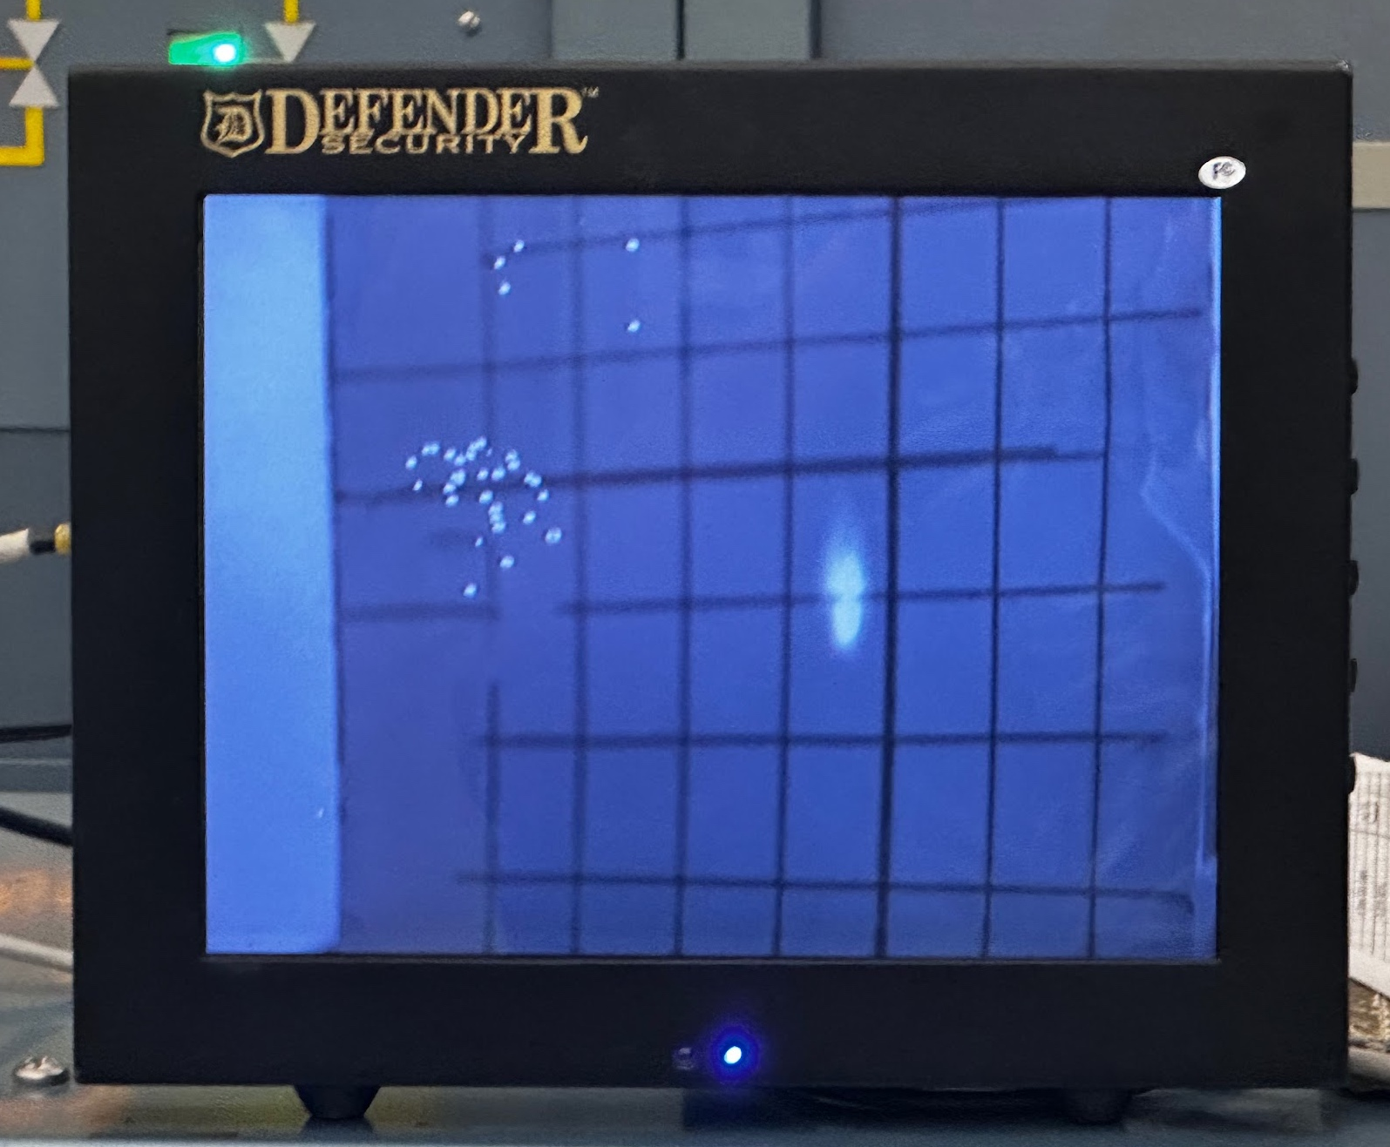
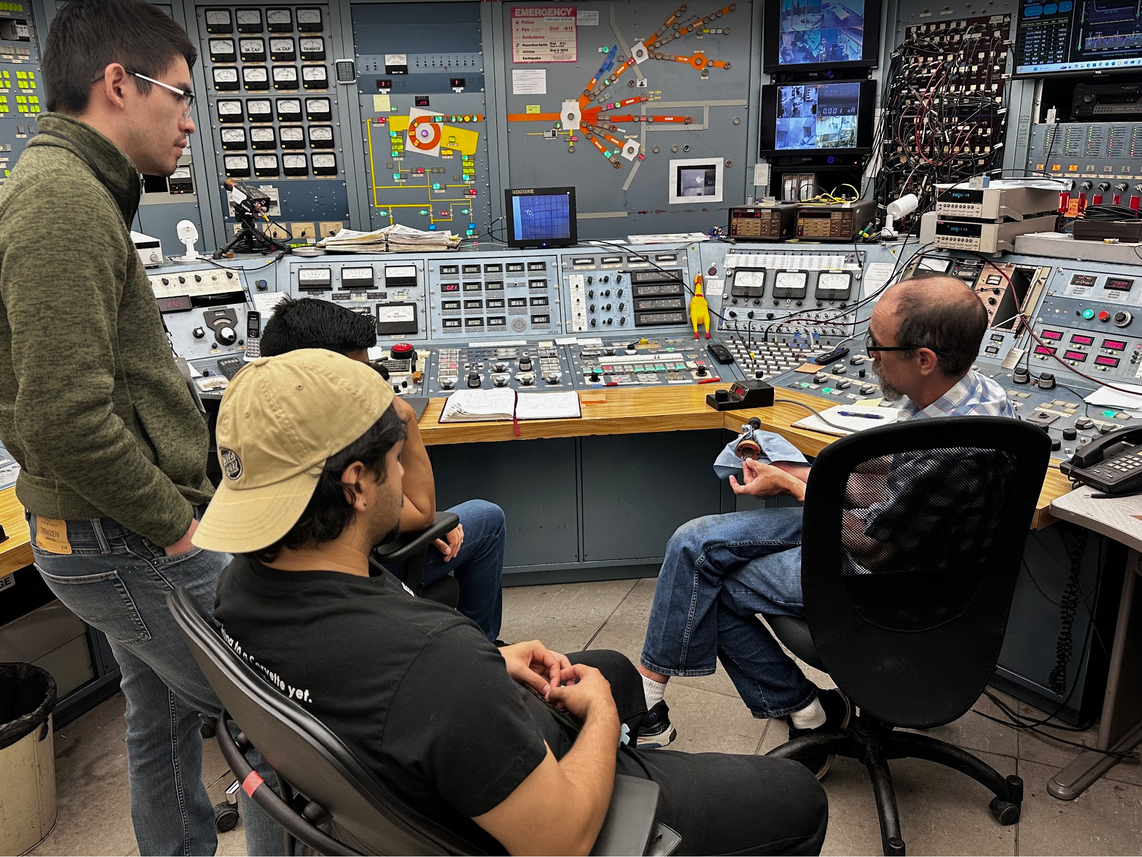
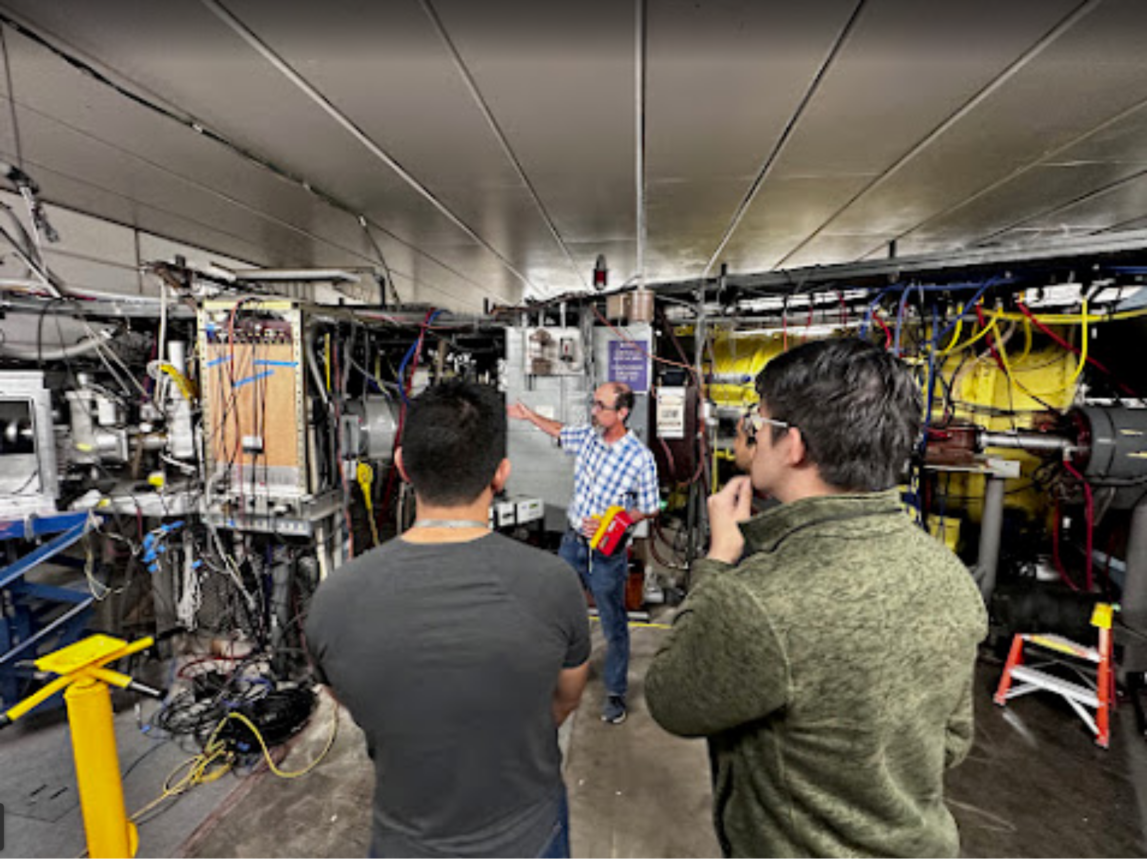
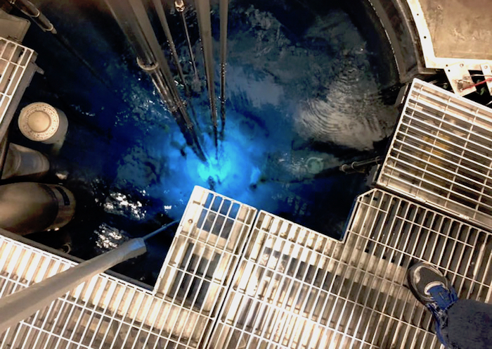
Some Highlights
Hands on experience with the cyclotron
Visit to McClellan Reactor

